Slide 1
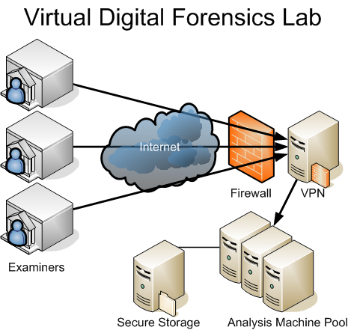
Network Forensics SI 2008 “Hacker Trackers"
Programmers
Chris Yungmann
Max Yano
Chris Hsu
Vinay Balajj
Animators
Robert Wirthman
Mike Huntley
Chris McAuley
Jacob Lincoff
Project Leaders
Prasad Calyam
Aaron Lafferty
Nathan “Q-Man” Howes

Slide 2
Discussion Subjects
Case of Examination
Hackers and Their Methods of Attack
Investigation Process
Evidence
Outcome

Slide 3
Case of Examination
Charlie Turner, owner of Games Online (GOL), has been a recent victim of DDoS (Distributed Denial-of-Service) attacks to his computer. Turner has hired the Hacker Trackers, our group of eight network forensic experts, to help him track down these criminals. GOL believes that these DDoS attacks originated from WCG (Worldwide Cyber Gaming), a rival online-game company.

Slide 4
About Us and Our Mission
The eight of us are network forensic experts. We set up a Honeynet framework, which is a network solely made to attract hackers. Then our group ran AttackGen, which created simulated “break-ins” by “hackers” of various IP addresses. Finally, we put together legal evidence, which involved the date and time of the break-ins, the severity of these attacks, possible locations of the hackers, and how the attacks could have been prevented. This legal evidence was made to prove the hackers guilty of crime in court.

Slide 5
Cyber-Criminals
Known as hackers, these people have expertise in finding the vulnerability of other networks and how to exploit these servers for personal gain
A Hacker’s Motivations
- Blackmail (to get money)
- Loathes Victim
- Acceptance in the Cyber World
- “To have a good time!”

Slide 6
DNS Poisoning
Venomously created situation that gives data to a Domain Name Server (DNS) that was not originally from authoritative DNS sources
To perform this attack, the hacker exposes a flaw in the DNS software that allows it to accept incorrect information
To prevent these kinds of attacks, DNS servers could be less trusting of information sent by other DNS servers

Slide 7
Buffer Overflow
Unusual condition where a process attempts to execute data beyond the boundaries of a buffer
As a result, the extra data overwrites nearby locations in memory
This may cause erratic program behavior, a memory access exception, incorrect results, a crashed computer, or even a possible breach of your computer’s security

Slide 8
Ping Flood
Simple denial-of-service (DoS) attack
Attacker overwhelms the victim with ICMP Echo Request (ping) packets
Attacker must have greater bandwidth than victim to succeed in hacking
Hacker hopes prey responds with ping reply packets to consume outgoing bandwidth along with incoming server bandwidth
To combat the ping flood, people should call their ISP (Internet Service Provider) to block the pings at their core

Slide 9
Smurf
Generates loads of network traffic to victim host
Denial-of-service attack (DoS)
Floods a target system via spoofed broadcast ping messages
The pings are sent to many IP (Internet Protocol) addresses, and if they reply, the traffic is multiplied
Many Smurf attacks are unsuccessful thanks to routers being configured to ignore pings

Slide 10
Dictionary
Technique to defeat cipher or authentication by determining its password from searching a large number of possibilities
Two methods of using dictionary are cryptanalysis and computer security
Spammers use the dictionary method to find
e-mail addresses, such as carl@yahoo.com

Slide 11
- Attack Generator
Investigation
Process

Slide 12
Perl and MySQL
Perl is a programming language based upon C
Used for system administration, web development, and network programming
Interfaces well with databases
MySQL
Database management system
Open source
Often used as a backend for websites

Slide 13
Requirements
Generate random attacks from random places at random times
Equal distribution
Create an attack log
Proper formatting

Slide 14
Design
For each day, we created a random number of attacks, which took place at random times throughout the day
For each attack, we created a random IP address
From that, we assigned the location
We randomly assigned attack types and assigned them the appropriate threat levels
We stored the information in an attack log

Slide 16
Implementation 1

Slide 17
Implementation 2

Slide 18
Implementation 3

Slide 19
Testing
We just ran the program several times, making sure we got the expected results. We looked for:
A good spread of times
Randomness in locations and attacks

Slide 20
Perl to MYSQL
Importing Data into Databases

Slide 21
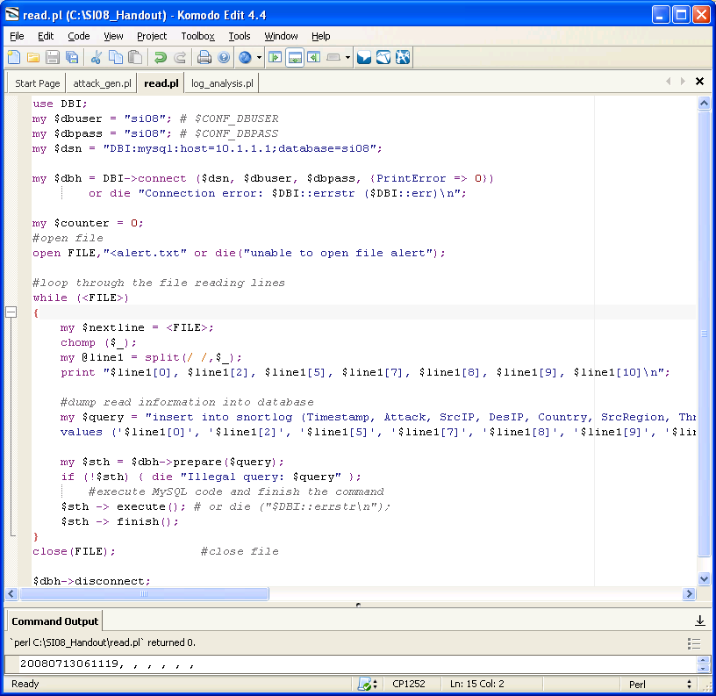
Program Requirements
Open attack logs generated by SNORT
Parse the file to index required info
Send data to the MySQL database

Slide 22
Design & Application
Set MySQL Connection Settings
Open SNORT log file
Read each line & parse into an array
Send required info from each array to MySQL database
Close file & exit MySQL

Slide 23
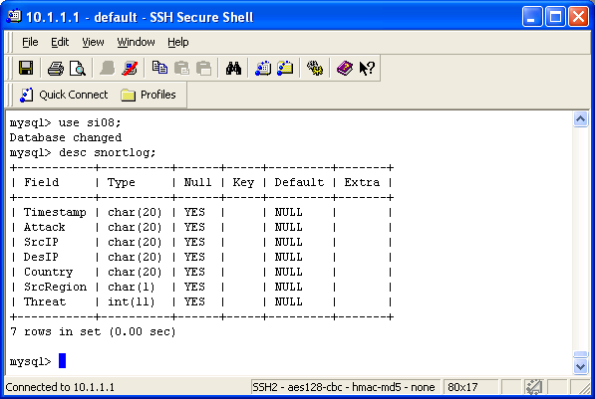
Design & Application
Continued

Slide 24
Testing
Errors
See if connection settings match
Confirm that SNORT log file opens
Verify parsing accuracy
Check MySQL database for data
sent by program
MySQL sometimes denied Perl access
File extensions (.txt) sometimes didn’t open
Parser, at first, constructed incorrect strings
At times, data was sent to a nonexistent database

Slide 25
Database querying
Using Perl & MySQL

Slide 26
Requirements
Connect to MySQL database
Format data for easier reading
Format data into 6 hour portions
Format data to fit needs of team
Create a txt file with the data

Slide 27
Design
Open connection to MySQL database
Print formatted data into a txt file
Query the database for specific columns
Print data from columns
Repeat queries until all needed data is gathered

Slide 28
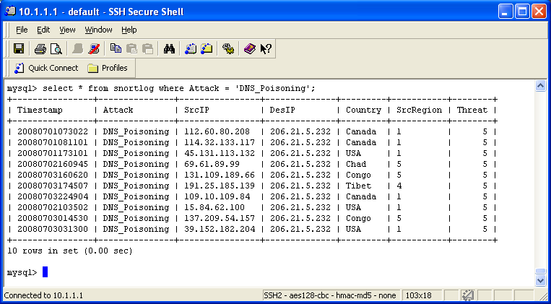
Development
How to query in MySQL:
>select {column} from {table}
where {column};

Slide 29
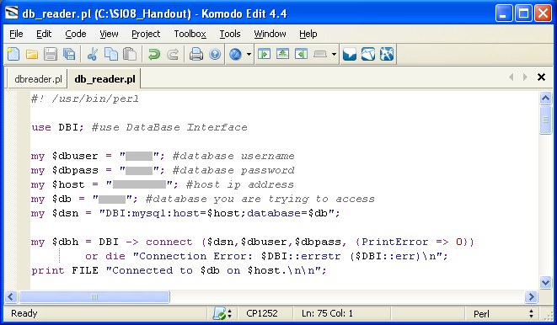
Development
How to query in Perl:
my $query = “{MySQL command}”;
my $sth = $dbh->prepare($query);
$sth->execute;

Slide 30
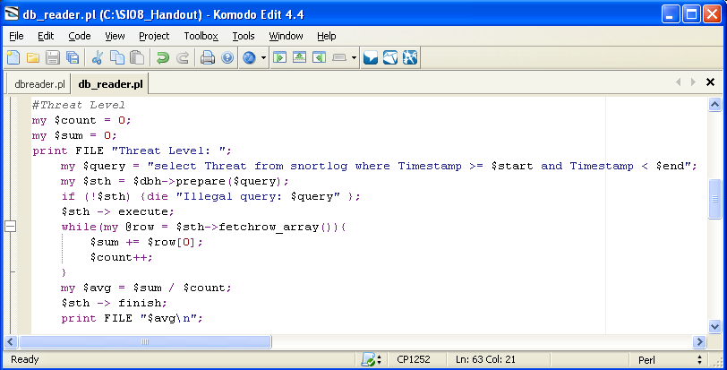
Development
@day = (…….)
20080719103000
10:30 AM 7/19/08
foreach (@day) {…}

Slide 31
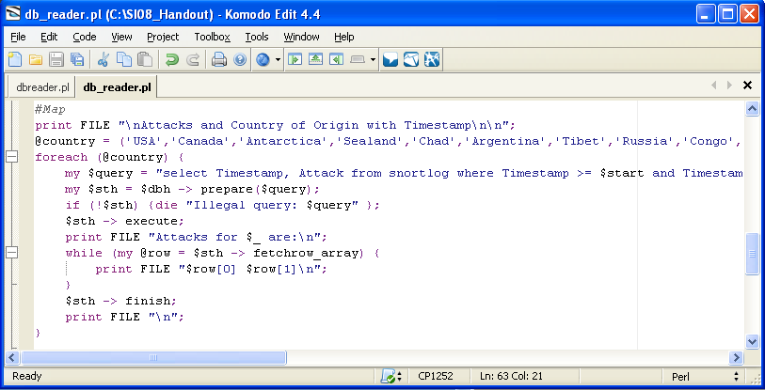
Development

Slide 32
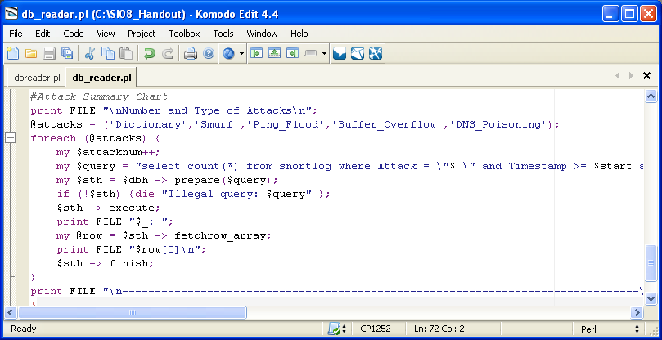
Development

Slide 33
Testing
Errors
Check the program to make sure it is connecting to the MySQL database
Confirm that queries are working properly
Verify that data is being written to the txt file
Queries were not accepted by MySQL

Slide 34
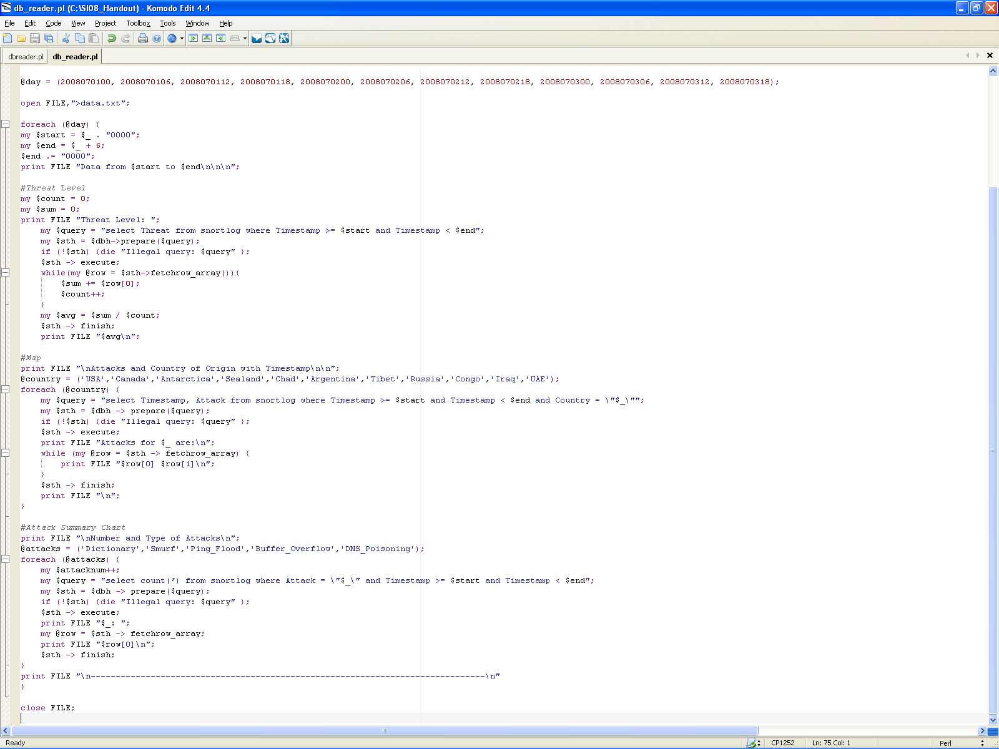

Slide 35
Dashboard Aspects
Threat meter
World map/Clock
Security cam feed

Slide 36
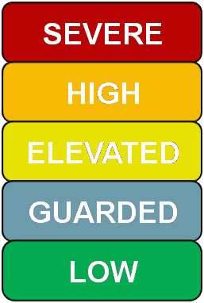
Indicates level of danger of cyber attacks
on internet at a given 6 hour period
Pointer animated to correspond to threat
level given by programming team
Based off of US terrorist attack threat meter
Threat Meter

Slide 37
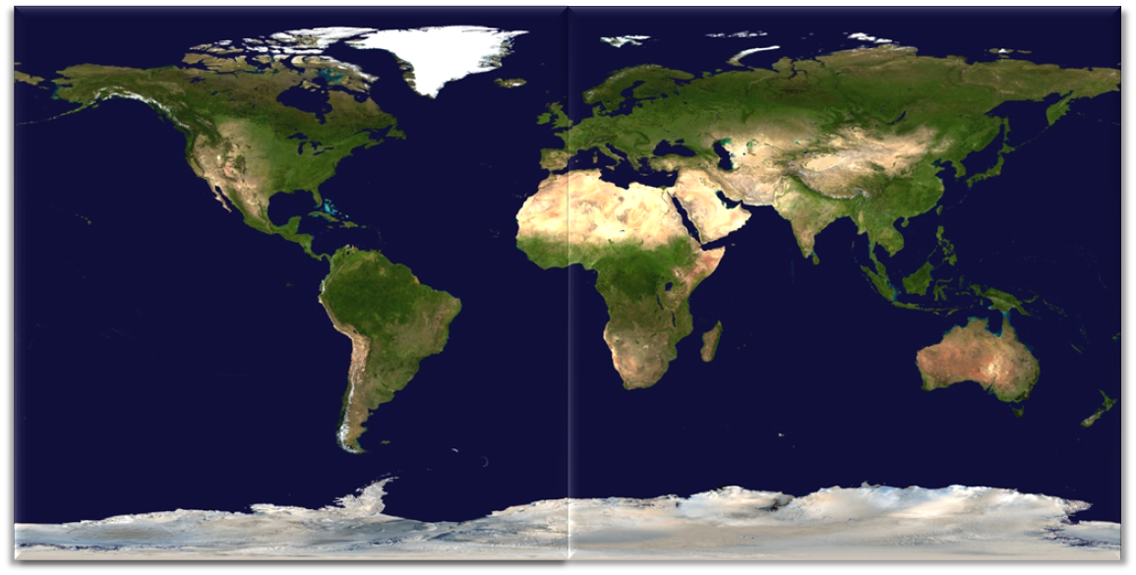
World Map/Clock
Combination of two high resolution NASA satellite images;
large file size created an issue
Dots represent attacks and correspond to graph colors
Clock indicates approximate time of attacks and how many
attacks occurred

Slide 38
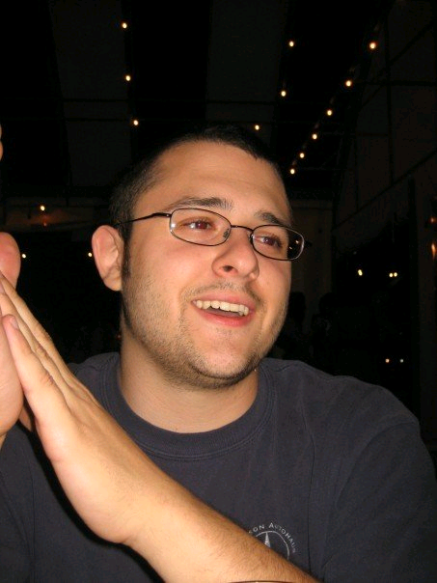
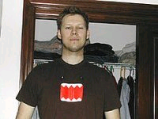
Security Cam Feed
Feed of Glenn supercomputer cluster
Aaron and Q-Man had fun making the video; supposed to be
‘hackers’ breaking into supercomputer complex doing an attack
Changed format so PowerPoint would accept it and inserted it in
Q-man (formerly
known as Nathan)
--------------------→

Slide 39
Animation
The Basics

Slide 40
Google Earth Pro

Slide 41
Google Earth Pro

Slide 42
ScreenHunter 5.0

Slide 43
Screen Shot Collection

Slide 44
Windows Movie Maker

Slide 45
Result

Slide 46
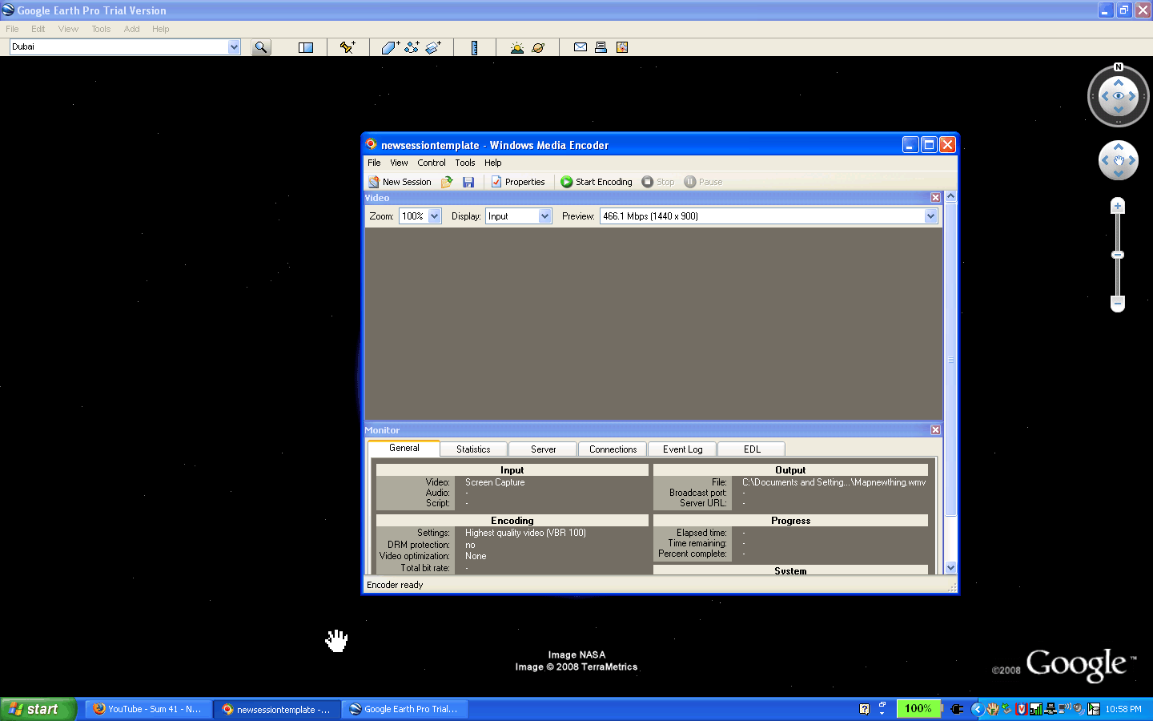
Original Google Earth Zoom In
Would position, then switch between earth and sky, and then back.
Windows Media Encoder

Slide 47
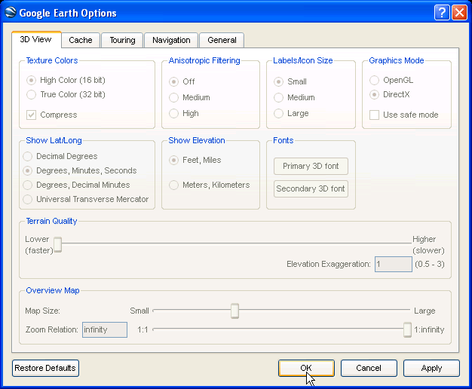
Extreme Choppiness and Lag
Google Earth’s incredible detail and accuracy = too much memory for the Windows Media Encoder to effectively capture.
Attempted a quality reduction for both Google
Earth and Encoder, both of which were
unsuccessful.

Slide 48
Compensation from Hackers
Item | Cost
GOL’s lost revenue for 4 days of lost service or lower performance | $437,000
Loss of customers and sponsorship/ads | $300,000
Expense for hiring the Network Forensic Experts of SI 2008 | $200,000
Court & Lawyer Costs for Civil Proceeding | $400,000
Total Cost | $1,337,000

Slide 49
Conclusion
By working with law enforcement and upstream providers our team of network forensic experts successfully tracked and apprehended the attackers.

Slide 50
Acknowledgements
Aaron Lafferty: Project leader
Prasad Calyam: Project leader
Nathan Howes (Q-man): Project assistant
Daniel Eyster: Dorm Supervisor
Brianna Austin: Dorm Supervisor
Elaine Pritchard: SI Director
Greg Trueb: Video Assistance

