Slide 1
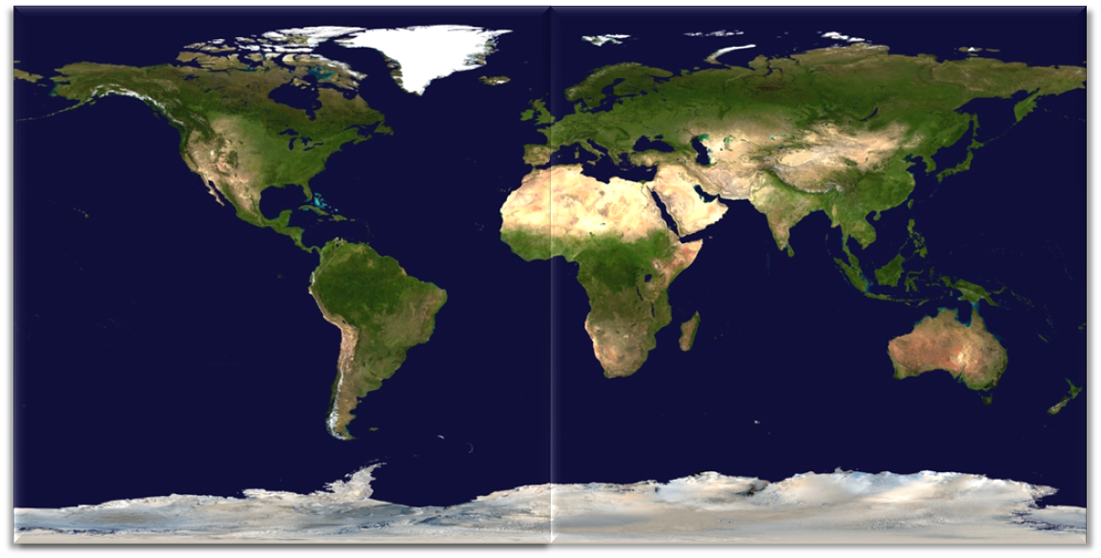
July 1st: 06:00:00 AM
Total Number of Attacks In Last 6 Hours:
13
ATTACK THREAT METER
SEVERE
HIGH
ELEVATED
GUARDED
LOW

Slide 2
July 1st: 12:00:00 PM
Total Number of Attacks In Last 6 Hours:
16
ATTACK THREAT METER
SEVERE
HIGH
ELEVATED
GUARDED
LOW

Slide 3
July 1st: 06:00:00 PM
Total Number of Attacks In Last 6 Hours:
15
ATTACK THREAT METER
SEVERE
HIGH
ELEVATED
GUARDED
LOW

Slide 4
July 2nd: 12:00:00 AM
Total Number of Attacks In Last 6 Hours:
7
ATTACK THREAT METER
SEVERE
HIGH
ELEVATED
GUARDED
LOW

Slide 5
hackertrackers@laptop5:~$ fatal error 0x3fa45c
hackertrackers@laptop5:~$ SHUTTING DOWN SYSTEM NOW!
hackertrackers@laptop5:~$ killing processes done
hackertrackers@laptop5:~$ init runlevel 0 done
…
hackertrackers@laptop5:~$ cd /etc/logs
hackertrackers@laptop5:~$ snort.log | more
Timestamp Source IP Destination IP Attack Type
200807170435 24.56.34.89 31.45.68.27 DNS Poisoning
200807140435 24.56.34.89 31.45.68.27 DNS Poisoning
200807140436 24.56.34.89 31.45.68.27 DNS Poisoning
200807140437 24.56.34.89 31.45.68.27 DNS Poisoning
200807140440 24.56.34.89 31.45.68.27 DNS Poisoning
-MORE-

Slide 6
Tracing Incoming Attack…
Location Confirmed:
Dubai, United Arab Emirates

Slide 8
hackertrackers@laptop5:~$ “24.56.34.89” > /etc/snort/conf.d
hackertrackers@laptop5:~$ /etc/logs/snortstatus | more
ATTACK RESOLVED! W00T!!!1!!!!!!
hackertrackers@laptop5:~$ clear

Slide 9
hackertrackers@laptop5:~$

