Slide 1
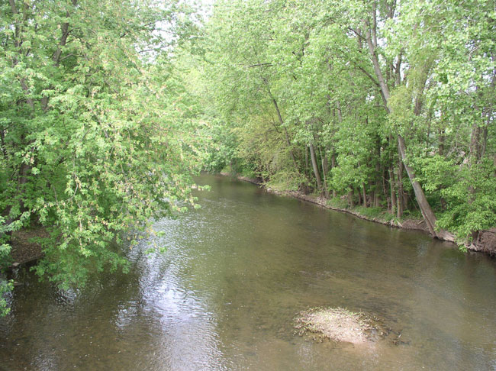
Stillwater River Watershed
Group 5
Deepthi Thumuluri
Caitlyn Baird
Sonia Pattisam

Slide 2
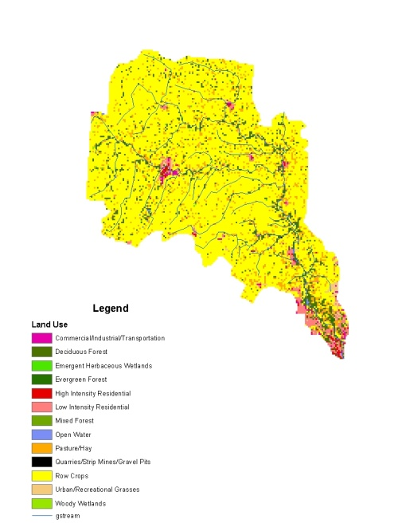
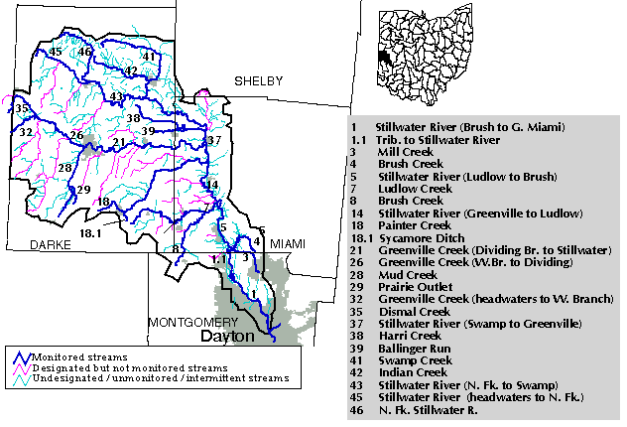
Stillwater River Watershed
Historically
The Shawnee and Miami tribes once inhabited the area.
European settlers came in the 1600s.
Originally swampy, transferred into rich farmland in the 1800s.
Today
Eighty percent of the watershed is cropland.
Has 313.4 miles of stream.
In Darke, Shelby, Montgomery,
and Miami counties.
Notes:
Known for grain production, water power, and various mills
………….

Slide 3
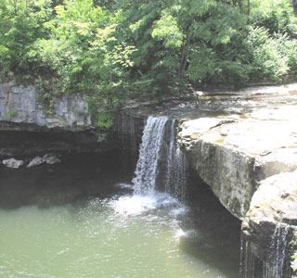
What we studied. . .
Land use. For example, the percentage of land used for agriculture.
Turbidity, which is the muddiness of the water.
Secchi depth is used to measure the clarity of the water.
Fish diversity, which is measured in IBI.
Habitat quality, which is measured in QHEI.

Slide 4
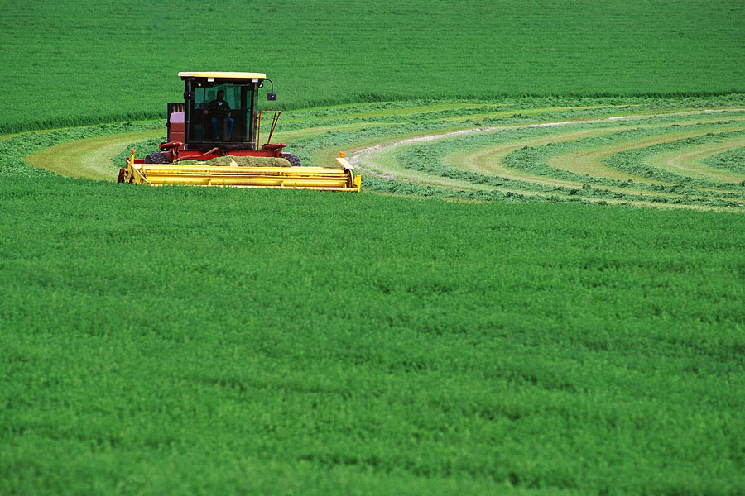
Deepthi’s Hypothesis
An increase in agriculture reduces the habitat quality.
QHEI is a measure of the physical habitat of the river and it’s surroundings.
Plowing the fields and clearing away natural vegetation creates erosion.
Channelizing streams alters the natural flow of the water.

Slide 5
Deepthi’s Conclusion
Evidence supports my hypothesis.
0.81 correlation

Slide 6
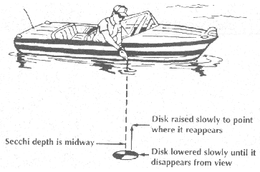
Caitlyn’s Hypothesis
More agricultural land use in the watershed leads to turbid water.
I analyzed two different measurements: Secchi depth and non-filterable solids.
Non-filterable solids are sediments that are suspended in the water.
Secchi depth is measured by
lowering a Secchi disk into the
water.
Notes:
When there is more agriculture in the watershed it tends to make the turbidity higher in the river . I think this because I compared data that has to deal with Secchi disk depth and the amount of agriculture surrounding the area that the test was taken. The Secchi disk is a black and white disk used to measure how deep a person can see into the water, or pretty much the clarity of the water.

Slide 7
Caitlyn’s Conclusion
There is evidence that agricultural land use in the watershed does correlate with turbidity.
-0.66
correlation

Slide 8
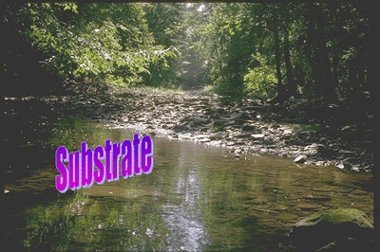
Sonia’s Hypothesis
High quality habitat leads to an increase in fish diversity.
A good habitat leads to a healthy fish population.
Substrate is the habitat at the bottom of the stream, good substrates have rocky bottoms.

Slide 9
Sonia’s Conclusion
Research shows that fish diversity and habitat quality do correlate.
0.68 correlation

Slide 10

Conclusion
Parts of the Stillwater River Watershed are rated excellent, but it is still not the watershed we would like it to be.
You can help by:
  Keeping vegetation thick in the riparian zone.
  Cleaning up streams in your neighborhood.
  Allowing a wide buffer zone around waterways.
  There is an organization called the Stillwater Watershed Project, that is trying to help the Stillwater River.

Slide 11





THANK YOU!

