Slide 1
I.D.C.@Glenn-bash-3.2:
./Welcome
Loading.
.
.
########################################################
# Welcome ! #
# #
# We are the #
# Internet Defense Council #
# Jared McCollum, Aidan Globus, Isaac Luther, and Pranav Shankar #
# #
# #
########################################################
Loading Presentation.ppt

Slide 2
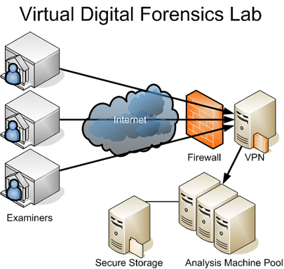
NETWORK FORENSICS
Ohio Supercomputer Center
SI 2012
GROUP MEMBERS:
Jared McCollum
Isaac Luther
Pranav Shankar
Aidan Globus
MENTORS:
Dr. Prasad Calyam
Arun Selvadhurai
Dr. Marcio Faerman

Slide 3
Our Organization
Internet Defense Council
Network Security Firm
Intrusion Detection and Litigation

Slide 4
Overview: Thunderbolt Games
Client: Thunderbolt Games
User passwords and credit card information hi-jacked
Suspect: AccordionSoft, rival game company

Slide 5
Hackers: Who are they?
Hackers are people who attack computers or intercept data from servers for malicious purposes
Why?
Financial Gain
Blackmail
Vengeance

Slide 6
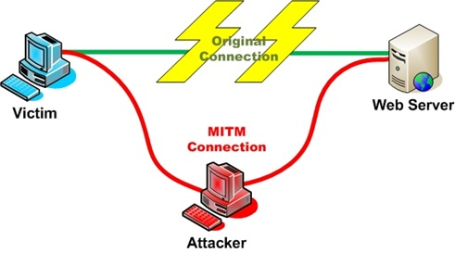
SSL-Authentication Attack
“Man-in-the-Middle” Attack
Hacker hijacks User Data
Bypasses nearly all site security

Slide 7
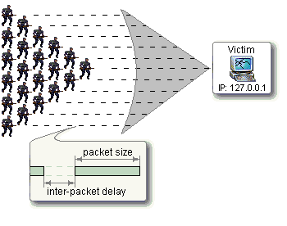
Ping Flood
Often from many computers
Ping used for testing latency
Huge amounts of pinging can slow a server and make it unusable

Slide 8
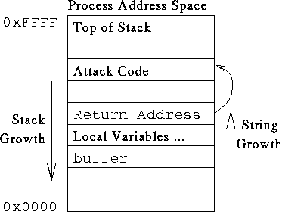
Buffer Overflow
Buffer is the window of space allotted for use in a computer
Hackers use viruses to use more memory than the buffer can handle
Often causes computer or server to crash

Slide 9
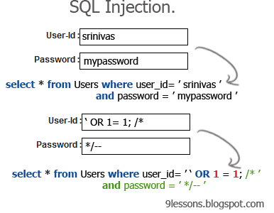
SQL-Injection
Executes malicious code with purposeful errors
Allows access into the computer’s or server’s databases

Slide 10


Network Security Tools
Wireshark - monitors all information entering and leaving the computer
Snort - detects intrusions into the system and logs them for further examination on servers AND networks
http://www.wireshark.org/
http://www.snort.org/

Slide 11
Network Security Tools (cont.)
Perl - programming language used for web development and interfacing with servers, files and databases
MySQL - engine used for managing databases on a server or computer

Slide 12
Attack Log Generation

Slide 13
Goals
Generate attack log identical to real log file
Randomly select IP address from list
Randomly select network protocol
Randomly generate timestamps in chronological order

Slide 14
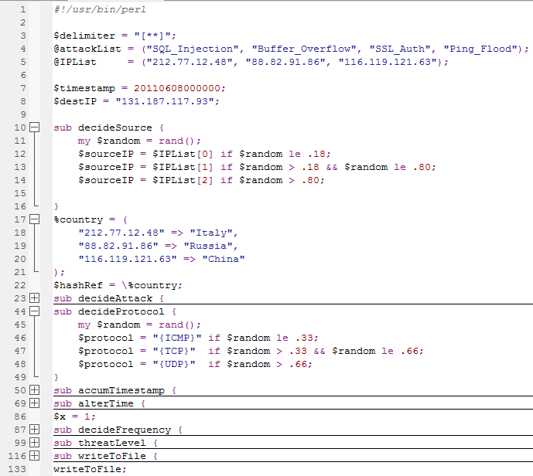

Slide 15


Select attack type from uneven distribution based on country
Select an IP address
Select corresponding country
Calculate threat level from frequency and attack type
Generate frequency, fluctuating differently depending on location
Randomly select a protocol
Print out to file

Slide 16
Country Originated From
Timestamp
Destination IP
Source IP
Protocol
Attack Type
Frequency
Threat Level

Slide 17
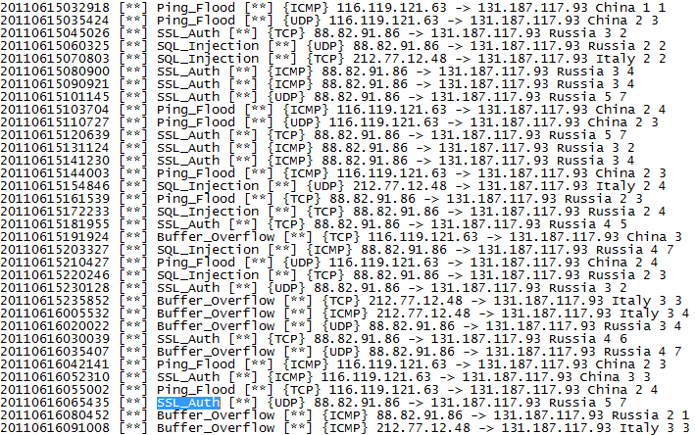

Slide 18
Parsing the Log

Slide 19
Parsing the Attack Log: Goals
Compile the attack log into an organized list
Calculate “Danger Level” of each entry
Calculate the Threshold level
Compile threats into a table
Import tables into MySQL

Slide 20
Plan
Load log file into our Perl code
Organize anomalies into a list
Modify Danger Level based upon certain parameters
Organize data into table
Upload table to MySQL database

Slide 21
Part 1
Gather data from log file
Put data into array
Parse Data
Display array in proper form
IP Address
Type of Attack
Danger Level

Slide 22
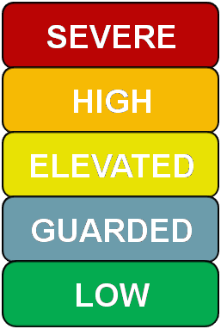
Explanation of the Danger Level
Wanted Danger Level to represent frequency, time, and logged Threat Level
Danger Level =
Allowed us to represent all “Danger” factors in one variable
((Frequency/Time) + Threat Level)
2

Slide 23
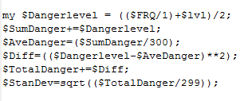
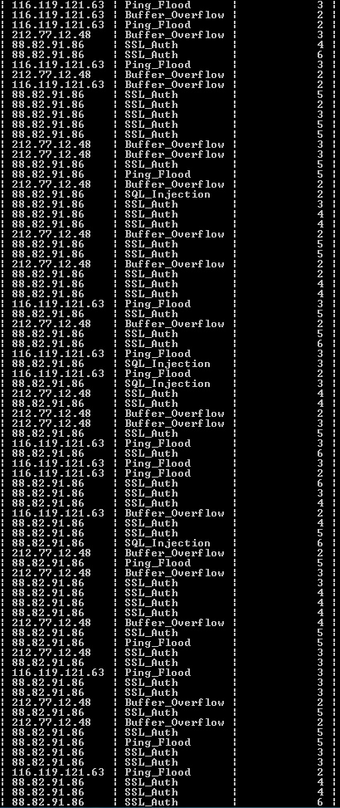
Part 2
4.Put data into array
1.Gather data from log file
3.Apply algorithm to remove false alarms
2.Parse Data with Threshold
5.Display array in proper form
2.5Get IP’s and look for repeats
6.Upload forms to database

Slide 24
Explanation of the Threshold
Wanted to capture all entries that were above the average Danger Level
Used a confidence interval
Interval gave a range for the mean
Upper limit of the interval became our threshold
Average Danger Level
Standard Deviation
Confidence Interval

Slide 25
Output of our Code:
We imported certain data from the log file to MySQL and into this table
Listed IP, Type, and Danger Level
IP addresses differed among the processes
Contained 4 Types of attacks; SQL Injection, Buffer Overflow, SSL Authorization, and Ping Overflow

Slide 26
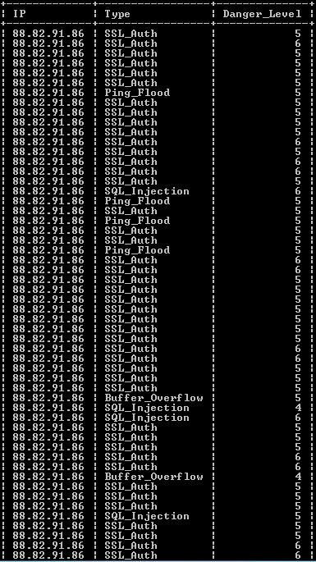
Output of our Code:
We listed the anomalies in the attack log
These entries all had a Danger Level that was more than our Threshold
We registered 170 anomalies/threats to the system
We tracked through a series of CPU’s being used as botnets to find the IP address of the controller

Slide 27


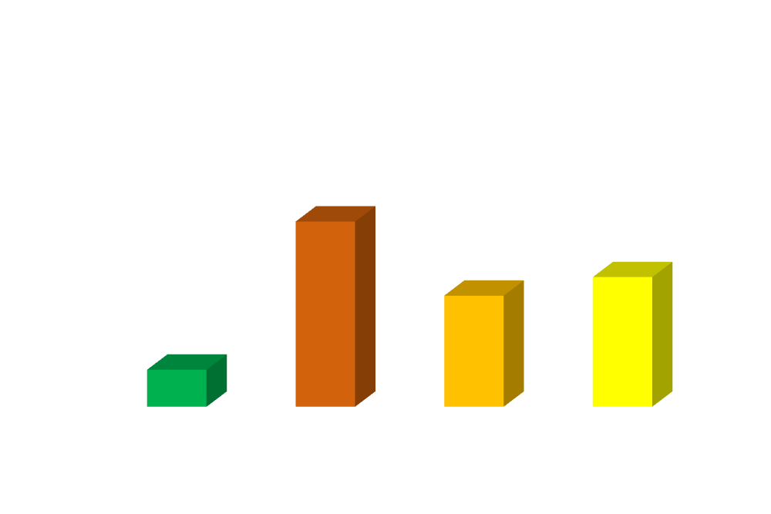
June 8th
We traced the source IP addresses of the attacks to certain locations. We will now show you a demonstration illustrating where the attacks came from:
Legend:
= SSL Authentication
= Ping Flood
= Buffer Overflow
= SQL Injection

Slide 28
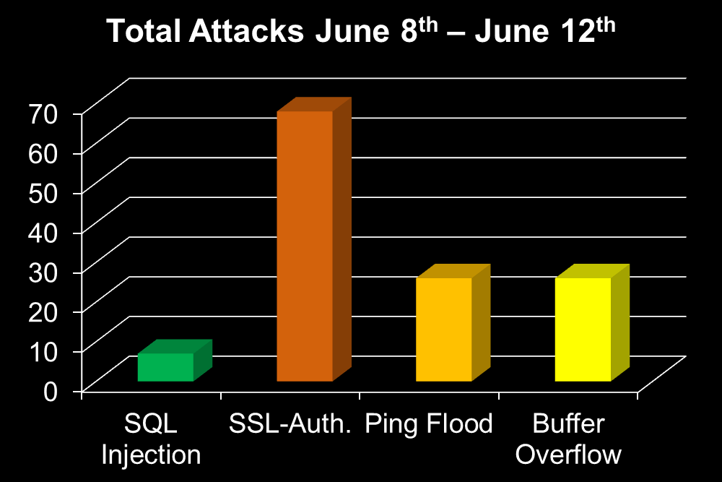
Map of all Attacks Throughout the 5 Days
Legend:
= SSL Authentication
= Ping Flood
= Buffer Overflow
= SQL Injection

Slide 29
Conclusion
Successful project outcomes
Learned how to program in Perl
Learned how to use MySQL
Learned about general network security and forensics
Excellent communication

Slide 30
Special Thanks to…
Dr. Prasad Calyam
Renea Colopy
Dr. Marcio Faerman
Arun Selvadhurai
Dr. Alan Chalker
Liz Hudak
Liz Stong
Dr. Ben Smith
Zarius Shroff

Slide 31
Thank you for your attention!

