Slide 1
Computing Services to Accelerate Research and Innovation
Kate Cahill
Education & Training Specialist
August 9, 2016
Notes:
GO through these slides quick
Available on our website or by contacting me

Slide 2
Outline
Overview
  What is OSC?
  HPC Concepts
  Hardware Overview
  Accounts
How to use our systems
  User Environment
  Storage
  Batch Processing
  Policies
  OnDemand walkthrough

Slide 3
What is the Ohio Supercomputer Center?

Slide 4






The OH-TECH Consortium
Ohio Supercomputer Center provides high performance computing, software, storage and support services for Ohio's scientists, faculty, students, businesses and their research partners.
OARnet connects Ohio’s universities, colleges, K-12, health care and state and local governments to its high-speed fiber optic network backbone. OARnet services include co-location, support desk, federated identity and virtualization.
OhioLINK serves nearly 600,000 higher education students and faculty by providing a statewide system for sharing 50 million books and library materials, while aggregating costs among its 90 member institutions.
eStudent Services provides students increased access to higher education through e-learning and technology-enhanced educational opportunities, including virtual tutoring.
Research & Innovation Center will operate, when opened, as the proving grounds for next-generation technology infrastructure innovations and a catalyst for cutting-edge research and collaboration.

Slide 5

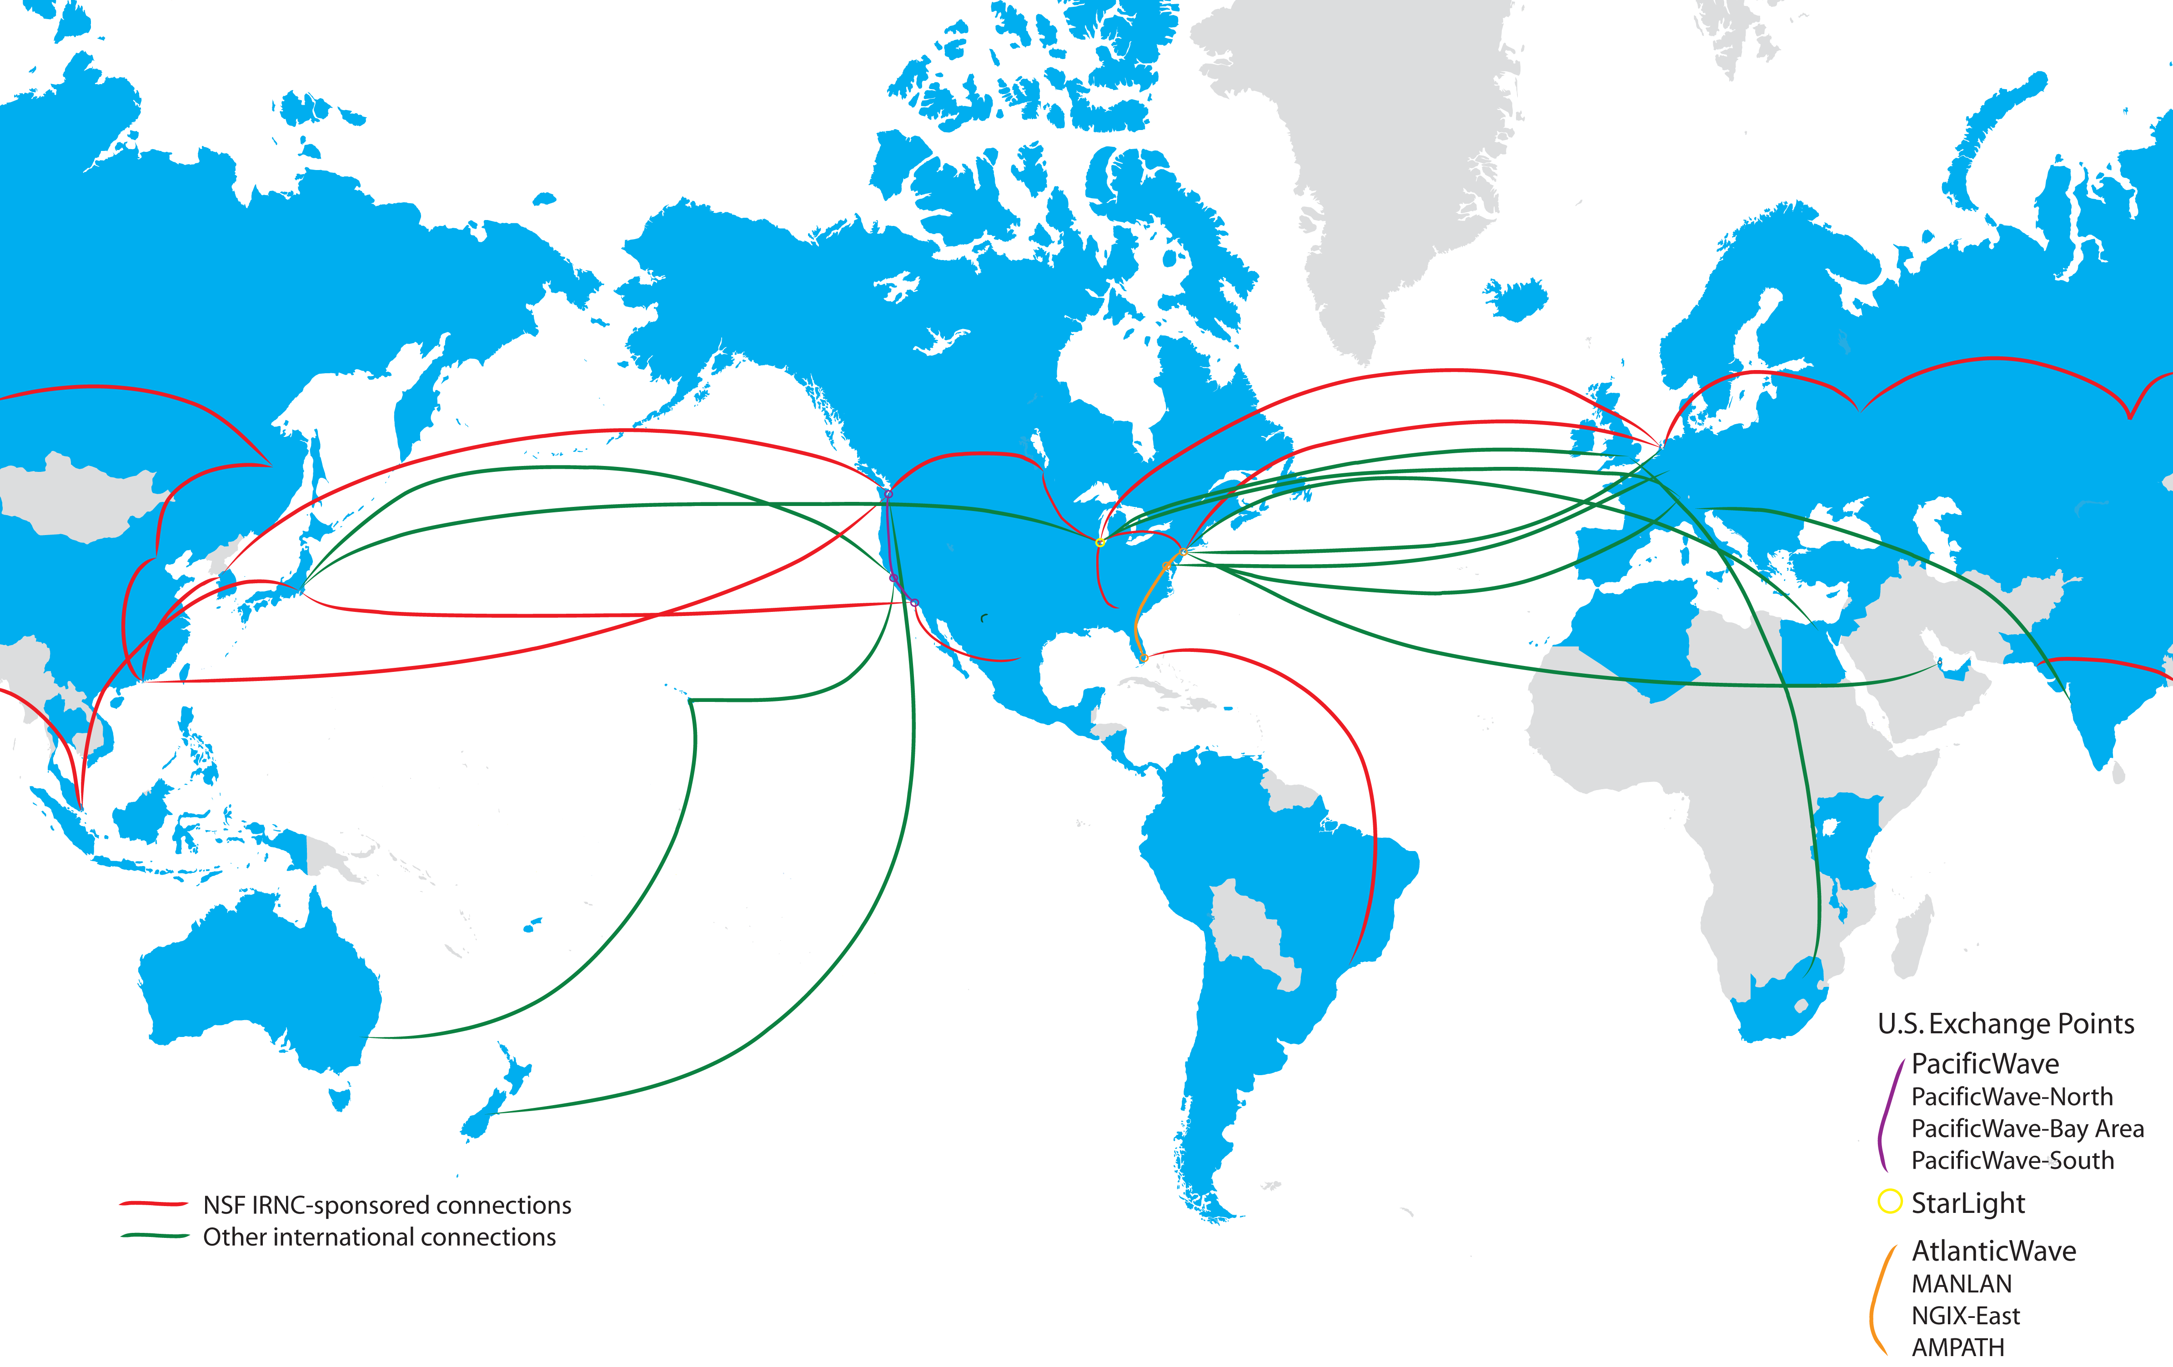
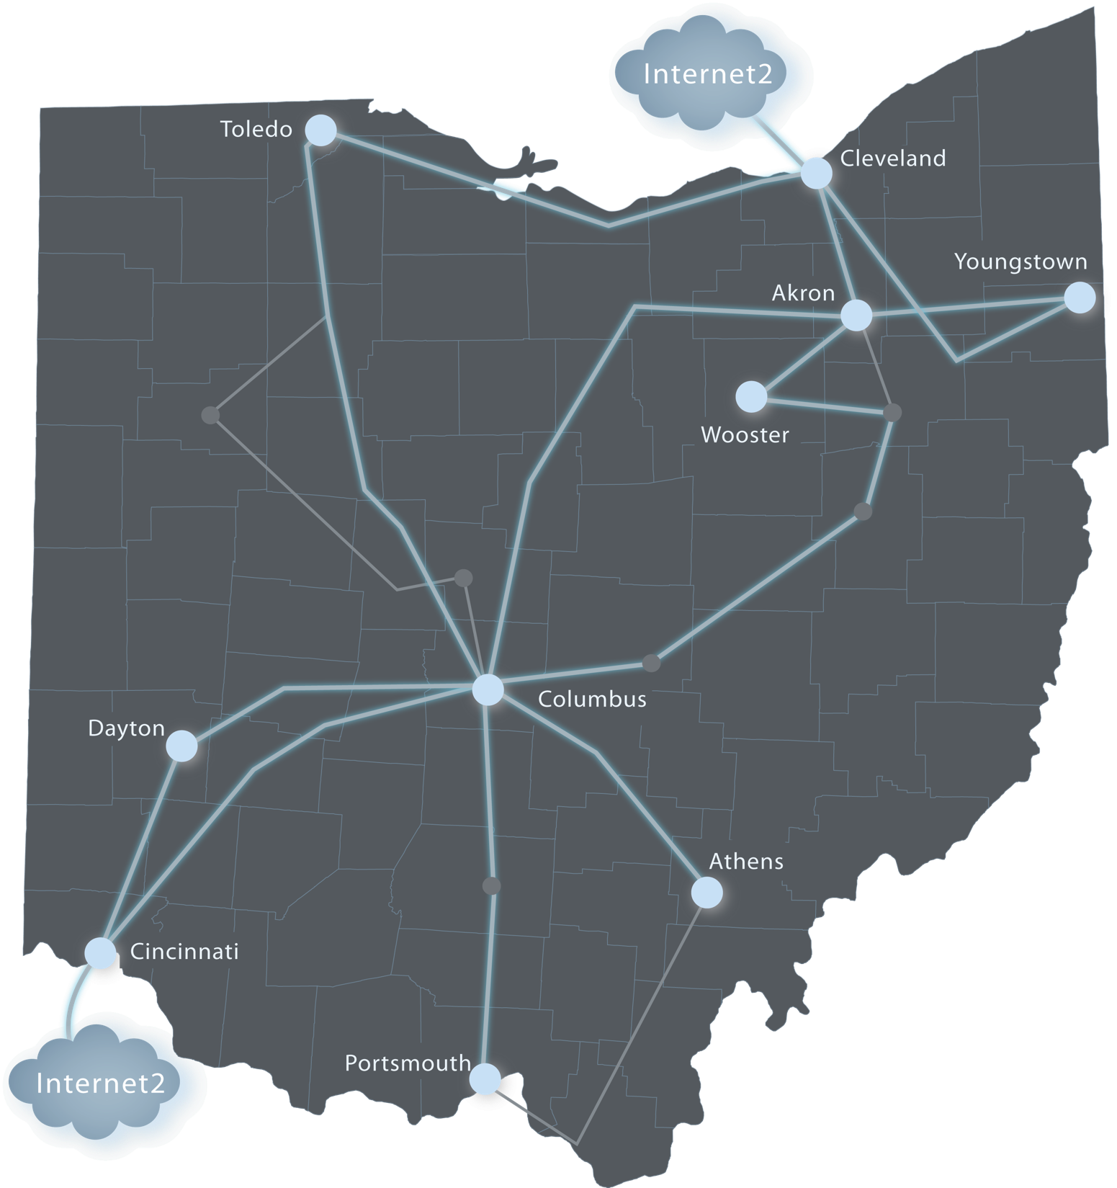
Ohio Innovates with the World
CERN
Bangladesh
Sao Paulo

Slide 6
About OSC
Founded in 1987
Statewide resource for all universities in Ohio
  high performance computing services
  computational science expertise
  “ … propel Ohio's research universities and private industry to the forefront of computational based research.”
Funded through the Ohio Department of Higher Education
Reports to the Chancellor
Located on OSU’s west campus
Fiscal agent is OSU
Notes:
Industrial engagement – this is our mandate

Slide 7
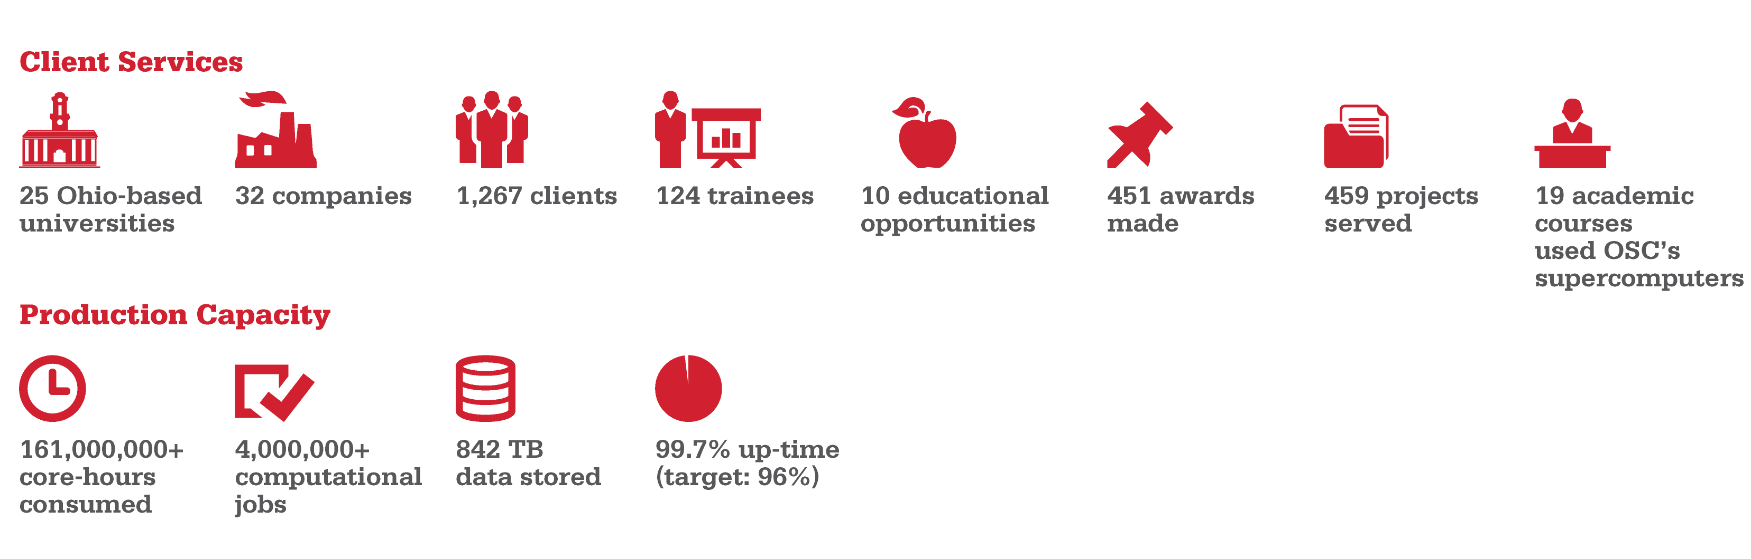
Empowering Clients:
Organizational Impact CY2015
Notes:
CPU and jobs per Usage by FoS (USDB)
Data storage per Koh
2015 project storage usage information: of 1.1P total storage, 842TB is currently used, with 228TB available, for a usage of 79%
Uptime per downtime notices on ARMSTRONG, Twitter, and osc.edu (8760 hrs in year, 30 hrs total downtime)
Universities and projects per Institutional Summary (USDB) – non-academic not included
Projects per Allocations by Project (USDB – sort and remove excess projects by date, checked on those with no date listed)
Individuals per Institutional Summary (USDB) – non-academic included
Training per training documents provided by Yuan (Regular Reporting, Training Folder)
Commercial clients, per Alan and Heidi Usage reports:
AltaSim
Nimbis
Bird Technologies
Advanced Numerical Solutions
TotalSim
Kinetic Vision
BASF
Cradle CFD
Gary and Mary West Health Institute
IcondCFD
Jose Unpingco
Komahan Boopathy
Owens-Corning Fiberglass
P&G
SIMCenter
TIAX
ECE
Henny Penny
EMC2
Rescale
SC Solutions
EWI Weld Predictor
GE Aviation
LG Fuel Cell
Nascar
Parallel Works
Milwaukee Institute
First Solar, Inc.
Honda R&D
IBM Research
Kadant Black Clawson
superH LLC

Slide 8
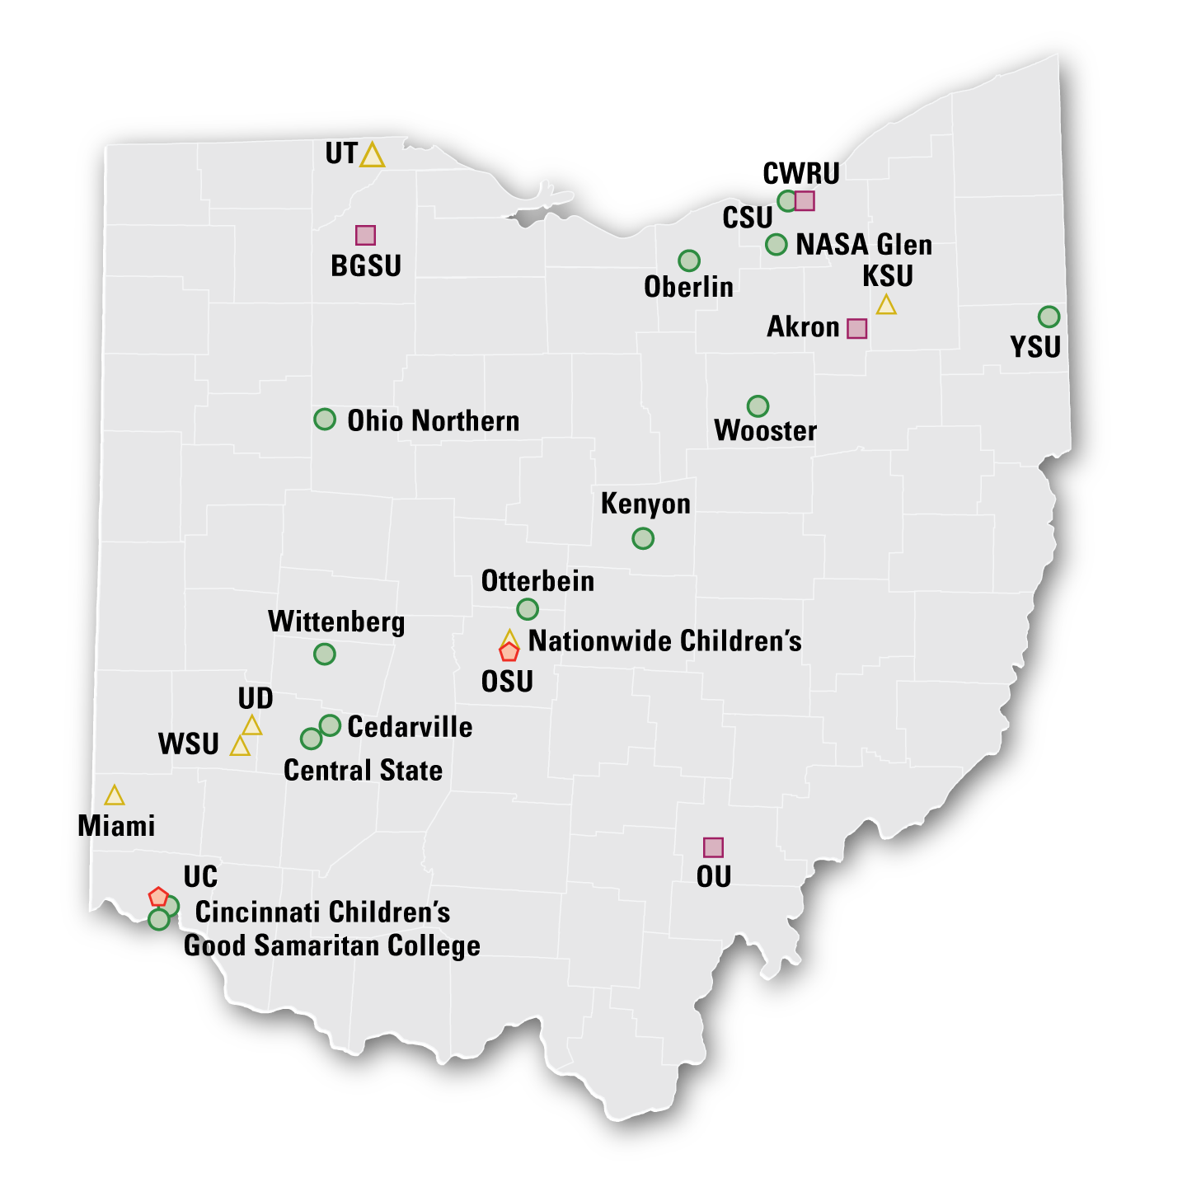

Active Awards
Total: 459
1 – 5
6 – 10
11 – 20
21+
Notes:
Information found in Institutional Summary 2015. I omitted OSC/OARnet from this calculation.

Slide 9
Computing Resource Usage by Field of Science (FoS)
Notes:
Data for this slide found in Usage Summary by FoS Date spreadsheet. Removed ‘none’ and ‘other’ from the list to get these figures.

Slide 10
OSC Service Catalog
Cluster Computing High Performance Computing High Throughput Computing Data-intensive Computing | Research Data Storage Project Storage Archival Storage
Client Services 24x7 Call Center Level 2 Engineering Support | Client Facilitation Consultation (in-person and online) Training and Education Classroom accounts
Scientific Software Development Software Development Software Parallelization | Web Software Development Software Development Software Consulting
Partner on Proposals Cyberinfrastructure solutions Modeling & simulation for industry | Visualization & Virtual Environments • Visualization Services • Virtual environments (DSL)

Slide 11
Statewide Licensed Software
Use the software in your lab or office
  Connect to license server at OSC
Software available
  Altair Hyperworks
  Totalview Debugger
  Intel Compilers, Tools, Libraries
  Portland Group Compilers
Contact OSC Help
  Provide your IP address

Slide 12
HPC Client Services
Technical Assistance
  Help desk and basic consulting
  Contact by phone or email (oschelp@osc.edu)
Facilitation
  Meet with OSC staff to discuss your research needs
  Get recommendations on services, connections to subject matter experts, and specialized projects initiated
Project Administration
  Manage allocations
  Add/Remove authorized users
  Utilization reports
Training
  Usually three workshops per semester on a variety of topics
Advanced consulting
  Code parallelization & optimization
  Software development, algorithm research
Website
  www.osc.edu/supercomputing

Slide 13
HPC Concepts

Slide 14
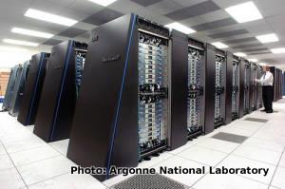

What is the difference between your laptop and a supercomputer?
X 10000 =
Remote Connect

Slide 15

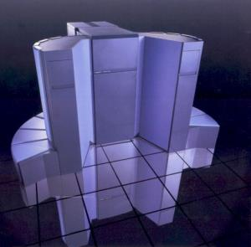
Supercomputers become history quickly!
Smartphone - 2015
Supercomputer - 1989
$740 | Cost | $20,000,000
4 GB | Memory | 128 MB
64 GB | Storage | 30 GB
302 GFLOPS | Speed | 2 GFLOPS
Notes:
A supercomputer in 1989 is less powerful than a smartphone today

Slide 16
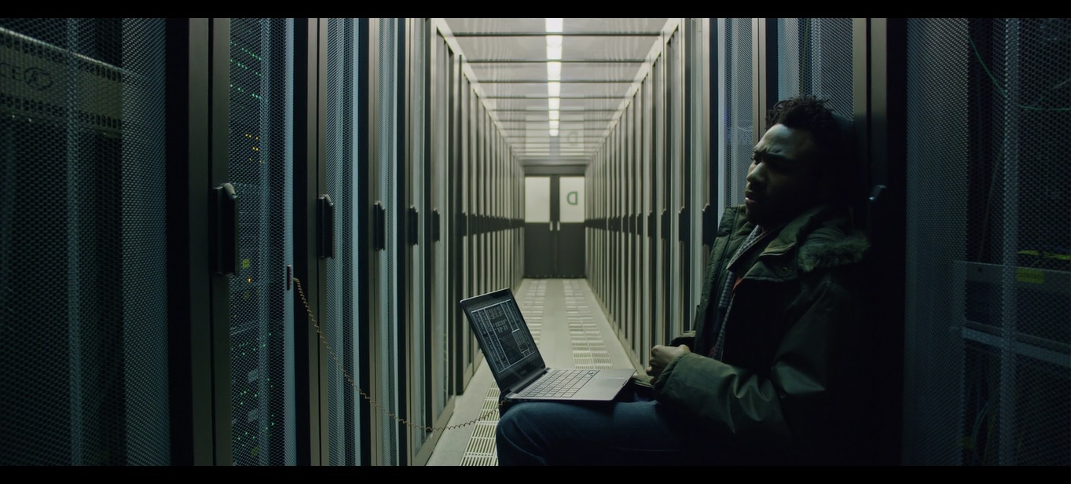
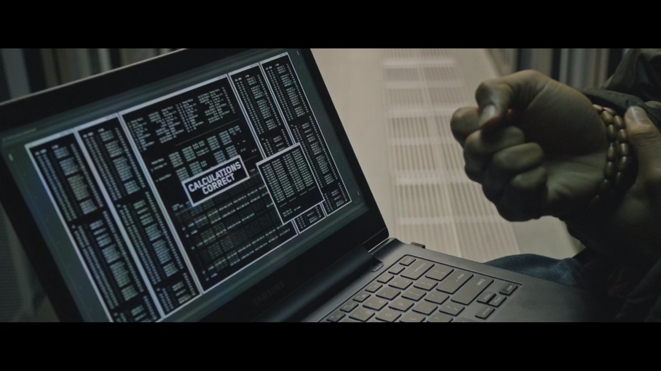

Slide 17
Big Numbers
Prefix
Example: bytes
K
  kilo, 10³, thousand
M
  mega, 10⁶, million
G
  giga, 10⁹, million
T
  tera, 10¹², trillion
P
  peta, 10¹⁵, quadrillion
E
  exa, 10¹⁸, quintillion
1KB – very small
12MB L2 cache per core
48GB memory per node
.5 TB disk space per user
4 PB aggregate storage
Exascale systems – current research area
Notes:
The numbers get big!
Solve problems that would take a really long time on a smaller computer!

Slide 18
HPC Terminology
Cluster
  A group of computers (nodes) connected by a high-speed network, forming a supercomputer
Node
  Equivalent to a high-end workstation, part of a cluster
Core
  A processor (CPU), multiple cores per processor chip
FLOPS
  “FLoating-point Operations (calculations) Per Second”
Notes:
Your laptop has multiple cores
FLOPS – you see computing power expressed in FLOPs easy way to compare from cluster to cluster

Slide 19
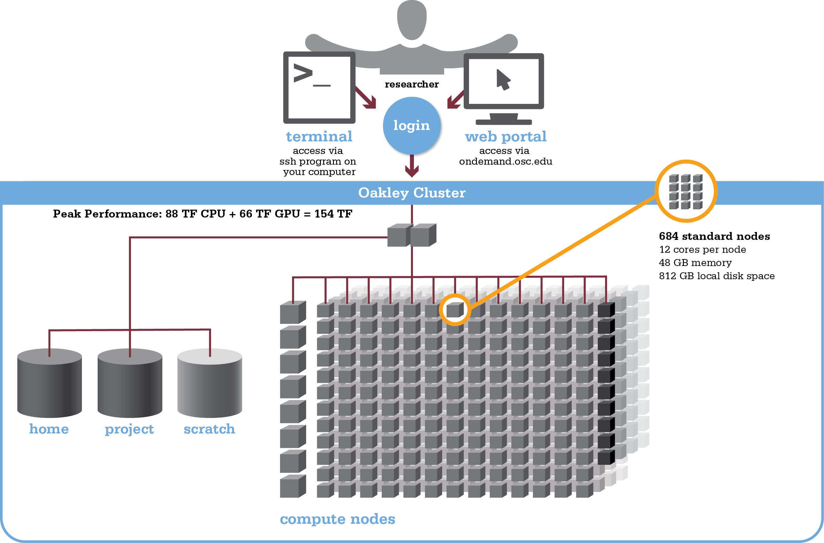
Organization of a Supercomputer

Slide 20
Login Nodes – Usage
Purpose
  Submit jobs to batch system
  Edit files
  Manage your files
  Interactive work – small scale
Limits
  20 minutes CPU time
  1GB memory
Use the batch system for serious computing!

Slide 21
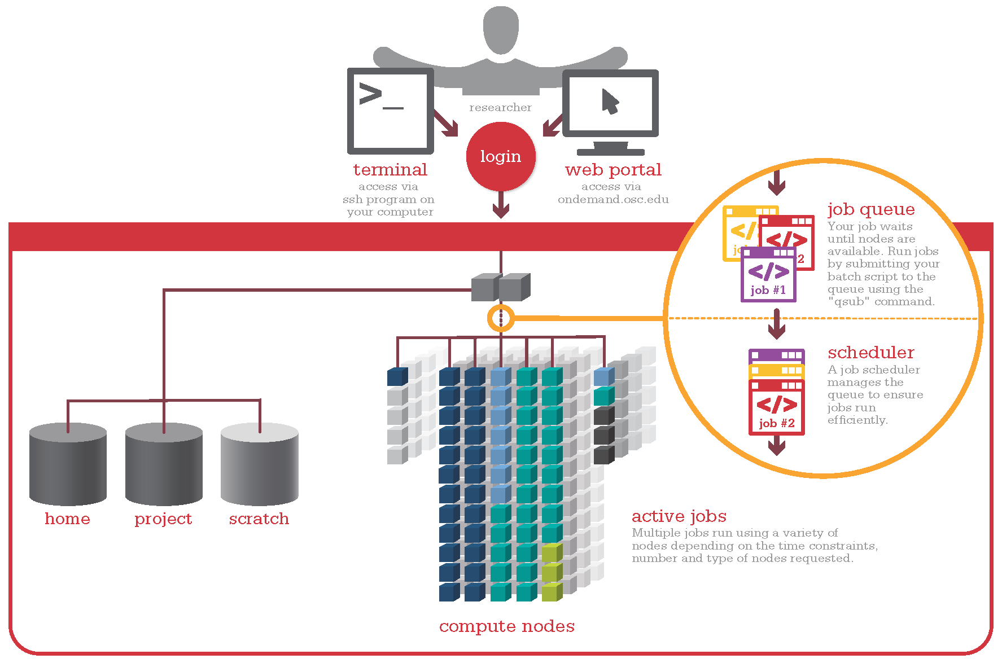
What do we use the login nodes for?
Notes:
Login to login nodes, access files, prepare scripts, submit jobs using qsub command to PBS, scheduler ensures jobs use resources requested most efficiently

Slide 22
Hardware Overview

Slide 23
Supercomputers at OSC
Ruby cluster (small cluster, limited access)
  Online March 2015
  Named for Ruby Dee, actress, poet, playwright, screenwriter, journalist and activist born in Cleveland.
  HP system, Intel Xeon processors, 4800 cores, 144 TF
Oakley cluster
  Online March 2012
  Named for Annie Oakley, famous Ohio sharpshooter
  HP system, Intel Xeon processors, 8280 cores, 154 TF
Owens
  Expected Fall 2016
  Named for Jesse Owens, 4-time Olympic gold medalist from Ohio.
  Dell system, Intel Xeon processors, 23,000+ cores, ~750 TF

Slide 24
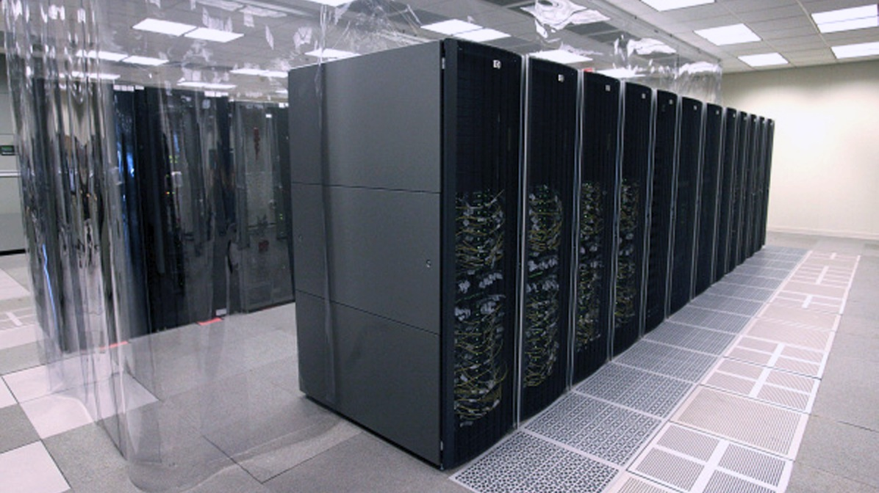
Oakley Cluster
Notes:
Hot-aisle containment

Slide 25
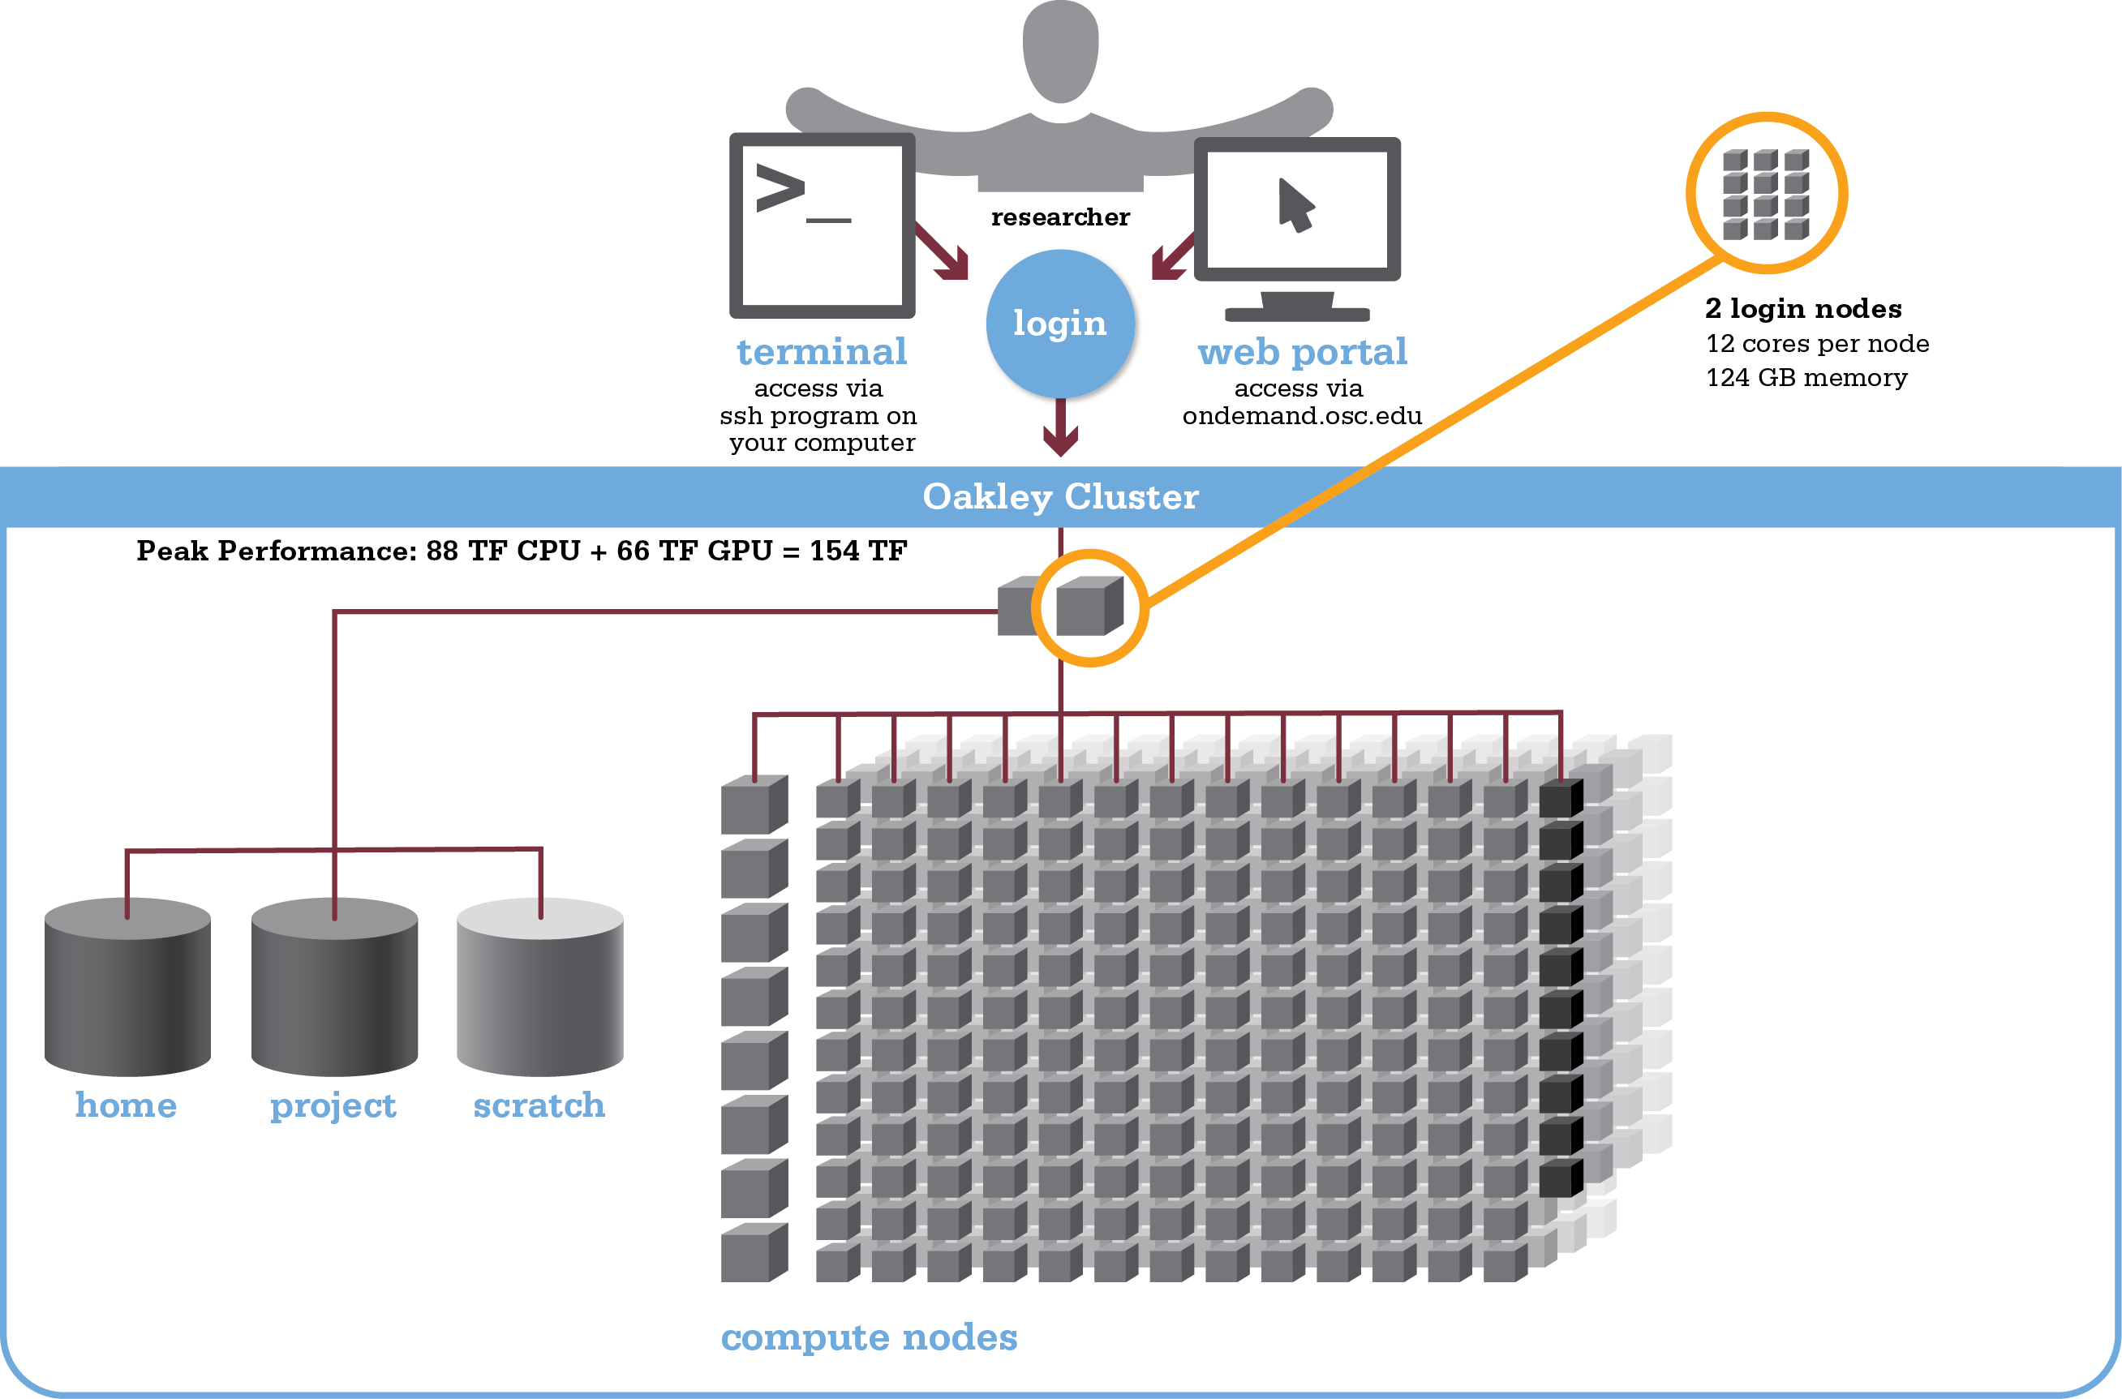
Oakley –
Login Nodes

Slide 26
Oakley –
Compute Nodes

Slide 27
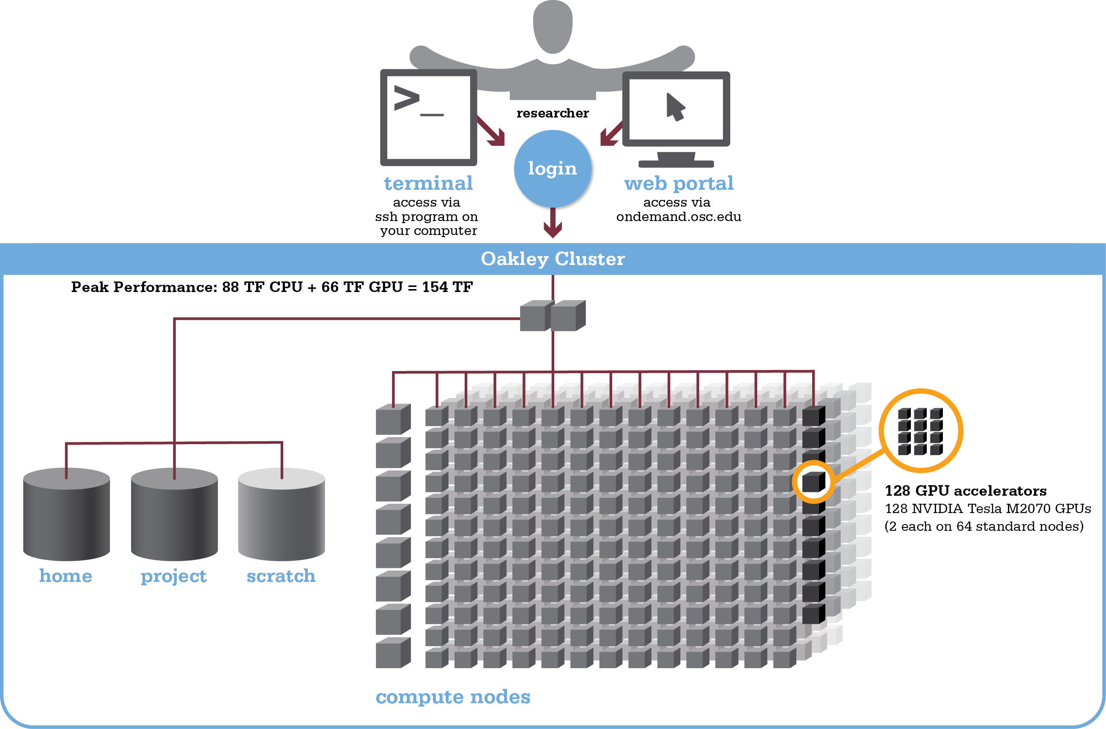
Oakley – GPU
Accelerators

Slide 28
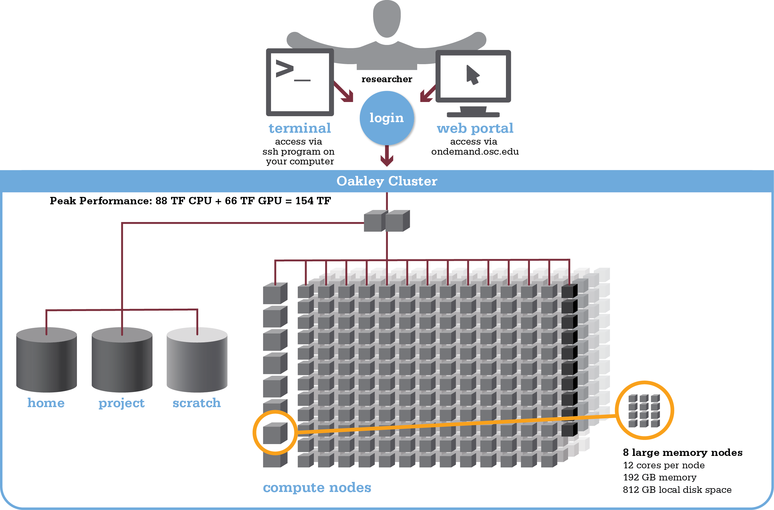
Oakley –
Specialized
Nodes

Slide 29
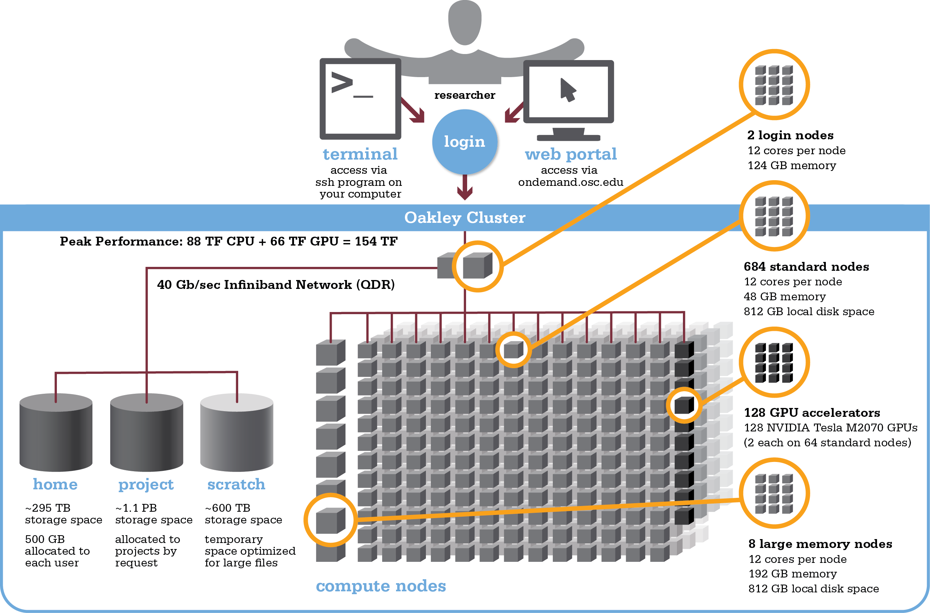
Oakley Cluster
Specifications

Slide 30
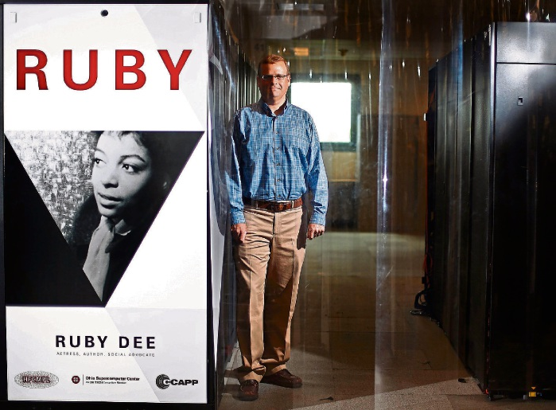
Ruby Cluster

Slide 31
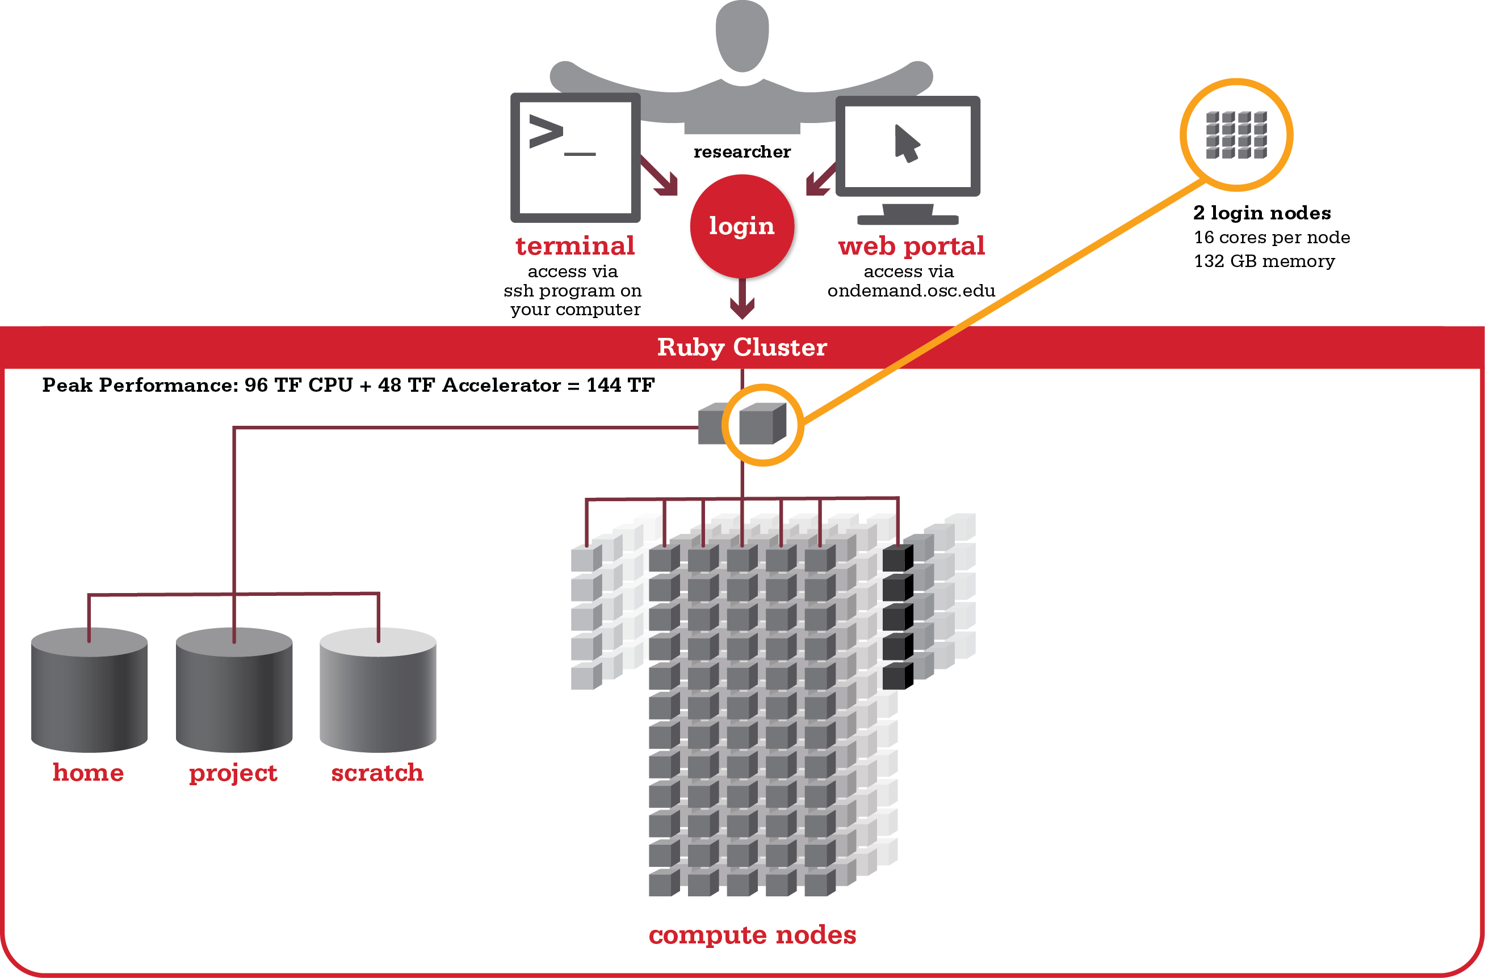
Ruby –
Login Nodes

Slide 32
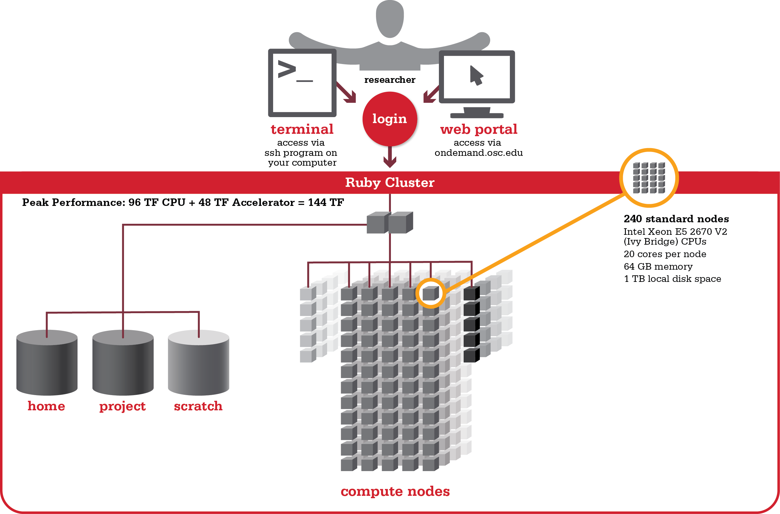
Ruby –
Compute Nodes

Slide 33
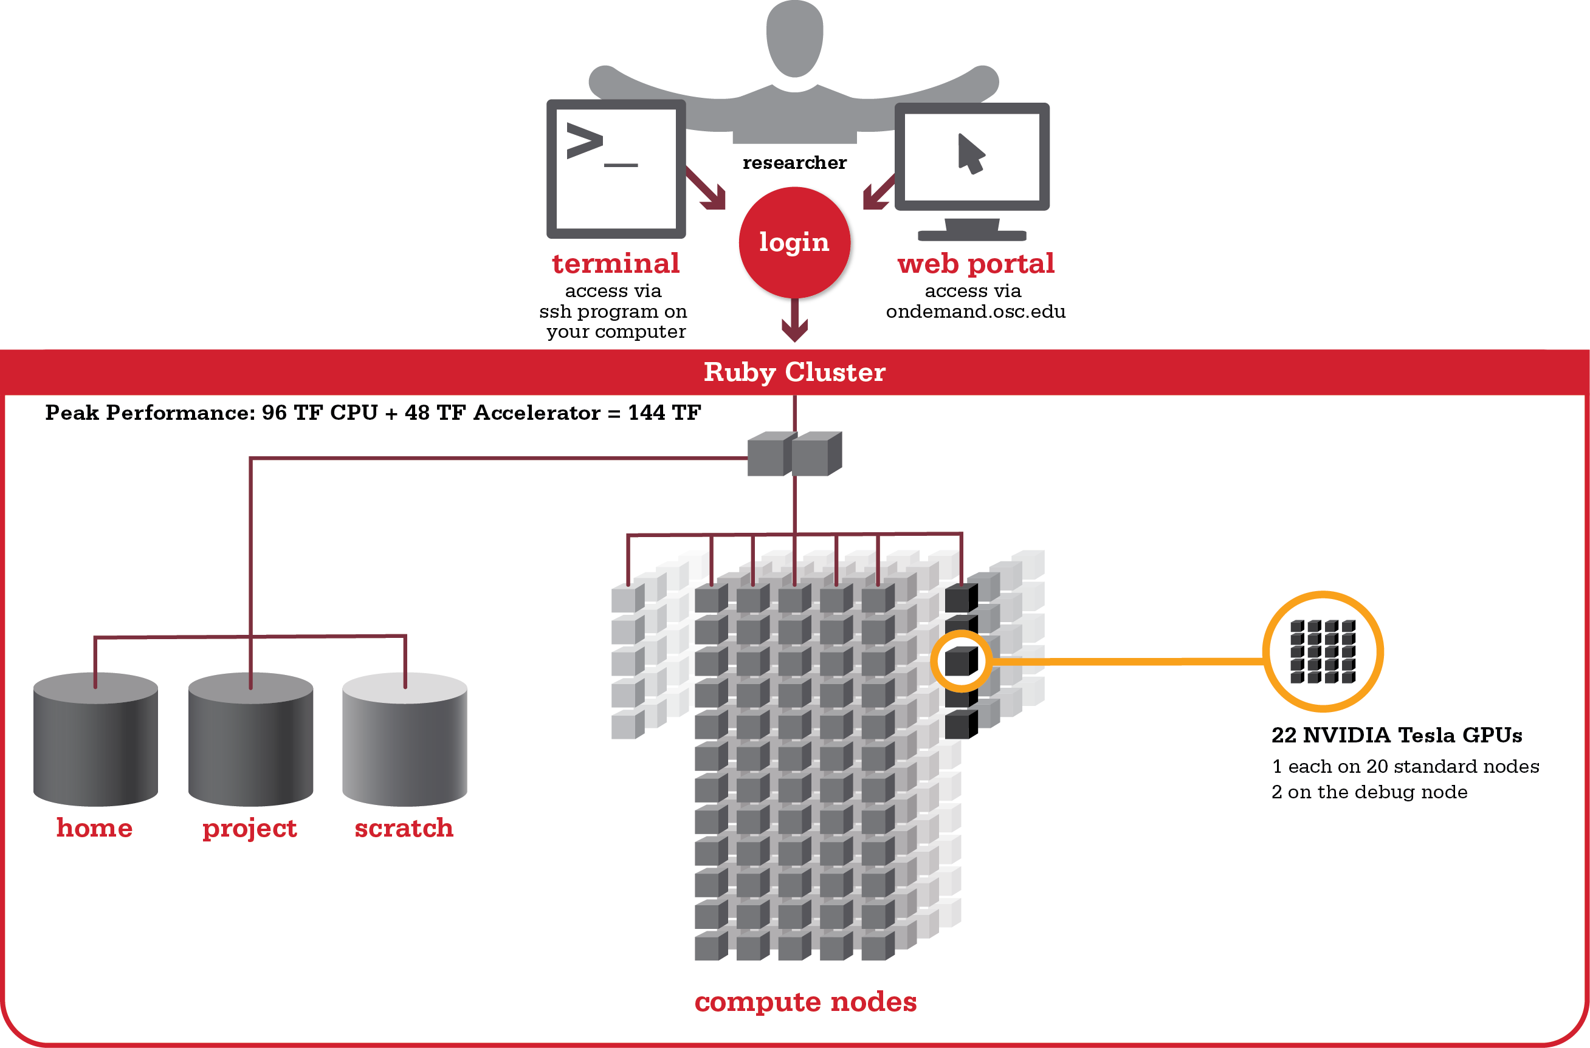
Ruby –
GPU Accelerators

Slide 34
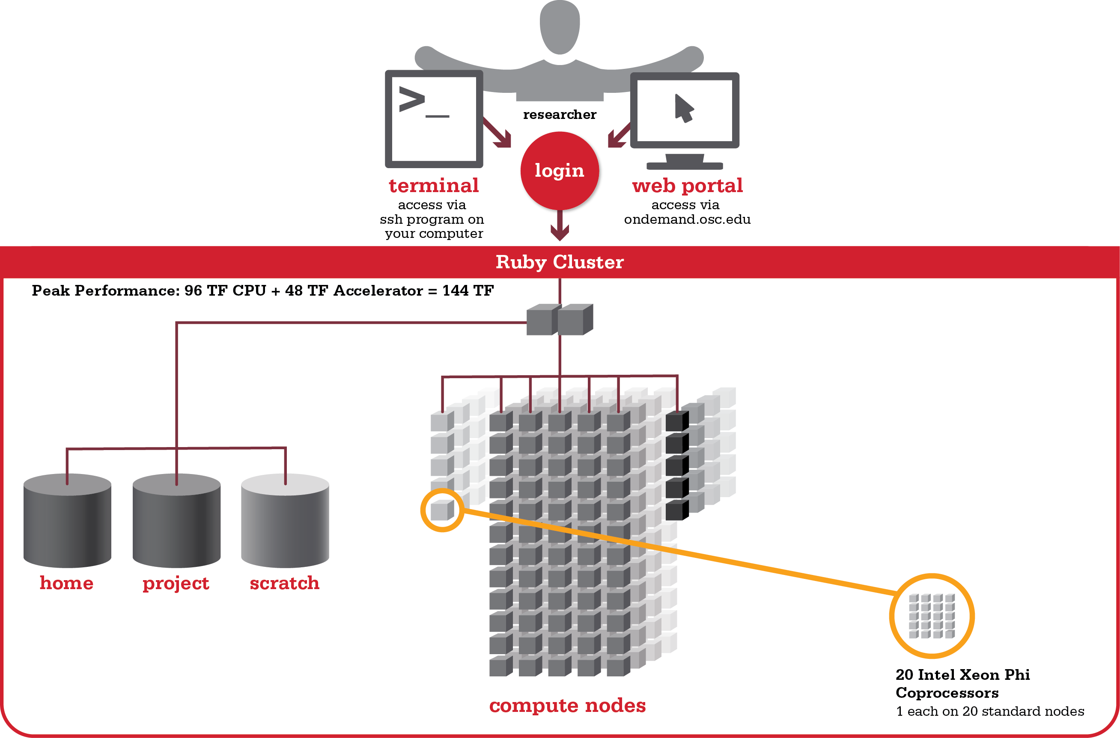
Ruby –
Coprocessors

Slide 35
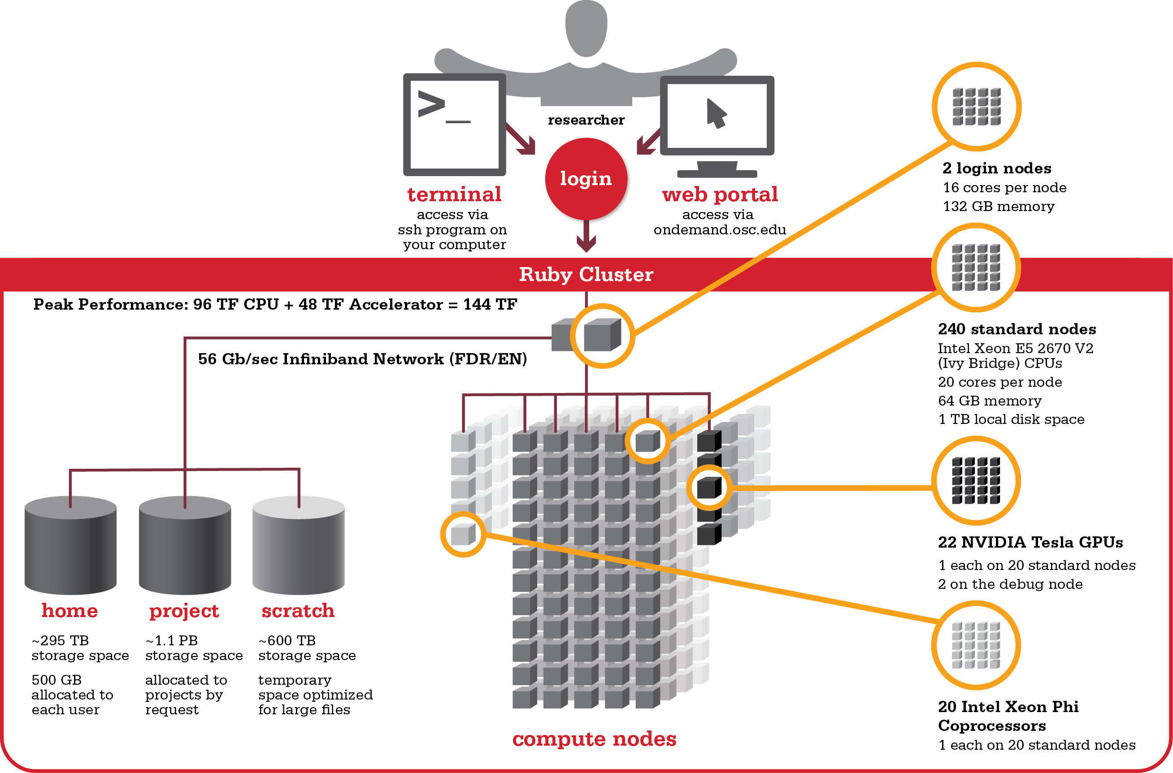
Ruby
Specifications

Slide 36
Resource Grants and Accounts

Slide 37
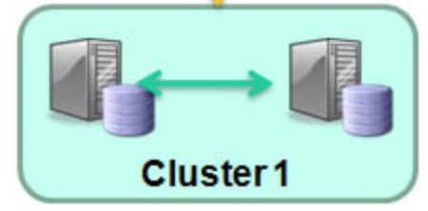
CWRU HPC Clusters
Old Cluster: hpclogin
RedCat Cluster: hpc1, hpc2, hpcviz, hpctransfer
20 nodes, 240 cores
Memory: 4GB/core
Types: regular (batch)
209 nodes, 2856 cores
Memory: 4GB/core up to 32GB/core
Types: batch, gpufermi, gpuk40 (the latest K40 gpu cards), smp
Storage:
Panasas (parallel fs): 180TB
/home, /scratch, /usr/local
Dell FFS (research storage): ~1PB
Hadoop Cluster: hpcdata
32 nodes, 250 cores
47TB local storage

Slide 38
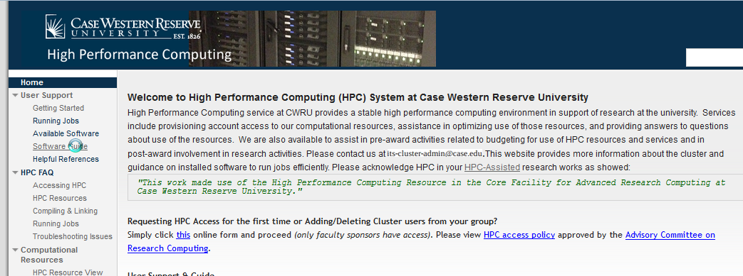
CWRU Cluster website
Google: “Case HPC” -> first or second entry

Slide 39
Resource Grants and Accounts at OSC

Slide 40
Who can get an OSC account?
Academic accounts
  Principal investigator (PI) must be a full-time faculty member or research scientist at an Ohio academic institution
  PI may authorize accounts for students, post-docs, collaborators, etc.
  Classroom accounts are also available
  No cost to Ohio academic users
Commercial accounts
  Commercial organizations may purchase time on OSC systems

Slide 41
Accounts and Projects at OSC
Project
  Headed by a PI
  May include other users
  Basis for accounting at OSC
  Submit proposal for computing resources for a project
Account
  Username and password to access HPC systems
  Each account associated with one project
  Each account used by one person (please!)
  If you work on multiple projects, you will have multiple accounts

Slide 42
Getting an Account - https://www.osc.edu/supercomputing/support/account
Startup grant
  One per PI per lifetime
  Provide contact info, institution, department
  5000 RUs
Additional allocations for a project
  Submit a proposal for more RUs
    Standard: 10,000
    Major: 30,000
    Discovery: >30,000
  Peer-reviewed
  Grants awarded by Statewide Users Group (SUG)
Classroom account

Slide 43
Allocations and Charges
Charges are in terms of resource units
Resource units
  1 resource unit (RU) = 10 CPU hours
  CPU hour = walltime x (total # of cores requested)
Project receives an allocation of RUs
Jobs are charged to a project
Notes:
1 hr on 1 node Oakley 12 cores = 12 CPU hr = 1.2 RUs

Slide 44
MyOSC
Site for managing your identity at OSC
Update your email
Change your password
Recover access to your account
Change your shell
And a lot more in the future
  Project reporting
  Authorized user management
  Requesting services (e.g. software access)

Slide 45
Your Contact Info
Keep your contact information current
  Use my.osc.edu to manage your account details.
If your student continues to use OSC after graduation, make sure email address is updated
  Acceptable if still collaborating with you
May need to contact you about problems
Will need to contact you about regular password changes
You can opt out of routine notifications

Slide 46
System Status
Check system status on:
  https://www.osc.edu/supercomputing (bottom of page)
  Message of the day (/etc/motd) – displayed at login
  Twitter: @HPCnotices
  Email for major outages or problems
Scheduled downtimes
  Quarterly maintenance – one day outage
  Next one is August 18
  Jobs held for up to two weeks prior

Slide 47
Statewide Users Group (SUG)
The Statewide Users Group (SUG) is made up of OSC users
  Provides program and policy advice to OSC
  Meets twice a year
  Headed by a chairperson elected yearly
Standing committees
  Allocations
  Software and Activities
  Hardware and Operations
Get involved!
  Next meeting is October 6th in Columbus

Slide 48
Citing OSC
Please cite OSC in your publications:
  Details at www.osc.edu/citation
These publications should be reported to OSC

Slide 49
What’s New at OSC

Slide 50
Owens Performance Increase
Notes:
Add table comparison to highlight compute power of new cluster!

Slide 51
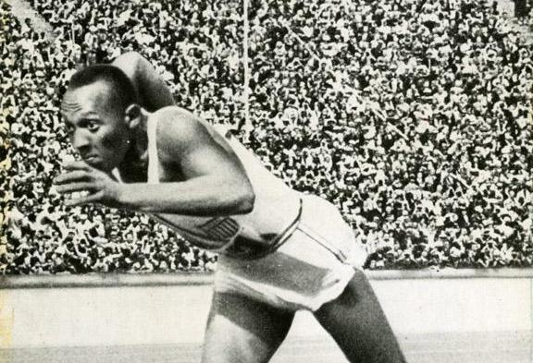
System Configurations
 | Owens (2016) | Ruby (2014) | Oakley (2012)
Theoretical Performance | ~750 TF | ~144 TF | ~154 TF
# Nodes | ~820 | 240 | 692
# CPU Cores | ~23,500 | 4800 | 8304
Total Memory | ~120 TB | ~15.3 TB | ~33.4 TB
Memory per Core | >5 GB | 3.2 GB | 4 GB
Interconnect | EDR IB | FDR/EN IB | QDR IB

Slide 52
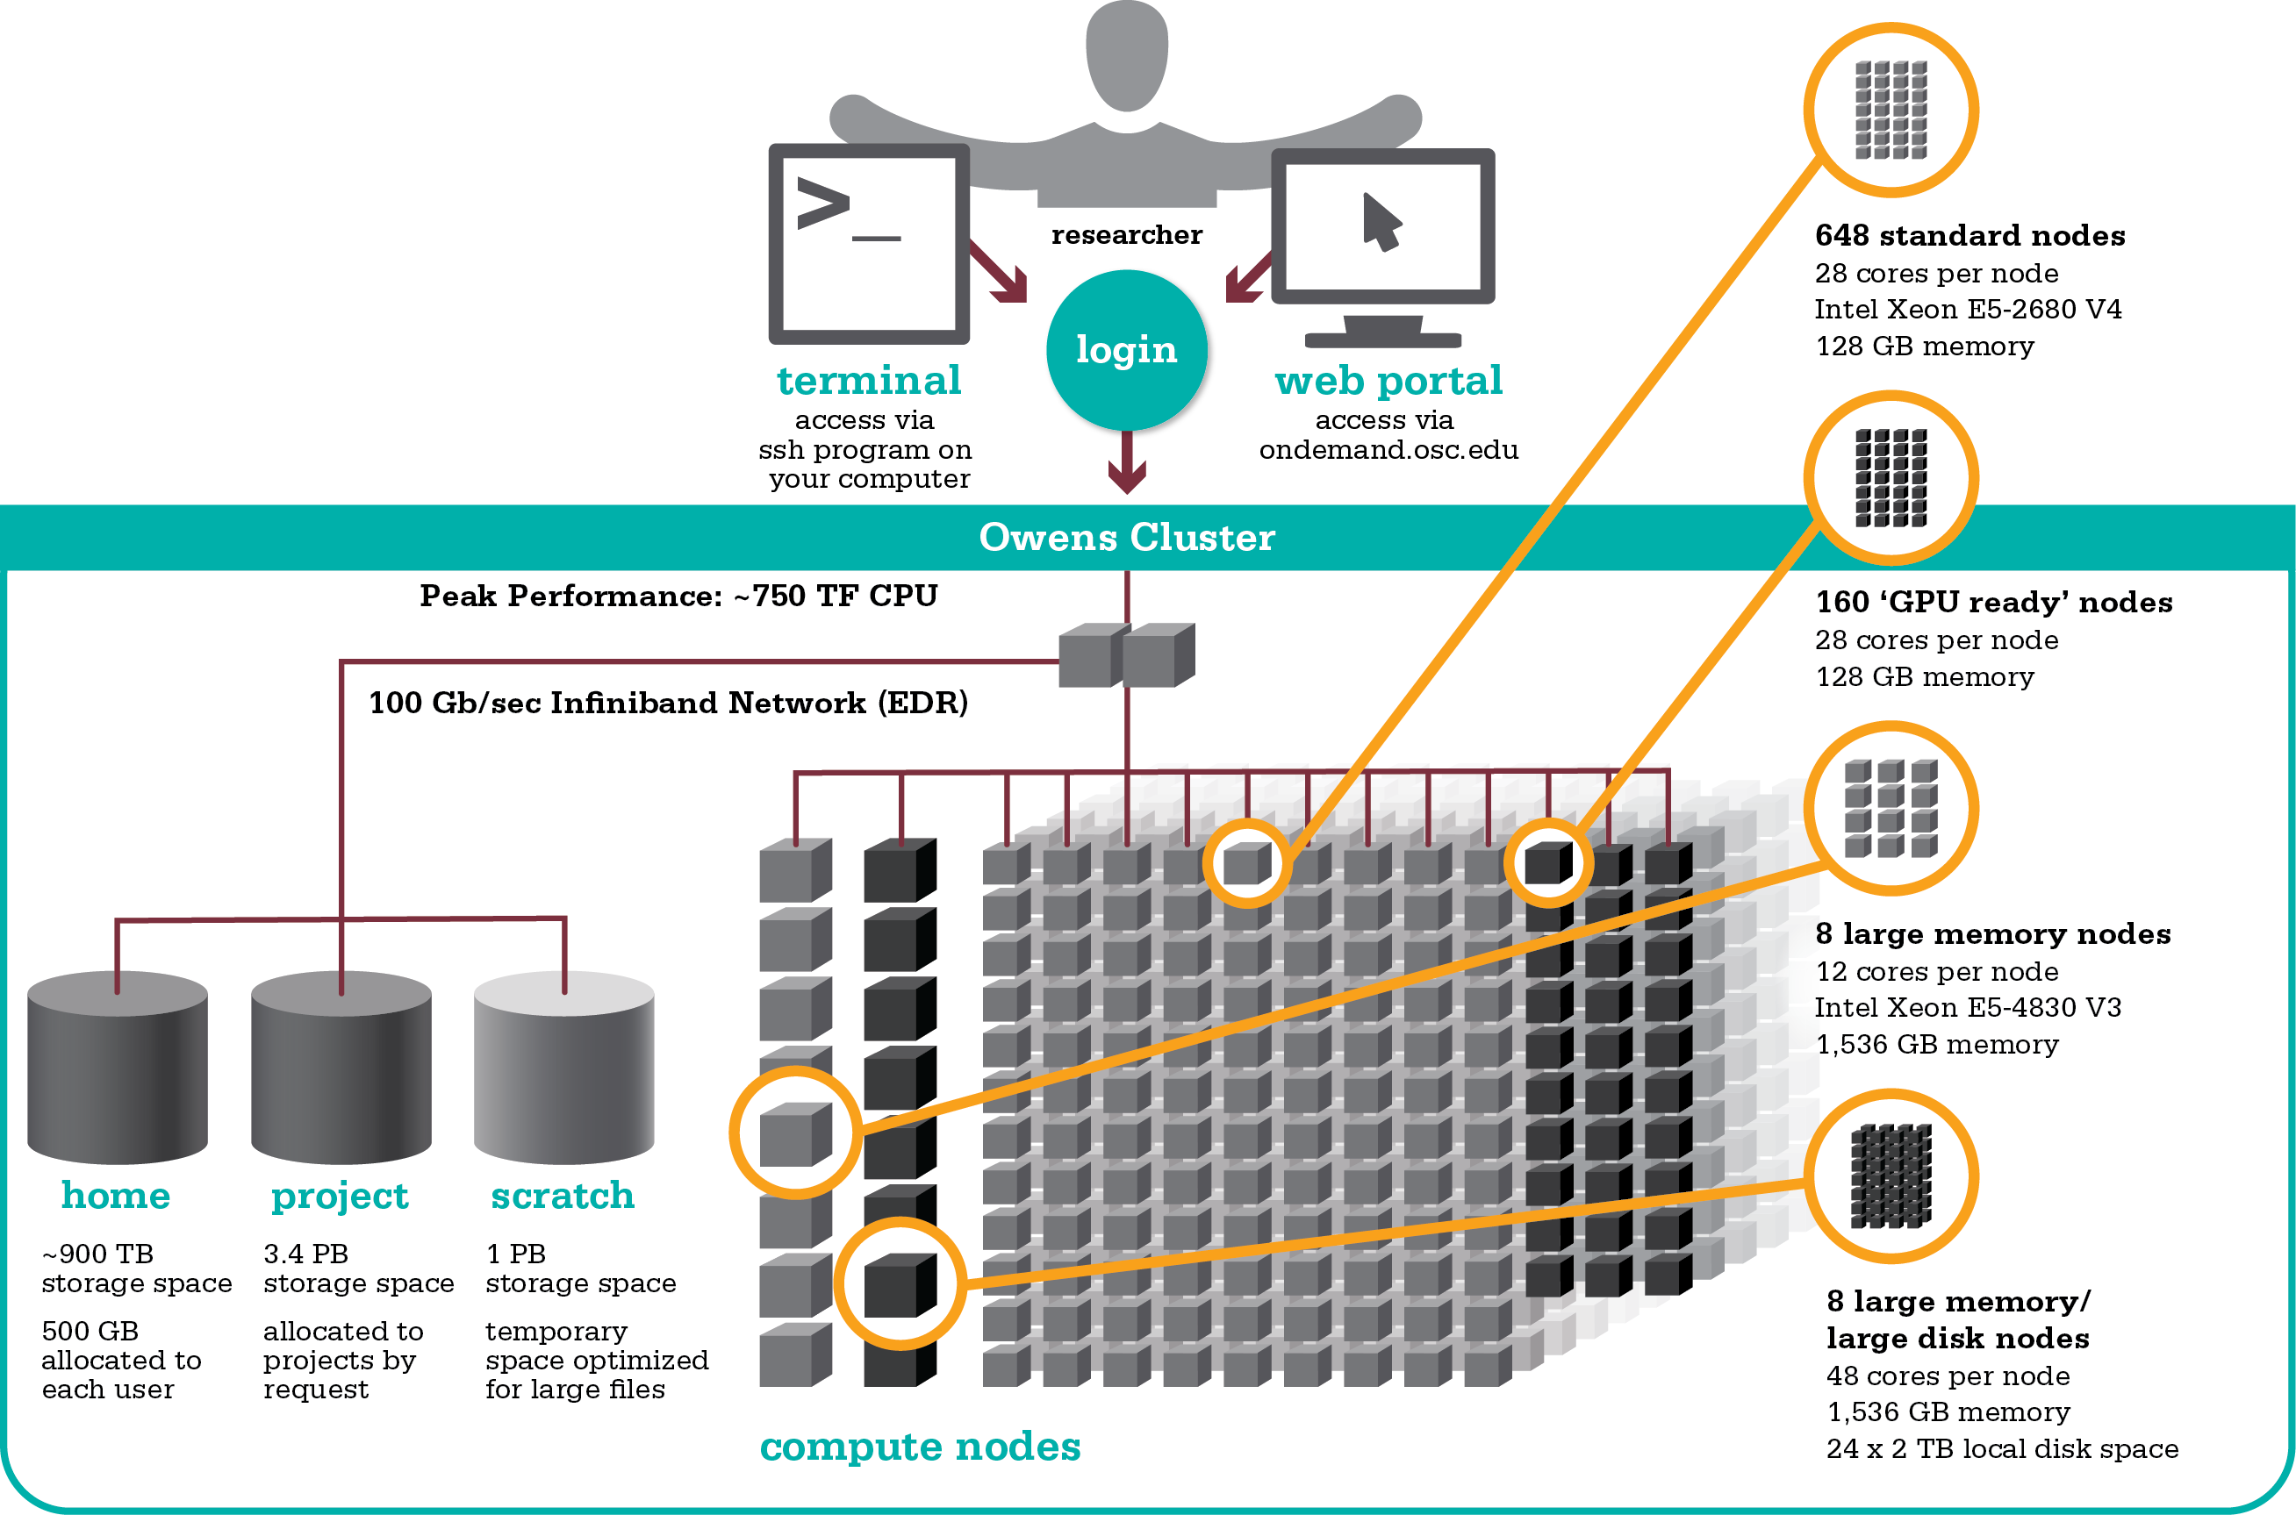
Owens Cluster Specifications

Slide 53
OSC File Space and Network Information Update
Scratch – DDN GPFS
  1 PB (~570 TB today)
  40-50 GB/s peak performance (~10 GB/s today)
Project – DDN GPFS
  3.4 PB usable space (~1.1 PB today)
  40-50 GB/s peak performance (8-9 GB/s today)
  Expected July 13th
Home Directory Space / (Net App) NFS
  New system online in May
  ~900 TB usable (Disk) (~300 TB previously)
  Allocated to each user, 500 GB quota limit
Mass Storage Update
>5 Petabytes (PBs) of usable disk
3.4 PB Project storage
1 PB Scratch space available
1.8 PBs tape – will be expanded
Notes:
Don’t know what the new policies are yet. Might be a project level quota.

Slide 54


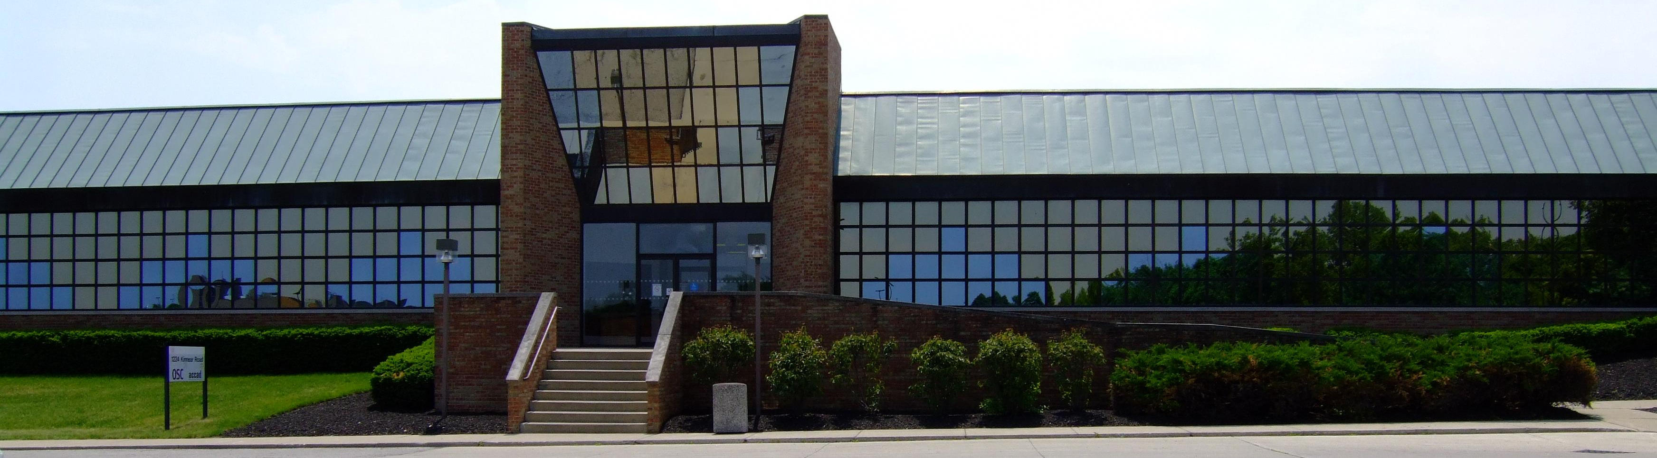
Questions
Kate Cahill
Education & Training Specialist
Ohio Supercomputer Center
kcahill@osc.edu
1224 Kinnear Road
Columbus, OH 43212
Phone: (614) 292-9623
ohiosupercomputercenter
ohiosupercomputerctr

Slide 55
User Environment

Slide 56
User Environment Topics
Connecting to the clusters
Transferring Files
Accessing installed software
Managing file permissions

Slide 57
Linux Operating System
“UNIX-like”
Widely used in HPC
Mostly command-line
Choice of shells (bash is default)
Freely distributable, open-source software
Tutorials available
www.linux.org

Slide 58
Connecting to the clusters
Connect to OSC machines using ssh (secure shell)
  From a Linux/UNIX machine : At prompt, enter
    ssh userid@oakley.osc.edu
    ssh userid@ruby.osc.edu
  From a Mac: Enter ssh command in TERMINAL window
  From Windows: ssh client software needed
    Both commercial and free versions are available
New: Connect using OnDemand portal (web-based)

Slide 59
Connecting to an OSC Cluster with Graphics
Programs on the cluster can have an X-based GUI
  Display graphics on your computer
Linux/UNIX and Mac: Use -X flag
  ssh -X userid@oakley.osc.edu
Windows: Need extra software
  Both commercial and free versions are available
  Configure your ssh client to tunnel or forward X11
Primarily used with programs on login node
  Can also use with interactive batch jobs

Slide 60
OSC OnDemand ondemand3.osc.edu
1: User Interface
  Web based
    Usable from computers, tablets, smartphones
    Zero installation
  Single point of entry
    User needs three things
      ondemand.osc.edu
      OSC Username
      OSC Password
    Connected to all resources at OSC
2: Interactive Services
  File Access
  Job Management
  Visualization Apps
    Desktop access
    Single-click apps (Abaqus, Ansys, Comsol, Paraview)
  Terminal Access
Notes:
OnDemand revamp coming including app support for HPC workflows

Slide 61
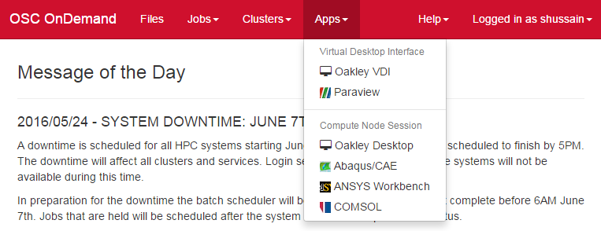
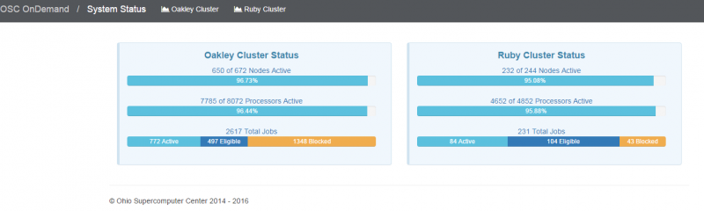

Slide 62
Transferring Files to and from the Cluster
Most file transfers to and from OSC machines use sftp or scp
  Linux and Mac have them built in
  Windows needs extra software - FileZilla
For small files, connect to login node
  oakley.osc.edu
For large files, transfer may fail due to shell limits
  Connect to gridftp01.osc.edu (file transfer only)

Slide 63
Modules and your shell environment
How modules work
  Modify environment variables like $PATH and $MANPATH within your shell
Default set of modules loaded at login
  module system, batch system (do not unload)
  default compiler and MPI modules
Do NOT completely replace $PATH in your .bash_profile or .bashrc
DO prepend directories to the existing $PATH
  Type: export PATH=$HOME/bin:$PATH

Slide 64
Adding or Removing Software from Your Environment
Load the module for the software you need, e.g.,
  module load comsol
Allows multiple versions of software to coexist on our system
Allow us to make changes without affecting you
  PLEASE DON’T HARDCODE PATHS!
Can load modules at command prompt or in your .bash_profile or .bashrc file
Also load modules in your job (batch) scripts

Slide 65
Module Commands
What modules do you have loaded?
  module list
What modules are available?
  module spider or module avail
Multiple versions of the same software
  module avail intel
Add a software module to your environment
  module load cuda
Remove a software package from your environment
  module unload intel
Load a different software version
  module swap intel intel/13.1.3.192
Notes:
Demo

Slide 66
File Permissions
By default all files are readable by all users
Check permissions using ls -l
  -rw-r--r-- 1 osu7824 PAS0925 10839 Jan 13 2015 triarm_VVVacid.sdf
  -rw-r--r-- 1 osu7824 PAS0925 11667 Jan 13 2015 triarm_VVVester.sdf
  drwxr-xr-x 8 osu7824 PAS0925 4096 Jan 16 2014 tutorial
  -rw-r-x--- 1 osu7824 PAS0925 9917889 Jan 15 2015 ValBaskEst32_gopt.log
  -rw-r--r-- 1 osu7824 PAS0925 12818 Jan 15 2015 ValBaskEst32_gopt.mol2
  -rwxr-xr-x 1 osu7824 PAS0925 453376 Feb 26 2015 ValBaskEst_c0_ValBaskEst0-CyHexPO-2OMe-cl1_md1.mdcrd
-rwxr-xr-x User, Group, Others
Change file permissions using chmod
    chmod u=rw,g=r file
    chmod –R u=rw,g=r directory
Notes:
Demo

Slide 67
Storage

Slide 68
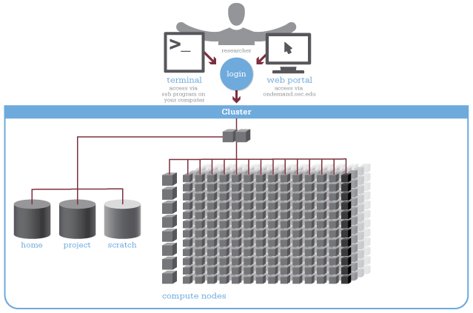
Four different file systems
Notes:
Users log in to the login nodes, create files there, submit jobs to batch system

Slide 69
Home Directories
Each user has a home directory
Visible from all OSC systems
Backed up daily – “permanent storage”
Quotas
  500GB of storage per user account
  1,000,000 files maximum
  Cannot create new files if over quota
  Quota and usage info displayed at login

Slide 70
Sample Quota Display
Quota display at login (information collected nightly):
As of 2010 Jul 15 04:02 userid usr1234 on /nfs/06 used 28GB of quota 500GB and 41374 files of quota 1000000 files
As of 2010 Jul 16 04:02 project/group PRJ0321 on /nfs/proj01 used 27GB of quota 5000GB and 573105 files of quota 1000000 files
Output from quota command (run manually):
Disk quotas for user usr1234 (uid 11059):
Filesystem
blocks quota limit grace files quota limit grace
fs06-oak.ten.osc.edu:/nfs/06/osc
201698292 450000000 524288000 631137 950000 1000000

Slide 71
Project Directories
PI may request project directory if more space needed
  Send request to OSC Help
  Large requests are reviewed by SUG Allocations Committee
  Shared by all users in the project
Backed up daily
Visible from all OSC systems
Project quota is separate from the home directory quota

Slide 72
Parallel File System – Lustre
Designed to handle heavy parallel I/O load
Faster access than home and project directories
NOT good for small files
Visible from all cluster nodes (shared)
Suitable for short-term storage (up to 6 months) of large amounts of data
Also useful as batch-managed temporary storage
Scratch storage – NOT backed up!

Slide 73
File Management
Compress large, rarely used files
  Use gzip or bzip2 commands
Combine large numbers of small files into an archive
  Use tar command

Slide 74
Compute Nodes– $TMPDIR
Local file system on each compute node
  812 GB on each Oakley node
  1 TB on each Ruby node
Fast – use for intermediate or scratch files
Not shared between nodes
Not backed up
Managed by the batch system
Data removed when job exits

Slide 75
Overloading the File Servers
“A supercomputer is a device for turning compute-bound problems into I/O-bound problems.” --Ken Batcher (parallel computing pioneer)
One user’s heavy I/O load can affect responsiveness for all users on that file system
Never do heavy I/O in your home or project directory!
Use $TMPDIR, copying files in and out as necessary
Don’t let large numbers of jobs run in lockstep.

Slide 76
Batch Processing

Slide 77
Organization of an HPC cluster
Notes:
Users log in to the login nodes, create files there, submit jobs to batch system

Slide 78
Batch System at OSC
Compute nodes are allocated through the batch system
  PBS – Portable Batch System
  Torque – resource manager
  Moab – scheduler
Documentation at
  www.osc.edu/supercomputing/batch-processing-at-osc

Slide 79
Why do supercomputers use queueing?
Notes:
Login to login nodes, access files, prepare scripts, submit jobs using qsub command to PBS, scheduler ensures jobs use resources requested most efficiently

Slide 80
Idea Behind Batch Processing
Whatever you would normally type at the command prompt goes into your batch script
Output that would normally go to the screen goes into a log file (or files)
The system runs your job when resources become available
Very efficient in terms of resource utilization

Slide 81
Running a Job on the Compute Nodes
Create a batch script for a job
Submit the job
Job gets queued
Job runs when resources become available
Get your results when the job finishes

Slide 82
Specifying Resources in a Job Script
Nodes and cores (processors) per node
Memory
GPUs
  See “Batch Processing at OSC” on OSC website
Walltime
  Overestimate slightly – job will be deleted if it hits limit
  Shorter job may start sooner due to backfill
Software licenses
  See specific software page on OSC website

Slide 83
Sample Batch Script
#PBS –N serial_fluent
#PBS –l walltime=1:00:00
#PBS –l nodes=1:ppn=1
#PBS –j oe
#PBS –l software=fluent+1
# Set up the FLUENT environment
module load fluent
# Move to directory job was submitted from
cd $PBS_O_WORKDIR
# Copy input files to compute node
cp run.input $TMPDIR
cd $TMPDIR
# Run fluent and copy results back to home
fluent 3d -g < run.input
cp ‘results*’ $PBS_O_WORKDIR
Job setup information for PBS
# This is a comment
Commands to be run
Put all this into a text file!
Notes:
Best practices? Cp to $TMPDIR?

Slide 84
Submitting a Job and Checking Status
Command to submit a job
  qsub script_file
Response from PBS (example)
  123456.oak-batch.osc.edu
Show status of batch jobs
  qstat -a jobid
  qstat –u username
  qstat -f jobid

Slide 85
Scheduling Policies and Limits
Walltime limit
  168 hours for serial jobs (single node)
  96 hours for parallel jobs (multiple nodes)
Per-user limits
  128 concurrently running jobs
  2040 processor cores in use
  1000 jobs in the batch system, running or queued
Per-group limits
  192 concurrently running jobs
  2040 processor cores in use

Slide 86
Waiting for Your Job To Run
Queue wait time depends on many factors
  System load
  Resources requested
    nodes, cores, large memory, gpus, software licenses
  Fair share limits (if load is high)
    reduced priority for users or groups using a lot of resources
Notes:
Is this true for classroom accounts? HW deadline?

Slide 87
Job Output
Screen output ends up in file job_name.ojobid
  Copied to your working directory when job ends
  Example: testjob.o1234567
To see screen output while job is running
  qpeek jobid
  Example: qpeek 1234567
Notes:
demo

Slide 88
Interactive Batch Jobs
Interactive, but handled through batch system
  Resource limits same as standard batch limits
Useful for tasks forbidden on login nodes
  Debug parallel programs
  Run a GUI program that’s too large for login node
May not be practical when system load is high
  Long wait, same as standard batch job
To submit an interactive batch job (example)
  qsub -I -X -l nodes=2:ppn=12 -l walltime=1:00:00

Slide 89
Batch Queues
Oakley and Ruby have separate batch systems
  Submit job and check status on the same cluster
Debug reservation
  A few nodes on each system are reserved for short jobs
  (≤ 1 hour)
  Special flag required on Ruby: -q debug

Slide 90
Parallel Computing
Each processor is fast, but real speed comes from using multiple processors
Multithreading
  Use multiple cores on a single node
  Shared memory
Message passing (MPI)
  Use one or multiple nodes
  Distributed memory

Slide 91
To Take Advantage of Parallel Computing
Program must be written to take advantage of multiple cores and/or multiple nodes
Many commercial applications have multithreaded or parallel versions
Must use mpiexec for multiple nodes
Can’t just request more nodes or cores and expect your job to run faster

Slide 92
Specifying Resources in a Job Script for GPUs
Nodes and cores (processors) per node
Memory
GPUs
  See “Batch Processing at OSC” on OSC website
#PBS -l walltime=01:00:00
#PBS -l nodes=1:ppn=1:gpus=1
#PBS -N compute
#PBS -j oe
module load cuda
cd $HOME/cuda
cp mycudaApp $TMPDIR
cd $TMPDIR
./mycudaApp

Slide 93
Third-Party Software Applications

Slide 94
Access to Licensed Software
Most software licenses for academic use only
Some software requires signed license agreement
  Check website
  Contact OSC Help

Slide 95
Third party applications
Chemistry (*license agreement required)
  *AMBER
  ChemTools
  COLUMBUS
  *CSD (Cambridge Structural Database)
  ESPRESSO
  GAMESS
  *Gaussian
  GROMACS
  LAMMPS
  MacroModel®
  MEAD
  NAMD
  NWChem
  Open Babel
  *Turbomole
Notes:
Applications listed by categories

Slide 96
Third party applications
Bioinformatics
  Bioperl
  BLAST
  BLAT
  Bowtie
  Clustal W
  EMBOSS
  Fitmodel
  HMMER
  MrBayes
  NAMD
  PAML
  PAUP
  RAxML
  RepeatMasker
  TreeBeST
Notes:
Applications listed by categories

Slide 97
Third party applications
Structural Mechanics (*license agreement required; statewide licensed)
  *ABAQUS
  Altair HyperWorks
  *ANSYS
  COMSOL Multiphysics
  *LSDYNA
  LS-PREPOST

Slide 98
Third party applications
Fluid Dynamics (*license agreement required)
  *Fluent
  OpenFOAM
Notes:
Fluent--modeling fluid flow and heat transfer in complex geometries
Gridpro--an automatic object oriented multiblock grid generator
GridPro is not installed at OSC as it is intended for desktop use

Slide 99
Third party applications
Mathematics/Statistics (statewide licensed)
  MATLAB (special licensing restrictions)
  Octave
  R
  Stata
  FFTW
  ScaLAPACK
  MINPACK
  sprng2
   Intel MKL
  ACML (Glenn only)

Slide 100
Third party applications
General programming software (statewide licensed)
  gnu compilers and debugger
   Intel compilers
   Totalview debugger
   PGI compilers
  MPI library
  HDF5
  NetCDF
  Java, Java Virtual Machine
  Python

Slide 101
Third party applications
Parallel programming software (statewide licensed)
  MPI library (mvapich, mvapich2)
  OpenMP
  CUDA
  OpenCL
  OpenACC

Slide 102
Third party applications
Visualization software
  GNUplot
  Jmol
  VTK
More applications can be found at Software page:
http://www.osc.edu/supercomputing/software/

Slide 103
OSC doesn’t have the software you need?
Commercial software
  Fill out a request form (see our FAQ)
  SUG will consider it
Open-source software
  You can install it yourself in your home directory
  If there’s enough demand, we can install it for shared use
Have your own license?
  Contact OSC Help

Slide 104
OSC Policies

Slide 105
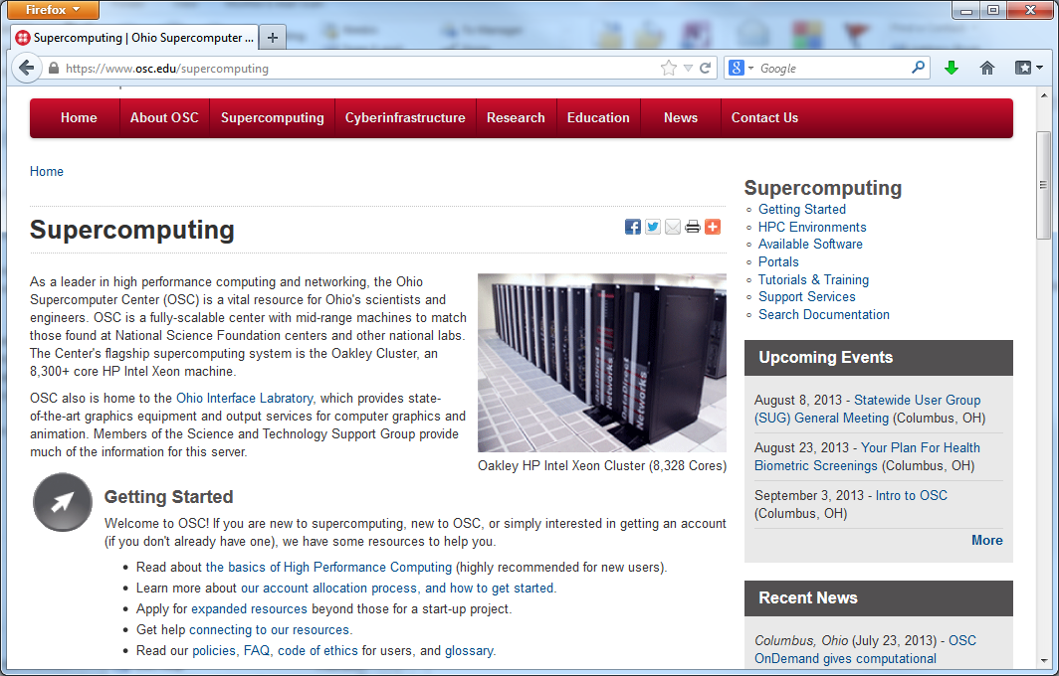
www.osc.edu/supercomputing
OSC Policies

Slide 106
OSC Policies
OSC-1, OSC Data Lifecycle Management Policy
  Use of home directory, project directory and $TMPDIR
  Storage and file quotas
  Backup and recovery

Slide 107
OSC Policies
OSC-11, OSC User Management Policy
  Who can get an account
  Charges for accounts
  Types of accounts
  Account restrictions
  Account resource units
  Inappropriate system use

Slide 108
For More Information
Key webpages
  www.osc.edu/supercomputing - general documentation
  https://www.osc.edu/supercomputing/batch-processing-at-osc
Contact the help desk (OSC Help) 24/7
  oschelp@osc.edu
  614-292-1800
  1-800-686-6472

Slide 109
Questions
Kate Cahill
Education & Training Specialist
Ohio Supercomputer Center
kcahill@osc.edu
1224 Kinnear Road
Columbus, OH 43212
Phone: (614) 292-9623
ohiosupercomputercenter
ohiosupercomputerctr

Slide 110
Demo
Website tour: www.osc.edu
MyOSC: https://my.osc.edu/
OnDemand: ondemand3.osc.edu
  https://www.osc.edu/ondemand

