Slide 1
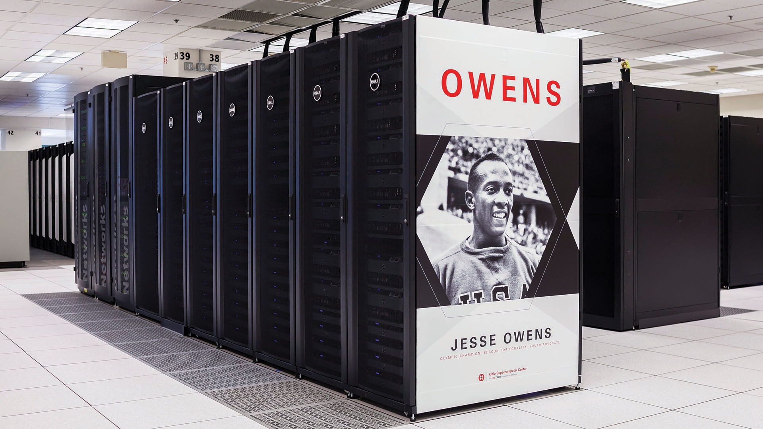

Slide 2
Computing Services to Accelerate Research and Innovation
An introduction to OSC services

Slide 3
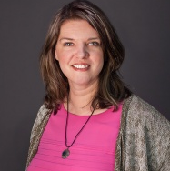
Kate Cahill
Education & Training Specialist
“OSC is here to empower your research.”

Slide 4
Outline
What is OSC?
Overview of Services
  Hardware Overview
  Data Storage Systems
  Software Overview
  Upcoming services
OSC Usage and Case Studies
Research Partnership
Getting Started at OSC
  Getting access
  Learning how to use OSC resources

Slide 5
What is the Ohio Supercomputer Center?
"640K ought to be enough for anybody.” – Not Bill Gates

Slide 6
About OSC
Founded in 1987
Statewide resource for all universities in Ohio
  high performance computing services
  computational science expertise
  “ … propel Ohio's research universities and private industry to the forefront of computational based research.”
Funded through the Ohio Department of Higher Education
Reports to the Chancellor
Located on OSU’s west campus
Fiscal agent is OSU

Slide 7




The OH-TECH Consortium
Ohio Supercomputer Center provides high performance computing, software, storage and support services for Ohio's scientists, faculty, students, businesses and their research partners.
OARnet connects Ohio’s universities, colleges, K-12, health care and state and local governments to its high-speed fiber optic network backbone. OARnet services include co-location, support desk, federated identity and virtualization.
OhioLINK serves nearly 600,000 higher education students and faculty by providing a statewide system for sharing 50 million books and library materials, while aggregating costs among its 90 member institutions.

Slide 8
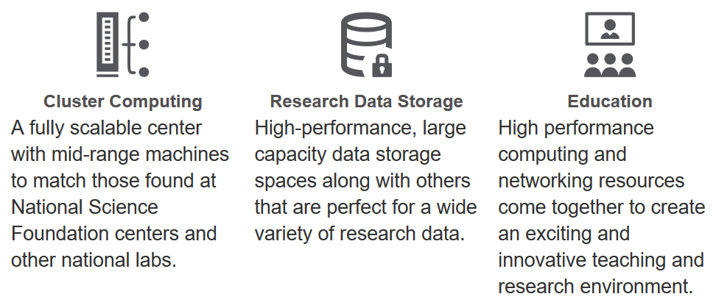
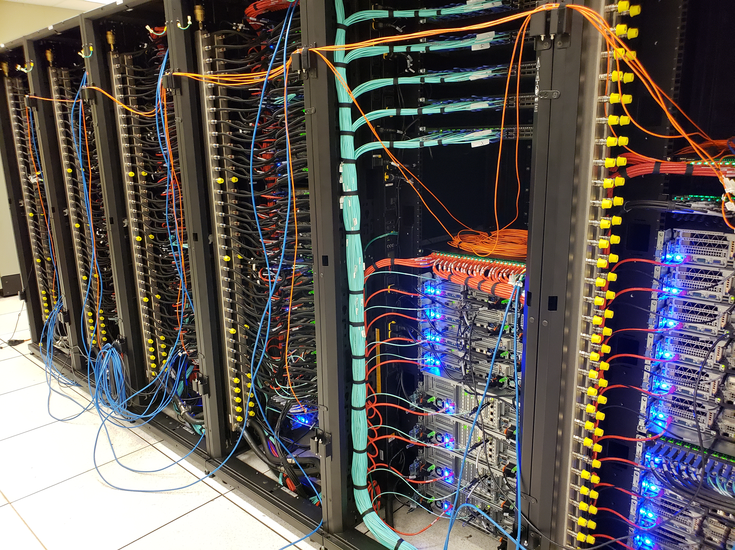
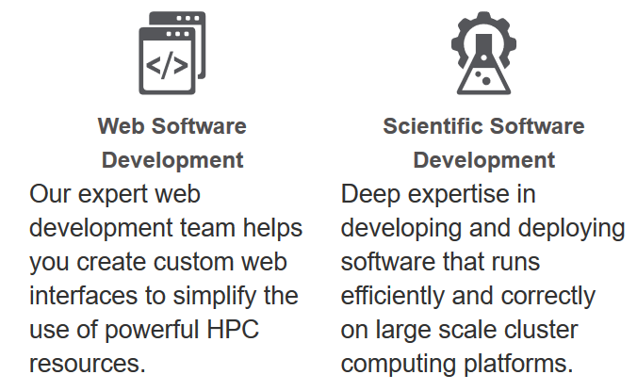
Service Catalog

Slide 9








Production Capacity
CY2017
221,400,000+ core-hours consumed
78% average HPC system utilization
4,400,000+ computational jobs
98% up-time
44% average storage system utilization
1.5 PB
data stored
2 PB data transferred
79% jobs started within one hour

Slide 10
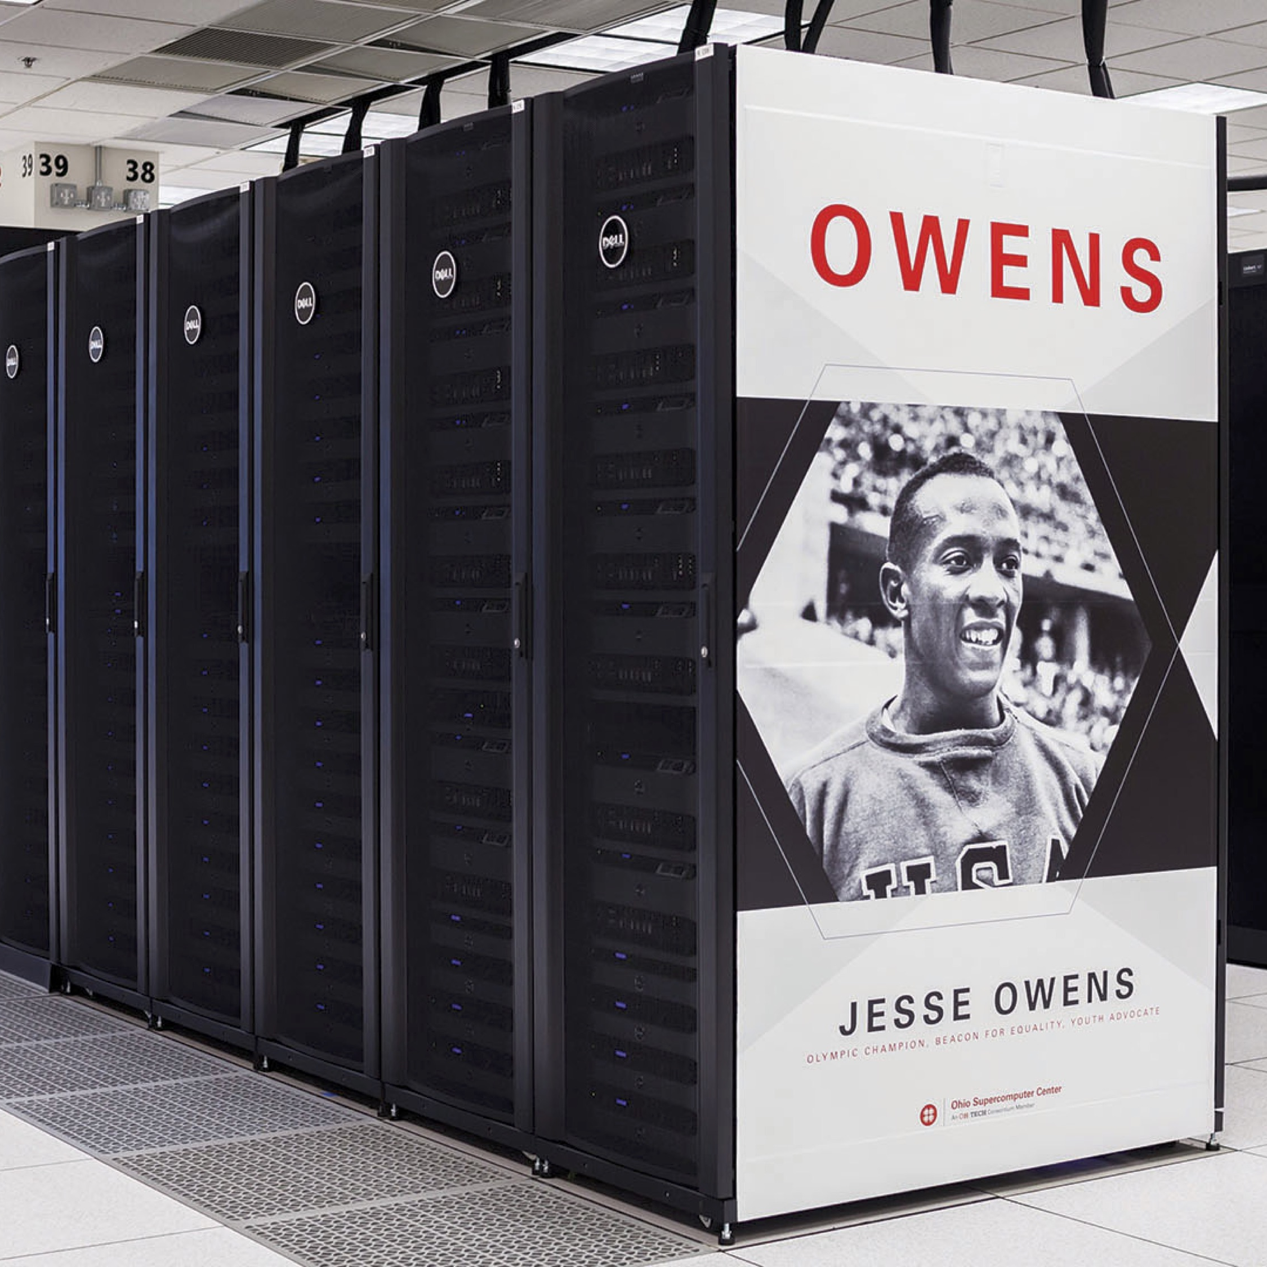
Hardware Overview
“To err is human, but to really foul things up you need a computer.” – Paul Ehrlich

Slide 11
System Status (2019)
SYSTEMS | Ruby | Owens | Pitzer
Date | 2014 | 2016 | 2018
Cost | $1.5 million | $7 million | $3.35 million
Theoretical Perf. | ~144 TF | ~1600 TF | ~1300 TF
Nodes | 240 | 824 | 260
CPU Cores | 4800 | 23392 | 10560
RAM | ~15.3 TB | ~120 TB | ~ 70.6 TB
GPUs | 20 NVIDIA Tesla K40 | 160 NVIDIA Pascal P100 | 64 NVIDIA Volta V100
 | Total compute: ~3,044 TF
STORAGE | Home | Project | Scratch | Tape Library
Capacity | 0.8 PB | 3.4 PB | 1.1 PB | 7+ PB
Current utilization Feb, 18 | 47% | 48% | 59% | 47%

Slide 12
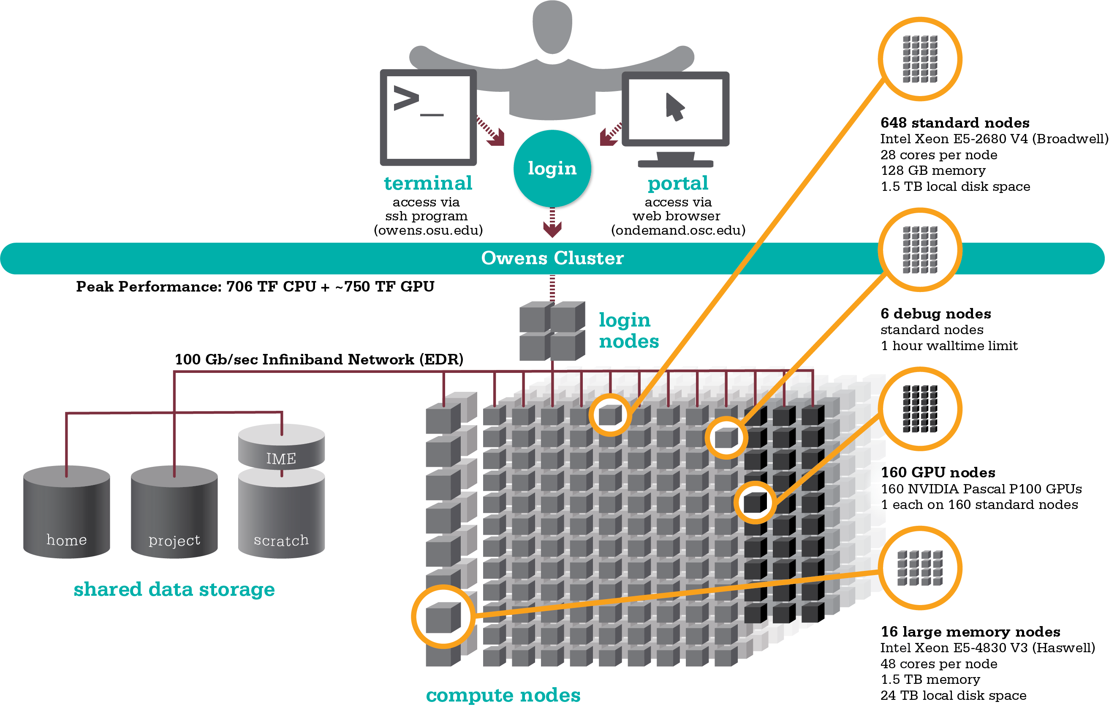
Owens Cluster Specifications

Slide 13
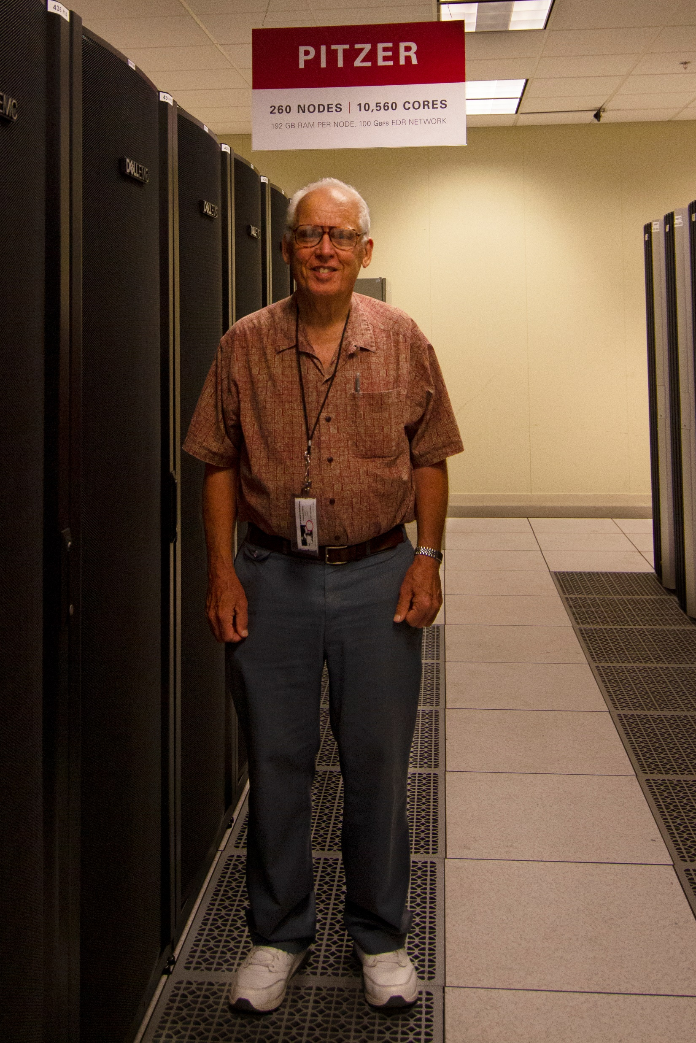
New HPC Cluster “Pitzer”
  Named after Russell M. Pitzer
    Emeritus professor of chemistry at The Ohio State University
    Instrumental in founding both OSC and OARnet
  Goals
    Complement existing systems
    Replace Oakley with a petaflop class system
  Timeline
    System delivery August 15, 2018
    Full production November 2018
    Oakley decommissioning Dec 2018

Slide 14
Pitzer Cluster
Characteristics relative to Oakley
  Delivers 8x the processing power (1,300 vs 154 TF)
  Costs 15% less ($4M vs $3.35M)
  Provides 25% more cores (10,560 vs 8,304)
  Has 2X the memory (70.6Tb vs 33.4TB)
  Uses 20% less power
Highlights
  10,560 processor cores, ~1.3 petaflop peak
  Latest generation: SkyLake processors, 100Gb InfiniBand
  Warm water cooling supports high density, increased performance and efficiency
3 Types of Resources and Example Workload
  Standard compute (224 nodes) / Modeling and simulation for industry
  GPU (32 nodes) / Machine learning, artificial intelligence (AI)
  Large memory (4 nodes) / Genomics Sequence Assembly

Slide 15
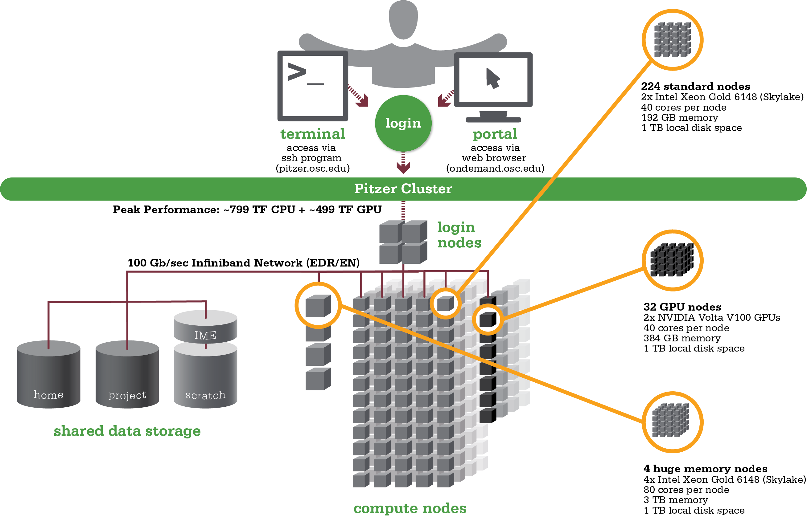
Pitzer Cluster Specifications

Slide 16
Data Storage Systems
”War is ninety percent information.” – Napoleon Bonaparte

Slide 17
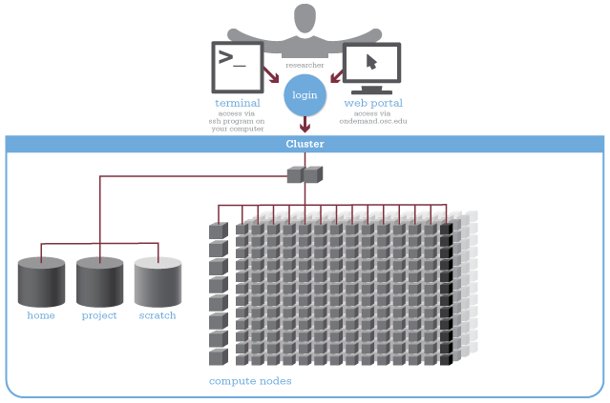
Four different file systems

Slide 18
Filesystem Overview
Home
  Store files for individual users
  Backed up daily
Project
  Large scale persistent storage
  Available to Project PIs by request
  Shared by all users on a project, backed up daily
Scratch
  Store large input or output files for HPC simulation or analysis
  Faster I/O than Home or Project
  Temporary storage, not backed up
$TMPDIR
  Storage on compute nodes, for use during a job
  Results must be copied to another location
  All data purged when job quits

Slide 19
Software Overview
“It works on my machine.” – unknown

Slide 20
Software Resources and Use
Software installed and maintained for users
  ~145 software packages overall, see https://www.osc.edu/resources/available_software
  Simulations, data analysis tools, numerical libraries, software development tools
  Support for containers (via singularity) on Pitzer and Owens
Mix of ISV, free and open source packages
  19 purchased software packages currently supported
  More than $90K spent on license renewals/maintenance in 2018

Slide 21
Overview – software development tools
Compilers: Intel, gnu, PGI
MPI: MVAPICH, IntelMPI, OpenMPI
OpenMP: supported by Intel, gnu and PGI compilers
GPU: latest CUDA, OpenACC (PGI compilers)
Performance and debug tools: Arm, Intel and opensource tools
Containers: singularity to run docker containers, with support for GPU

Slide 22
If OSC doesn’t have the software you need?
List of applications can be found at Software page:
http://www.osc.edu/supercomputing/software/
Commercial/Licensed software
  Fill out a request form (see our FAQ)
  SUG will consider it
Open-source software
  You can install it yourself in your home directory
  If there’s enough demand, we can install it for shared use
Have your own license?
  Contact OSC Help

Slide 23

Upcoming Services
“In God we trust. All others must bring data.” – W. Edwards Deming

Slide 24
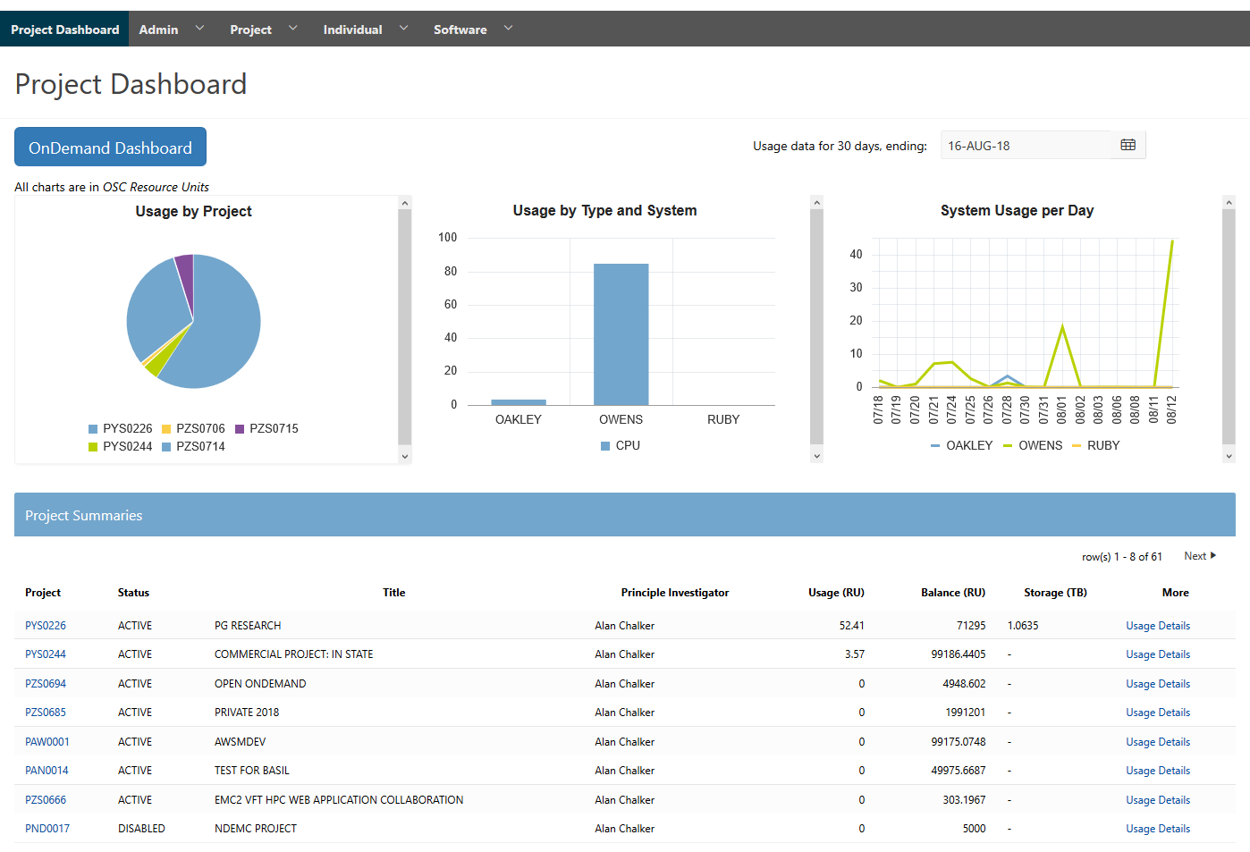
Client Portal Project
Replacement for my.osc.edu
  Friendly user testing started on August 17
  Scheduled go-live for all clients on October 23
New reports.osc.edu
  Provides OSC staff with robust client usage and billing reporting capabilities

Slide 25
Data Focused Projects
Protected Data Environment
  Unique resource supporting HIPAA, ITAR, or other sensitive data sets
  Initial requirements gathering (OSU Wexner Medical Center, Nationwide Children’s Hospital)
    Provide standard OSC environment with security assurances, assistance with data management plans
    Collect requirements for different services for new communities
Research Data Archive
  Simplify data management plans for sponsored research
  Provide publishing and other abstraction capabilities
  Additional off-site copy of data for resiliency/availability
Project file system expansion
  Increase space for metadata, 2-3B files/directories (1B today)
  Slower tier of storage for infrequently accessed files

Slide 26
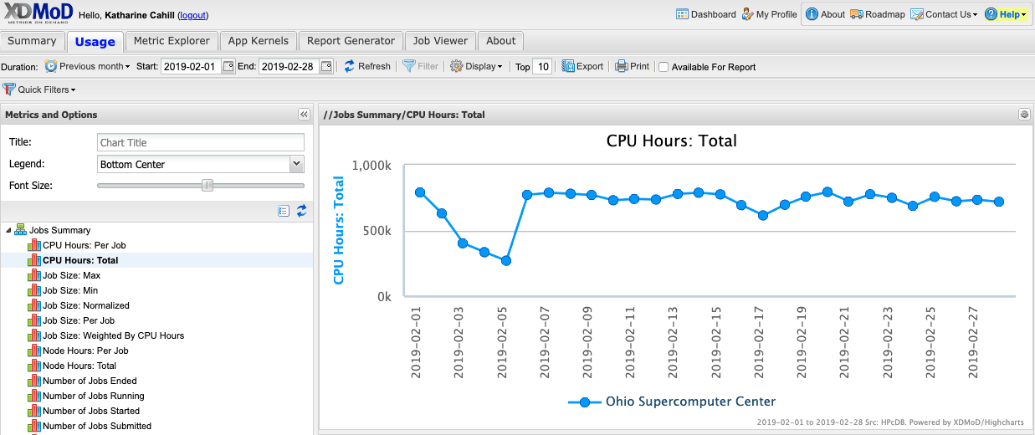
xdmod.osc.edu
Report tool for job activity
  Information and tutorials: https://www.osc.edu/supercomputing/knowledge-base/xdmod_tool

Slide 27
Other Capital Projects
Production infrastructure refresh
  “C20” HPC cluster (replaces the Ruby cluster)
  Storage upgrades
    Additional fast tier storage
    Other performance/capacity upgrades
    Tape media capacity expansion
  Hardware to support protected data environment and research data archive
    May include “Cloud” resources
  Other EOL hardware

Slide 28
HPC Usage and Case Studies
“The difference between us and a computer is that, the computer is blindingly stupid, but it is capable of being stupid many, many million times a second.” – Douglas Adams

Slide 29








Client Services
CY2017
23 academic institutions
48 companies
2,202 clients
256 awards made
23 training opportunities
461 trainees
604 projects served
33 courses
used OSC

Slide 30
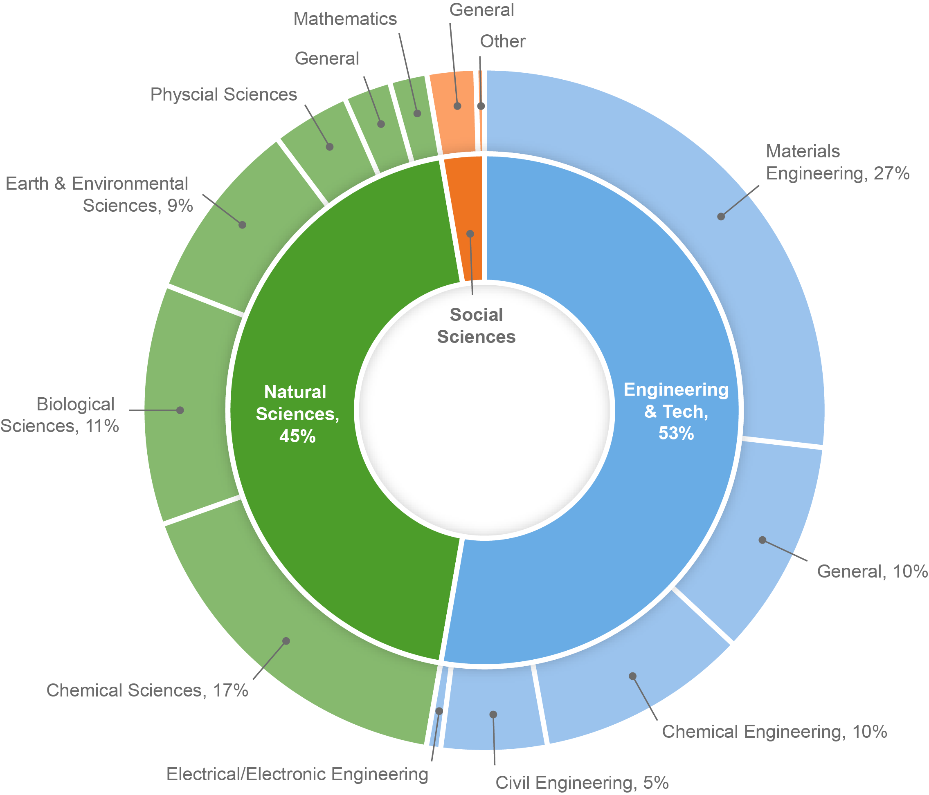
Usage by Field of Science
CY2017

Slide 31
Academic Course Enrollment
CY2017
Department
Bluffton Mathematics | 9
OU Chemical & Biomolecular Engineering | 10
OU Chemistry & Biochemistry | 2
OSU Materials Science & Engineering | 39
OSU Chemical & Biomolecular Engineering | 19
OSU Materials Science & Engineering | 16
OSU Materials Science & Engineering | 6
OSU Computer Science & Engineering | 30
OSU Computer Science & Engineering | 21
OSU Evolution, Ecology, & Organismal Biology | 18
OSU Computer Science & Engineering | 3
OSU Evolution, Ecology, & Organismal Biology | 12
OSU Biostatistics | 3
OSU Chemistry & Biochemistry | 28
OSU Computer Science & Engineering | 34
OSU Computer Science & Engineering | 75
OSU Geography | 13
Department
OSU Computer Science & Engineering | 49
OSU Computer Science & Engineering | 5
OSU Chemistry | 400
OSU Chemistry | 14
OSU Chemistry | 10
OSU Chemistry | 129
OSU Chemistry | 105
OSU Chemistry | 10
Akron Mechanical Engineering | 12
UC Electrical Engineering & Computer Systems | 18
UC Physics | 23
UC Electrical Engineering & Computer Systems | 63
UC Electrical Engineering & Computer Systems | 60
UD Electrical & Computer Engineering | 13
UD Electrical & Computer Engineering | 14
Toledo Chemistry | 16
1,279 total students

Slide 32
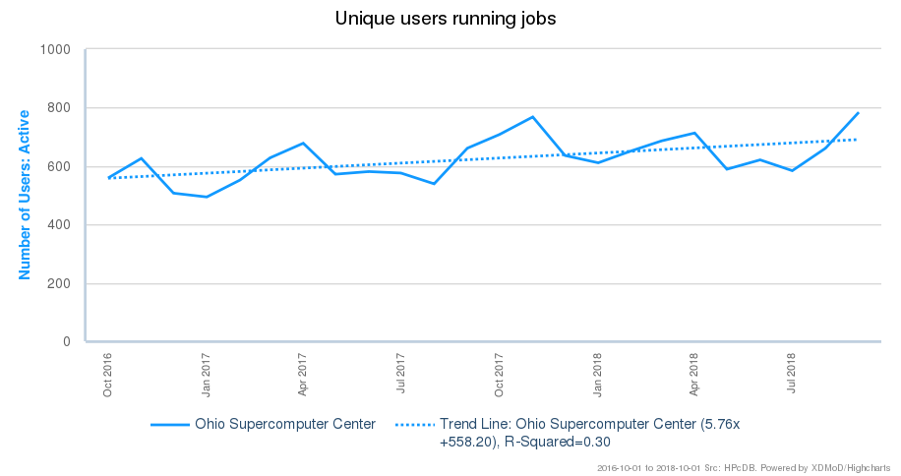
Unique Users

Slide 33
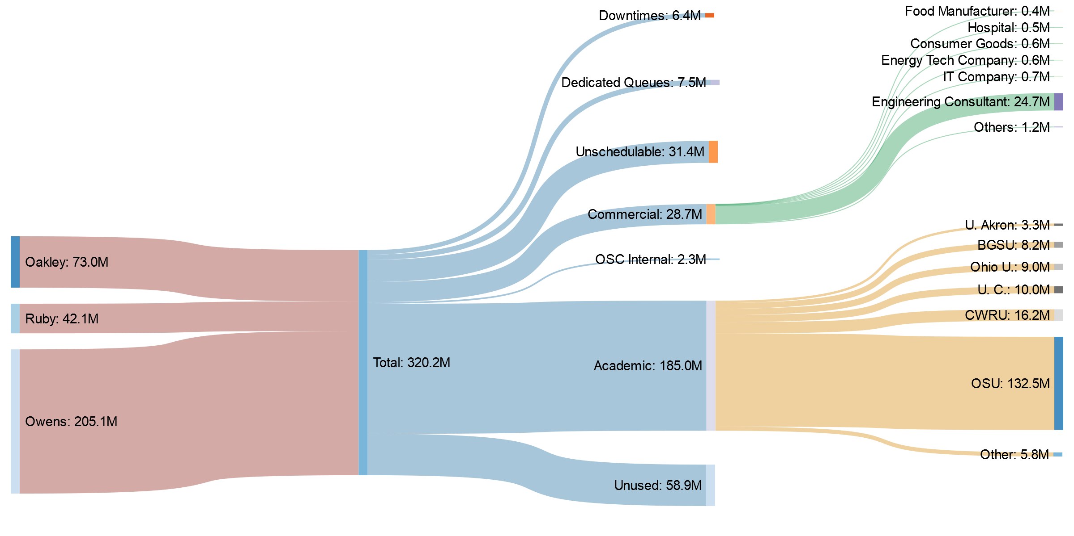
OSC Systems Core Hours
CY2017

Slide 34
Why would HPC be necessary for your work?
Your simulations or analyses take too long on your personal computer
The size of your data is too large to be contained (storage) or accessed (memory) on your computer
You would like to free up your own system to do other tasks
You need particular software for your work

Slide 35
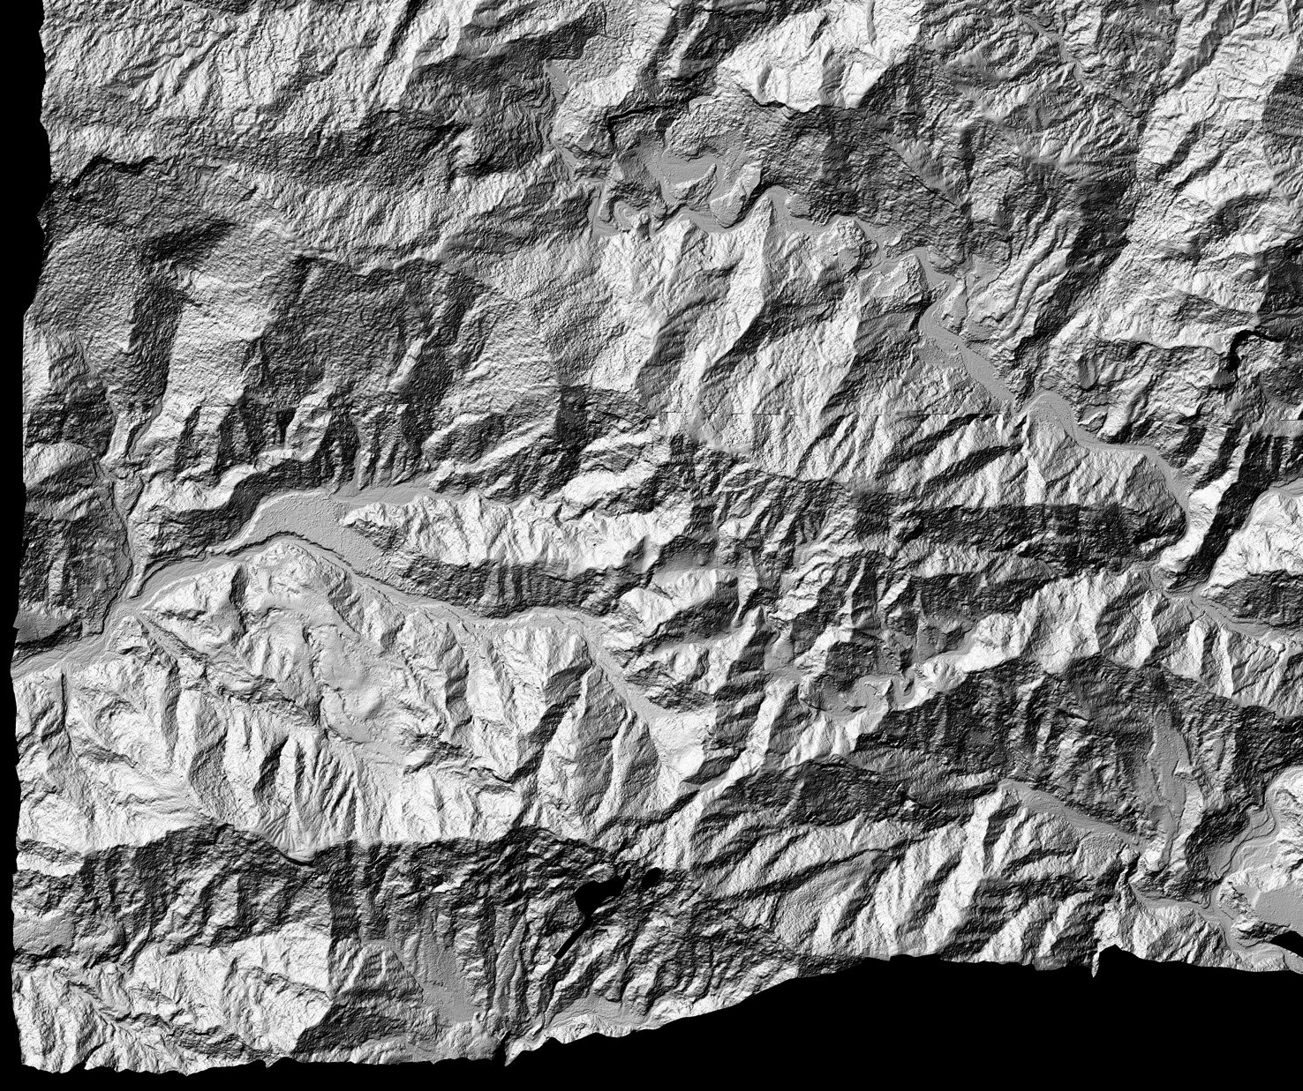
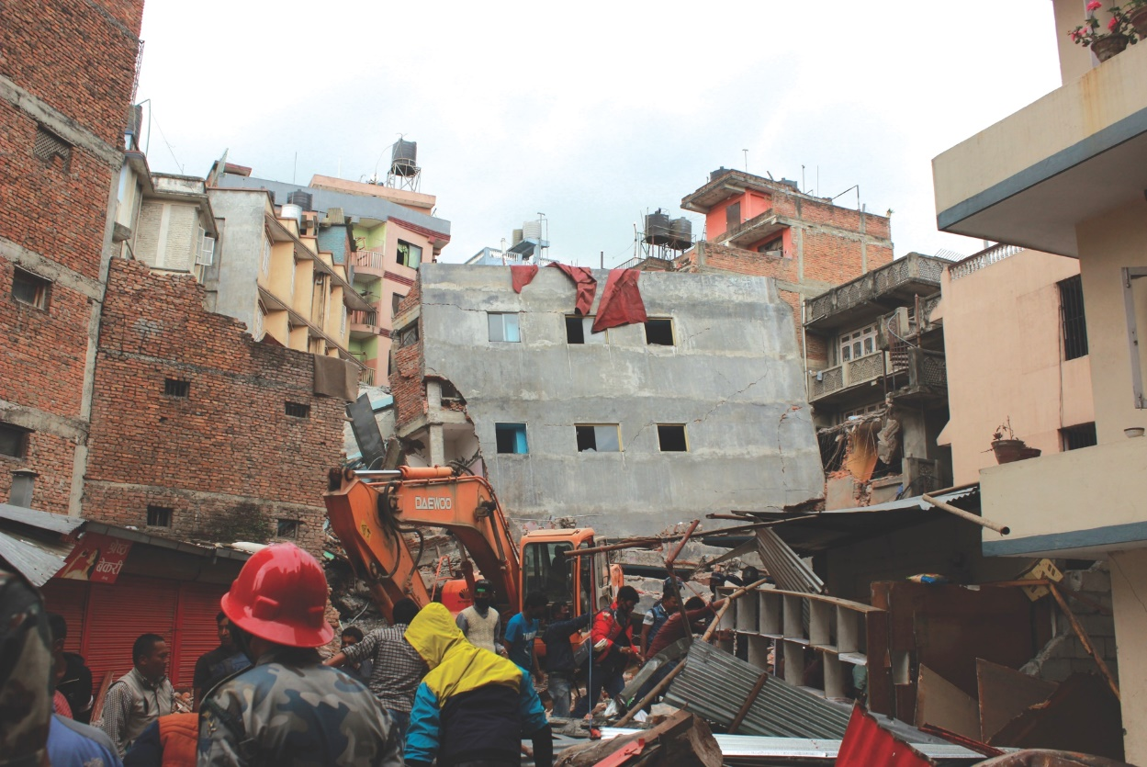
Mapping
Researchers who normally use OSC systems to enhance satellite images of glaciers turned their technology to disaster relief assistance following Nepal’s April 2015 earthquake
PI: Ian Howat, Ohio State University Source: NSF Office of Polar Programs

Slide 36
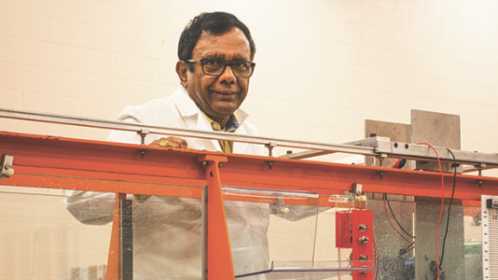

Renewable Energy
Researchers using computational fluid dynamics studies to design new hydropower turbines
PI: Subramania Sritharan, Ph.D., Associate Director for research, Land-Grant Program, Central State University Credit: WKMS

Slide 37
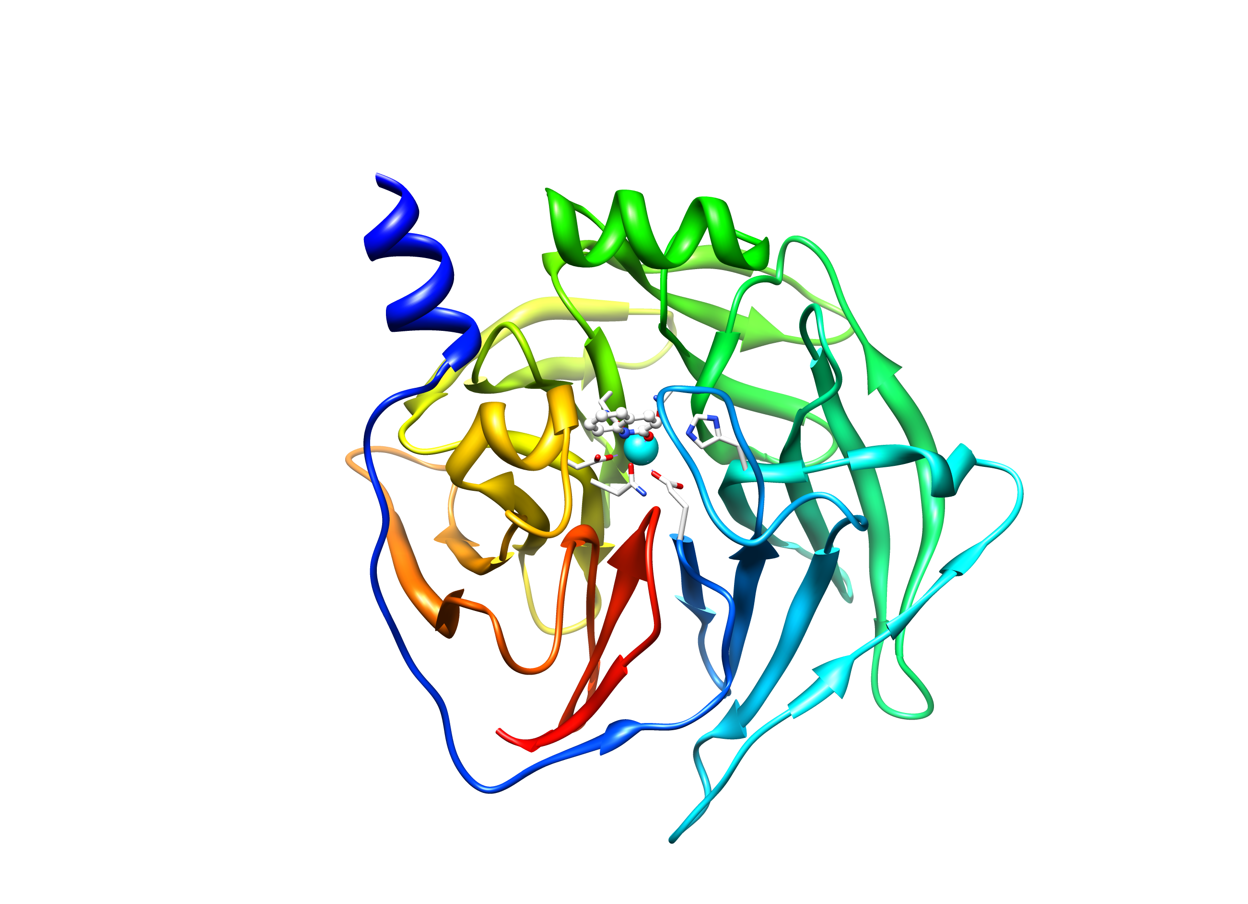
Treating Nerve Agent Exposure
Treating Nerve Agent Exposure
*
*
With the power of OSC computing services, a team studies how to capture and destroy organophosphorus nerve agents using modified proteins.
PI: Christopher Hadad, Ohio State University

Slide 38

Research Partnership
"Alone we can do so little; together we can do so much." – Helen Keller

Slide 39
Research Partnership Opportunities
Letters of commitment - sufficient resources needed for your project
Boilerplate text regarding computing and storage facilities and data retention policy
Quotes for specialized services such as: dedicated computing resources, large amounts of storage, HPC consulting
Expertise in areas such as: scientific software development, web software development and virtual environments by collaborating as co-investigators or senior personnel.
Opportunities for Outreach/Broader Impact activities with OSC’s K12 summer educational programs
Review of proposals for research computing infrastructure or research software development

Slide 40

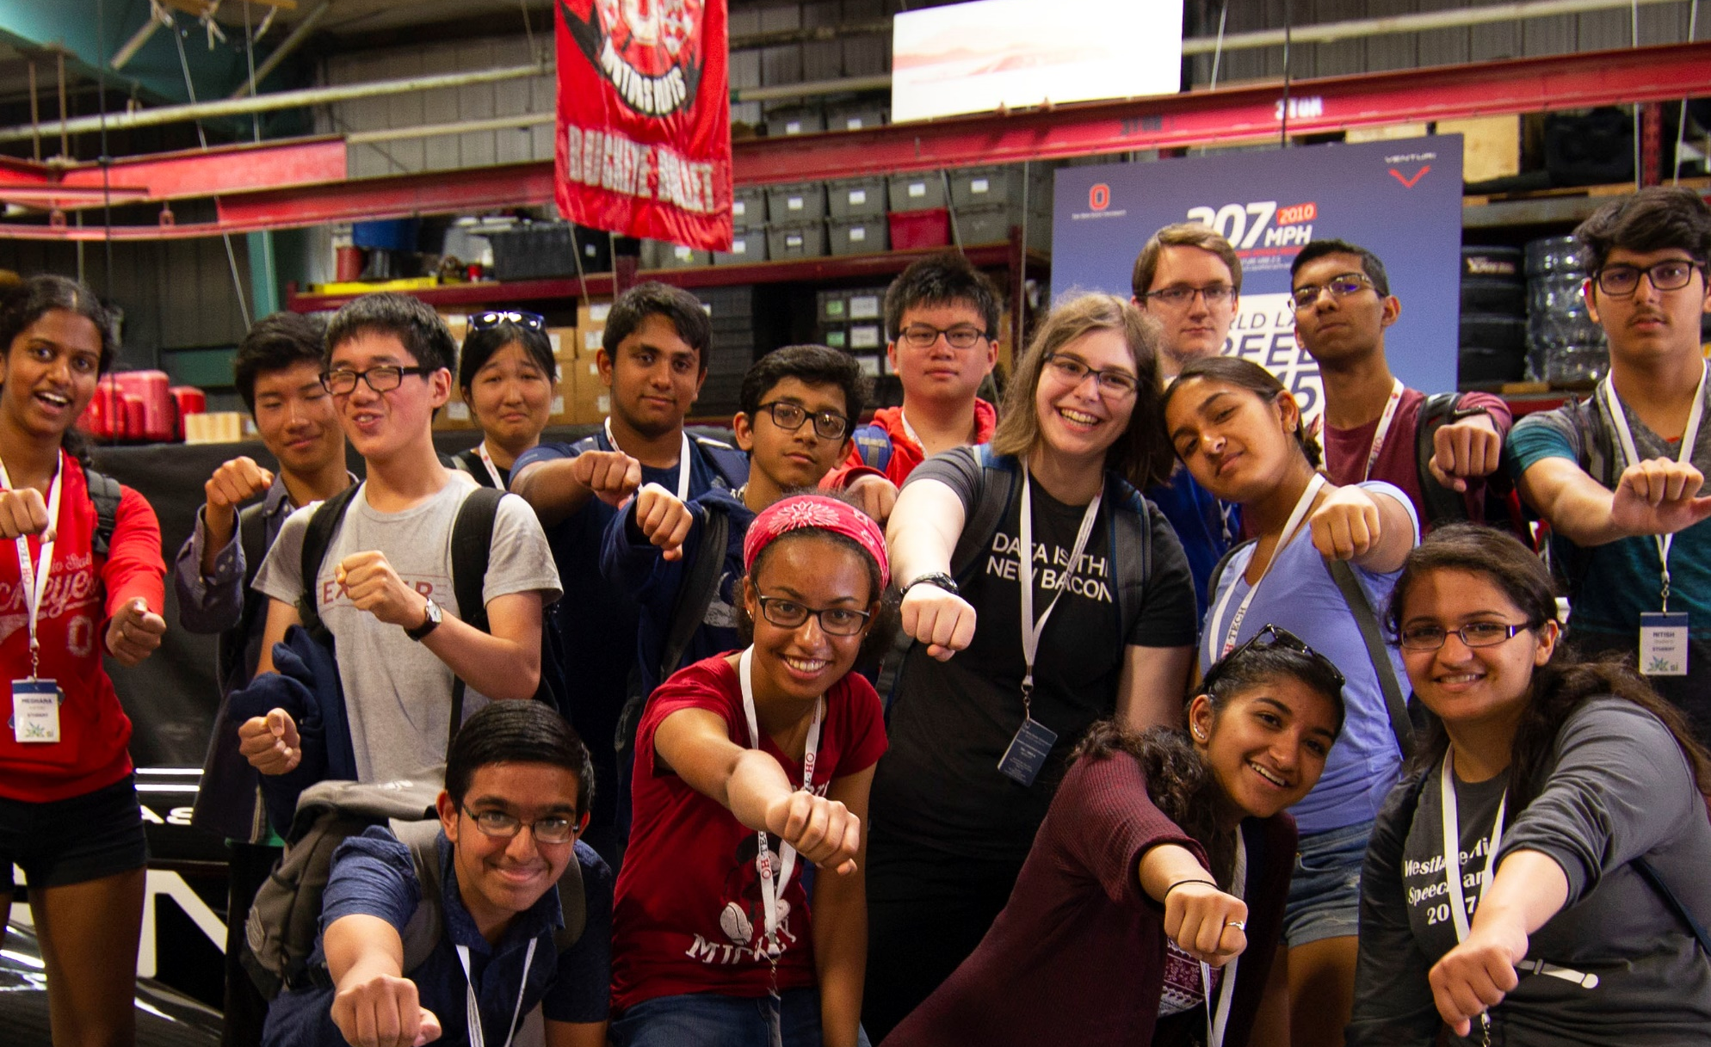

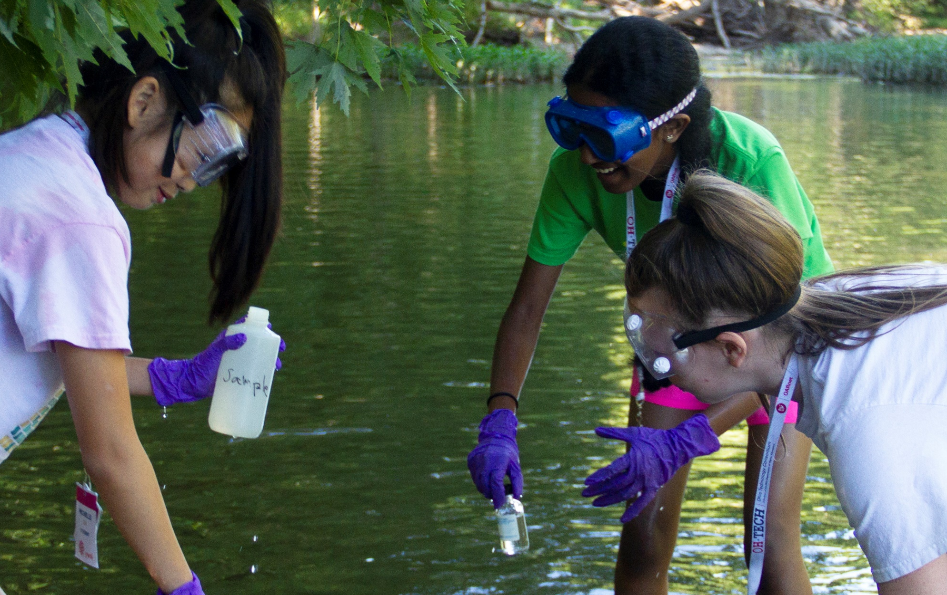
Summer Institute
Two-week residential program for high school students
16-20 participants each year since 1989
Students solve complex problems under mentorship of OSC faculty clients
Young Women’s
Summer Institute
One-week residential program for middle school girls
16 participants each year since 2000
Promotes STEM skills under mentorship of middle school teachers

Slide 41
Getting Started at OSC
“If you were plowing a field, which would you rather use? Two strong oxen or 1024 chickens?” - Seymour Cray

Slide 42
Who can get an OSC project?
Academic project
  Principal investigator (PI) must be a full-time faculty member or research scientist at an Ohio academic institution
  PI may authorize accounts for students, post-docs, collaborators, etc.
  Classroom projects are also available
  No cost** to Ohio academic users
Commercial projects
  Commercial organizations may purchase time on OSC systems
** See slide on Fee Structure Transition

Slide 43
Allocations and Charges
Charges are in terms of resource units
Resource units
  OWENS 1 resource unit (RU) = 10 CPU hours
  RUBY 1 resource unit (RU) = 20 CPU hours
  Pitzer 1 resource unit (RU) = TBD
  CPU hour = walltime x (total # of cores requested)
Project receives an allocation of RUs
Jobs are charged to a project

Slide 44
Requesting a New Project- my.osc.edu
Startup grant
  One per PI per lifetime
  Provide contact info, institution, department
  5000 RUs
Additional allocations for a project
  Submit a proposal for more RUs
    Standard: 10,000
    Major: 30,000
    Discovery: >30,000
  Peer-reviewed
  Grants awarded by Statewide Users Group (SUG)
Classroom accounts

Slide 45
Fee Structure Transition
FY19 Plan details
  FY19 rate of $0.075 / RU for cycles > 10K RUs per project; no storage charges
  Projected to provide the $1M needed to cover the OSC budget gap
  FY19 MOUs signed by the 6 biggest universities (OSU, BGSU, OU, UA, CWRU, UC: signing in process)
  OSC will be reaching out to other schools (e.g. Cleveland State) that have low expenses projected ($5K or more for the year).
Implementation
  Initial OSC Pricing Committee meeting March 12th, recent meeting on June 1st
  Implementation issues are being worked out, including an updated allocations process, regular institutional usage reporting, and refund policies
  Discussions are beginning with the OSC pricing committee regarding a revised model for FY20 that will likely include other charges / services

Slide 46
Onboarding new users
“After growing wildly for years, the field of computing appears to be reaching its infancy.” – John Pierce

Slide 47
Beyond Command Line Access
OSC OnDemand ondemand.osc.edu
1: User Interface
  Web based
    Usable from computers, tablets, smartphones
    Zero installation
  Single point of entry
    User needs three things
      ondemand.osc.edu
      OSC Username
      OSC Password
    Connected to all resources at OSC
2: Interactive Services
  File Access
  Job Management
  Visualization Apps
    Desktop access
    Single-click apps (RStudio, Jupyter, Matlab, Abaqus, Ansys, Comsol, Paraview)
  Terminal Access
  Tutorial available at
  osc.edu/ondemand

Slide 48
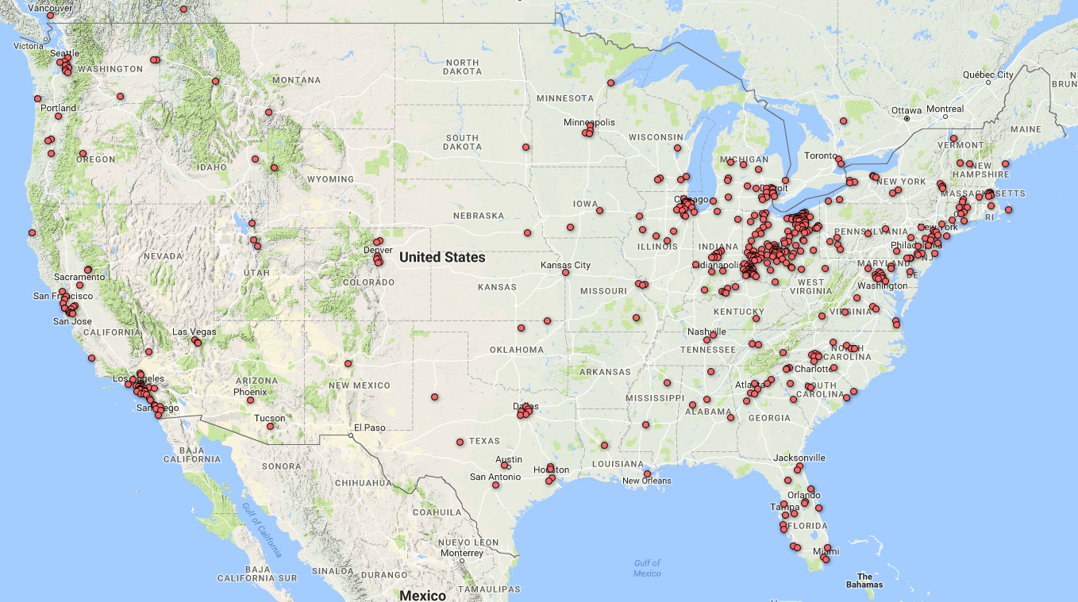
Web-based US Logins
CY2017

Slide 49
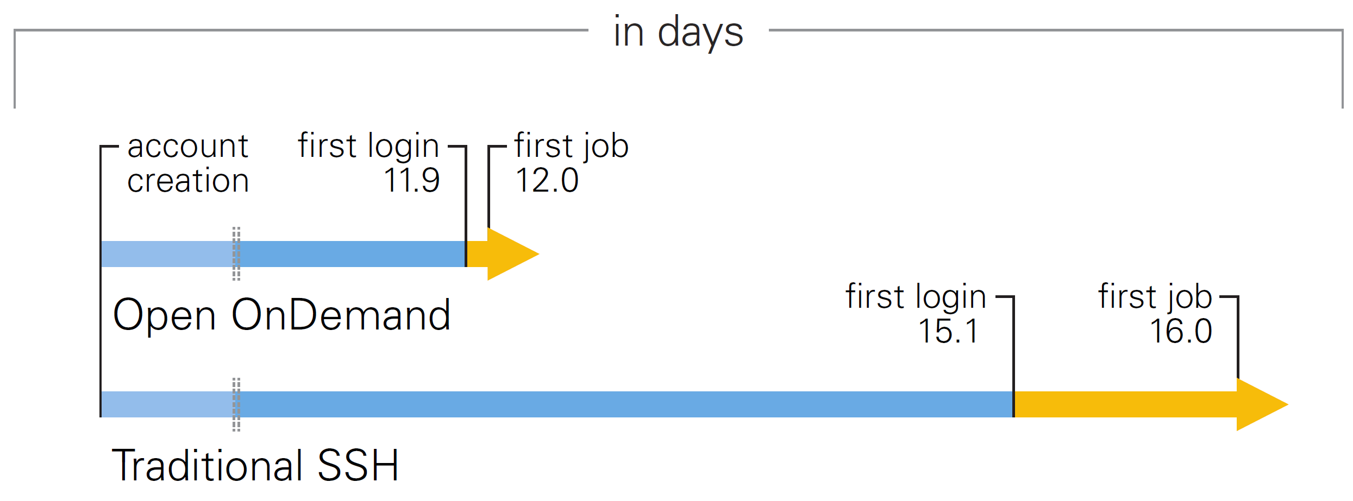
Open OnDemand Project
New OSC OnDemand users start faster than ssh users: first login & job
Open OnDemand currently in use / evaluation at 30+ organizations
Open OnDemand 2.0: NSF CSSI award, Jan’19 – Dec’22, $3.5M

Slide 50
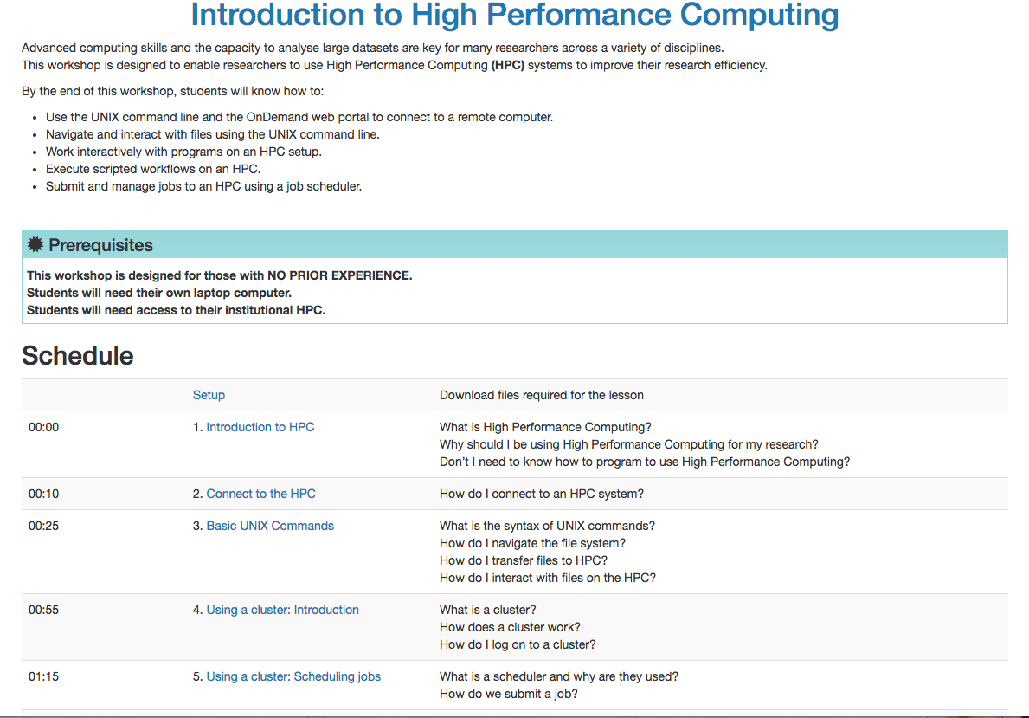
New Intro to OSC materials
https://khill42.github.io/OSC_IntroHPC/
  Highlights OnDemand for OSC access
  Always available training
  Continually being updated and improved
  Based on HPC/Data carpentry materials

Slide 51
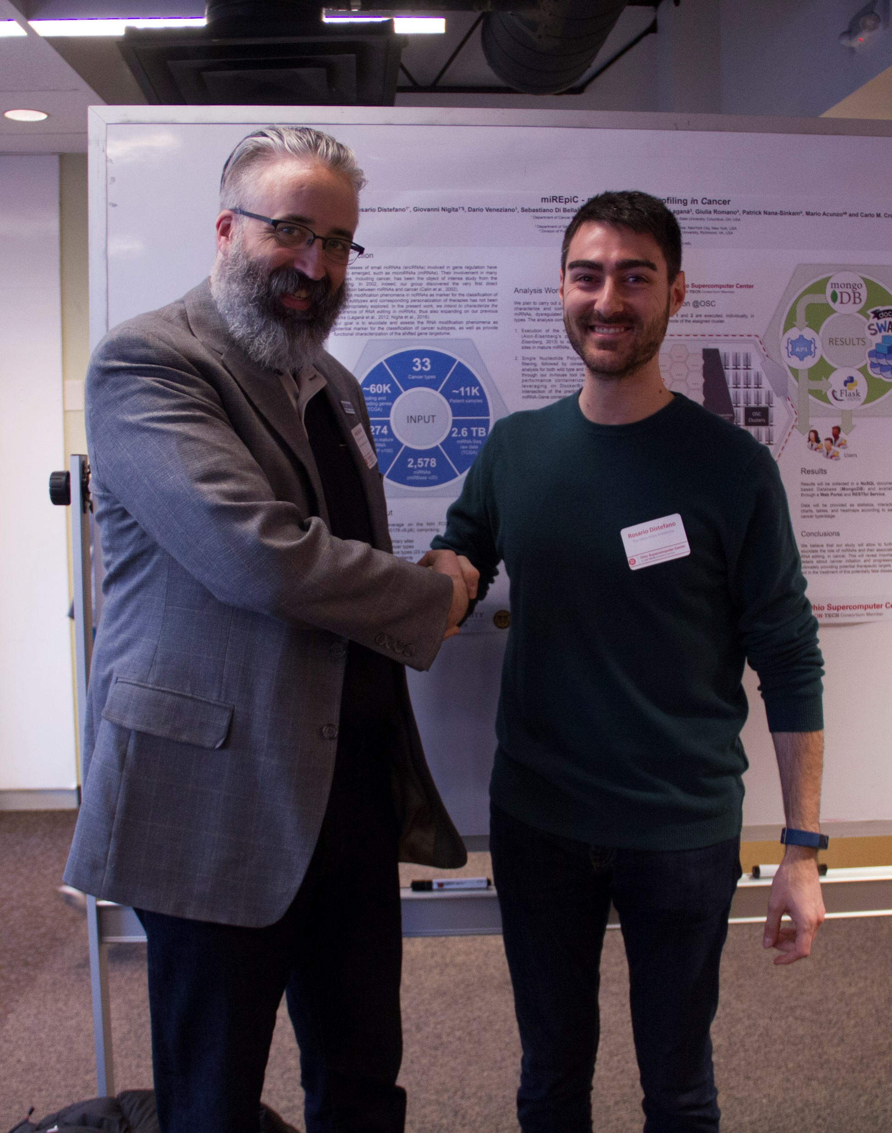
Academic Community Engagement
  Deepen outreach to Ohio universities
  Empowers local support staff to work directly with clients
  Projects created at UC, OSU, Miami, and CWRU

Slide 52
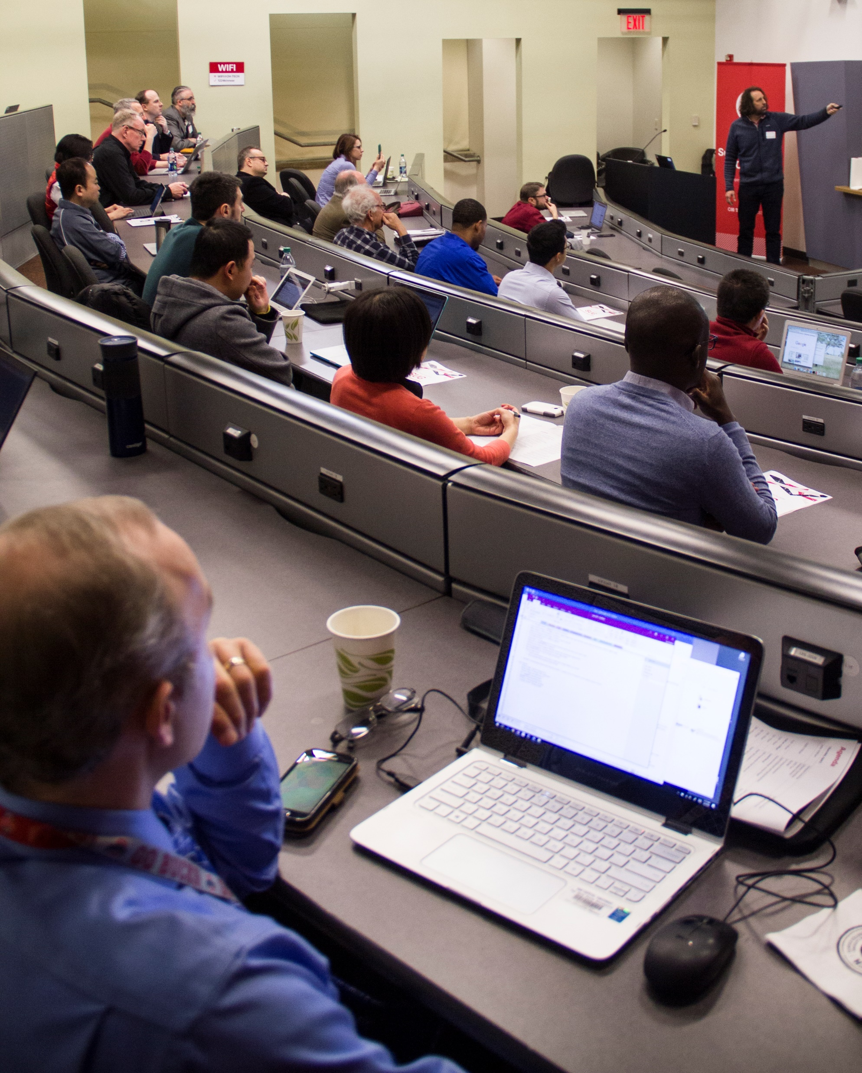
Statewide Users Group (SUG)
The Statewide Users Group (SUG) is made up of OSC users
  Provides program and policy advice to OSC
  Meets twice a year
Standing committees
  Allocations
  Software and Activities
  Hardware and Operations
Get involved!
  Next meeting will be in March/April
Notes:
Image from: https://www.aoc.gov/image-gallery

Slide 53
Get your questions answered
FAQs: https://www.osc.edu/resources/getting_started/supercomputing_faq
HOW TOs: https://www.osc.edu/resources/getting_started/howto
New User Guide: https://www.osc.edu/resources/getting_started/new_user_resource_guide
Updated presentations: https://www.osc.edu/~kcahill/NewUser
Office Hours and contacting OSC support staff:
go.osu.edu/rc-osc Tuesdays 1-3 p.m. or Weekdays 4-5 p.m. at OSU Pomerene Hall
Email help: oschelp@osc.edu
System updates
  Read Message of the Day on login
  Follow @HPCNotices on Twitter

Slide 54

info@osc.edu
twitter.com/osc
facebook.com/ohiosupercomputercenter
osc.edu
oh-tech.org/blog
linkedin.com/company/ohio-supercomputer-center

