Slide 1
Running Parallel R jobs at OSC
Shameema Oottikkal
Data Application Engineer
Ohio Supercomputer Center
email:soottikkal@osc.edu
09/09/2020
OSC workshop

Slide 2
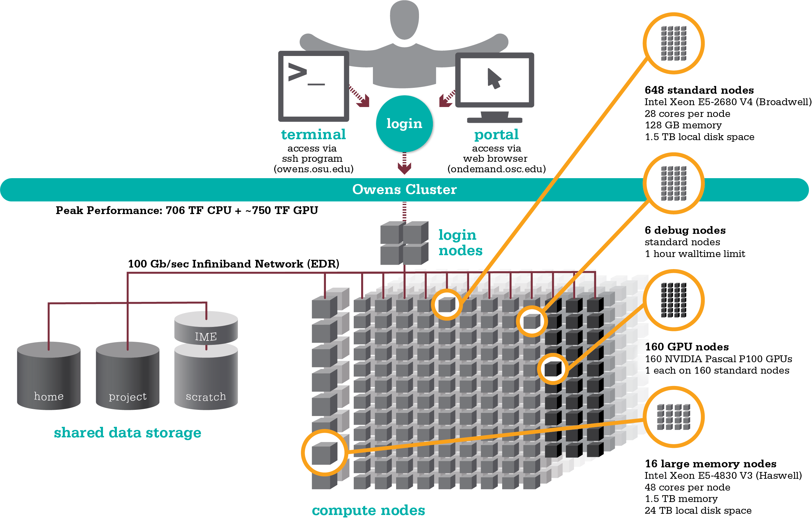
Data Analytical nodes@OSC
Owens’ data analytics environment is comprised of 16 nodes, each with 48 CPU cores, 1.5TB of RAM and 24TB of local disk.
$HOME:
500GB/per user
Backed up daily
Permanent storage
Local disk:$TMPDIR
1.5TB or 24TB
Not backed up
Temporary storage
/fs/scratch:
1200TB
Not backed up
Temporary storage
/fs/project:
Upon request
1-5TB
Backed up daily
1-3 years

Slide 3
https://my.osc.edu/

Slide 4
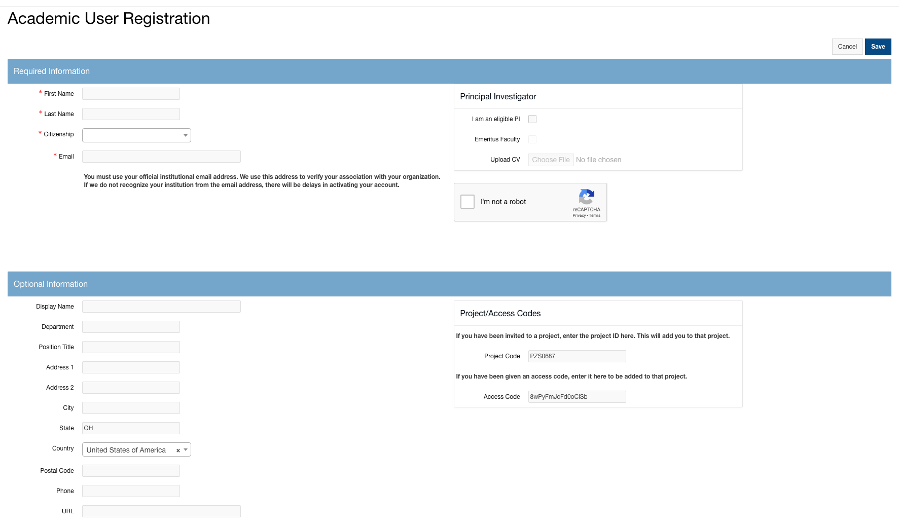
New Users
Project code:PZS0687
Access code: 712897

Slide 5
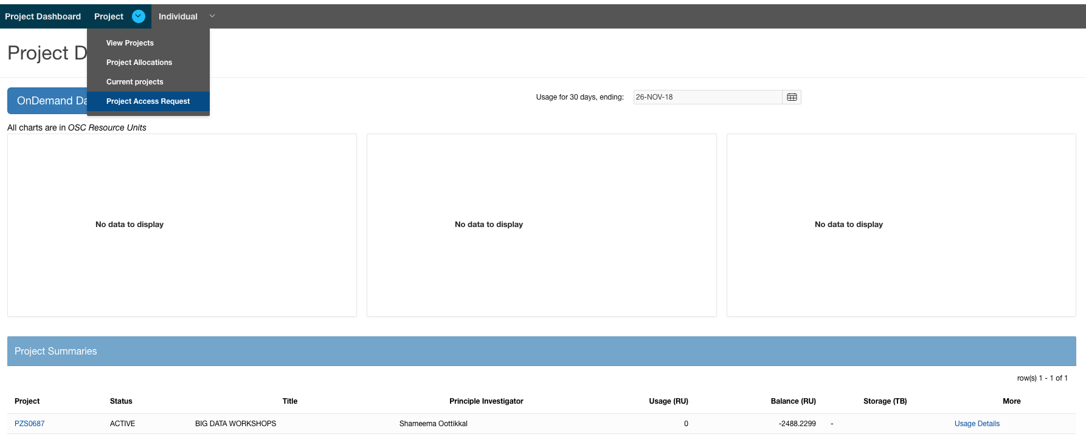
Existing Users

Slide 6
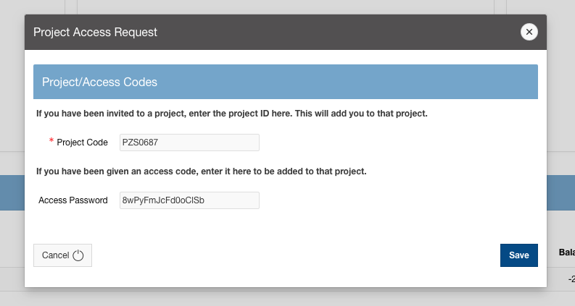
Existing Users
Project code:PZS0687
Access code: 712897

Slide 7
Exercise-1​ ​ Login to https://my.osc.edu

Slide 8
OSC OnDemand ondemand.osc.edu
1: User Interface
Web based
Usable from computers, tablets, smartphones
Zero installation
Single point of entry
User needs three things
ondemand.osc.edu
OSC Username
OSC Password
Connected to all resources at OSC
2: Interactive Services
File Access
Job Management
Visualization Apps
Desktop access
Single-click apps (Abaqus, Ansys, Comsol, Paraview)
Terminal Access
Tutorial available at
osc.edu/ondemand
Notes:
OnDemand revamp coming including app support for HPC workflows

Slide 9
Go to https://ondemand.osc.edu/

Slide 10
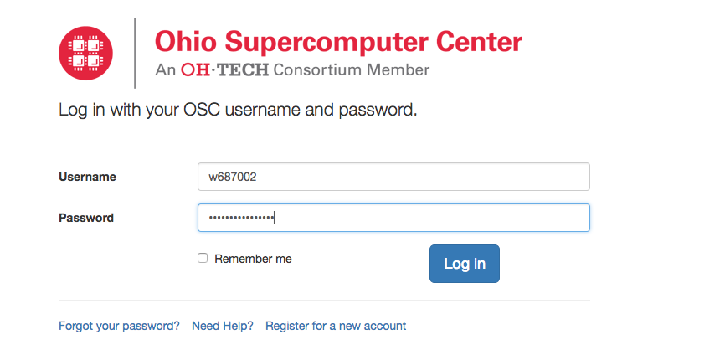

Slide 11
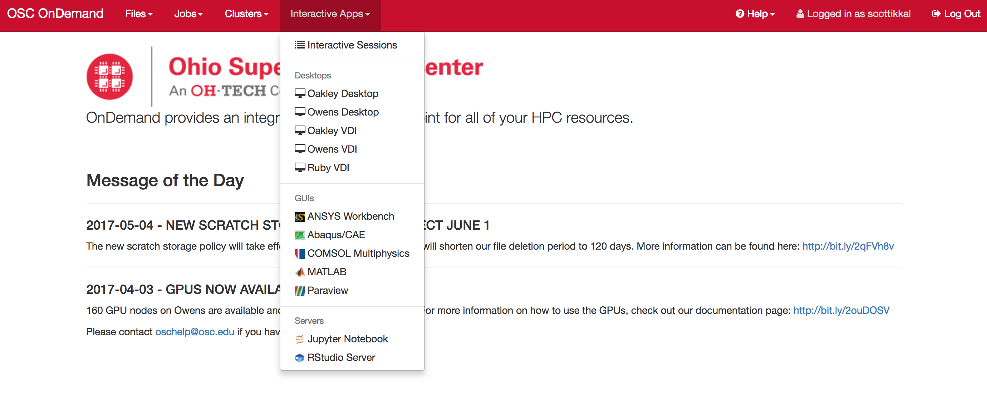

Slide 12
Exercise-2 Login to https://ondemand.osc.edu

Slide 13
Data Analytics@OSC
Python: A popular general-purpose, high-level programming language with numerous mathematical and scientific packages available for data analytics.
R: A programming language for statistical and machine learning applications with very strong graphical capabilities.
MATLAB:A full featured data analysis toolkit with many advanced algorithms readily available.
Spark and Hadoop: Frameworks for running map reduce algorithms
Intel Compilers: Compilers for generating optimized code for Intel CPUs.
Intel MKL: The Math Kernel Library provides optimized subroutines for common computation tasks such as matrix-matrix calculations.
Statistical software: Octave, Stata, FFTW, ScaLAPACK, MINPACK, sprng2

Slide 14
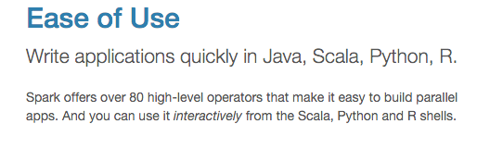
Apache Spark
Apache Spark is an open source cluster computing framework originally developed in the AMPLab at University of California, Berkeley but was later donated to the Apache Software Foundation where it remains today. In contrast to Hadoop's disk-based analytics paradigm, Spark has multi-stage in-memory analytics.

Slide 15
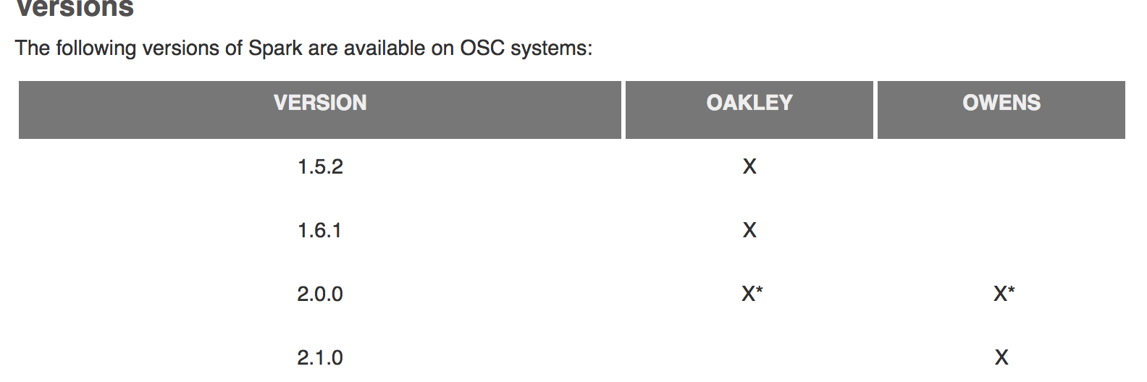
Spark documentation at OSC
https://www.osc.edu/resources/available_software/software_list/spark

Slide 16
Running Spark interactively: Jupyter+Spark App
Go to https://ondemand.osc.edu/

Slide 17
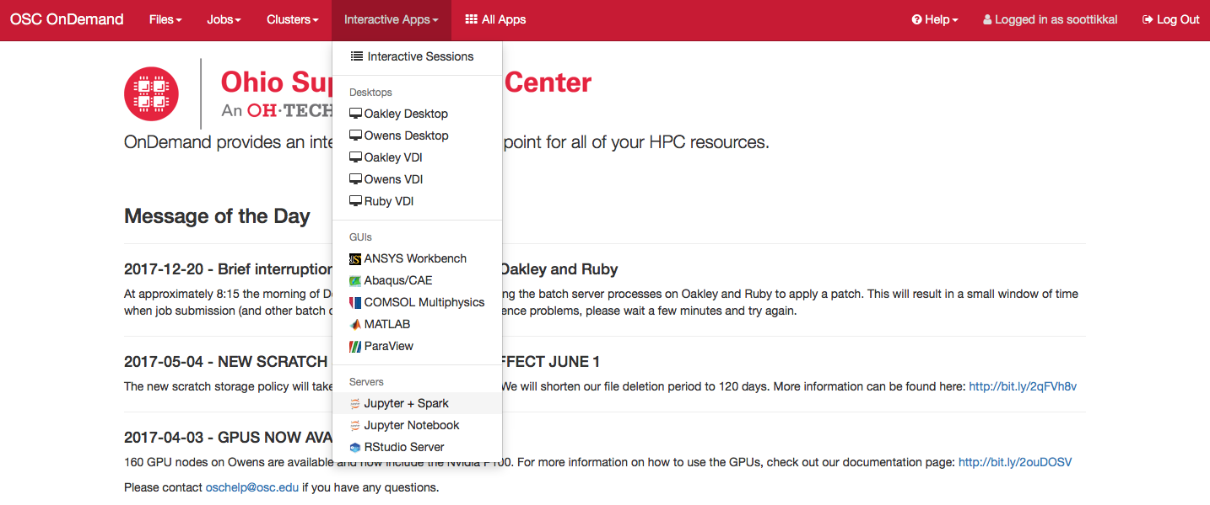
Choose Jupyter+Spark app from the Interactive Apps option.

Slide 18
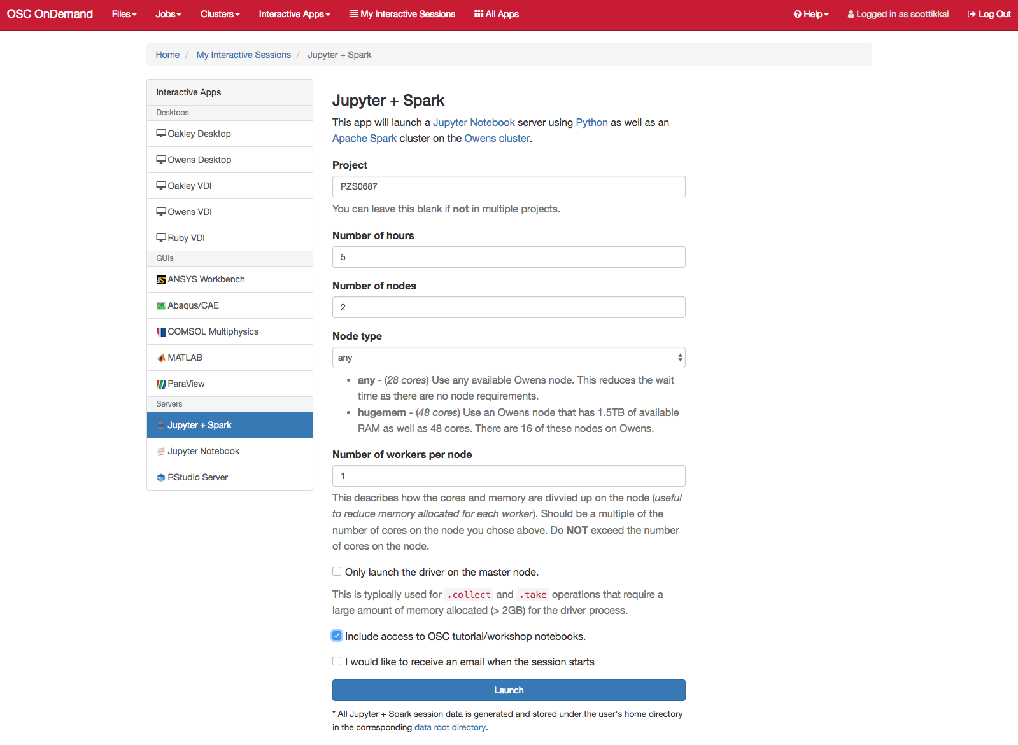

Slide 19
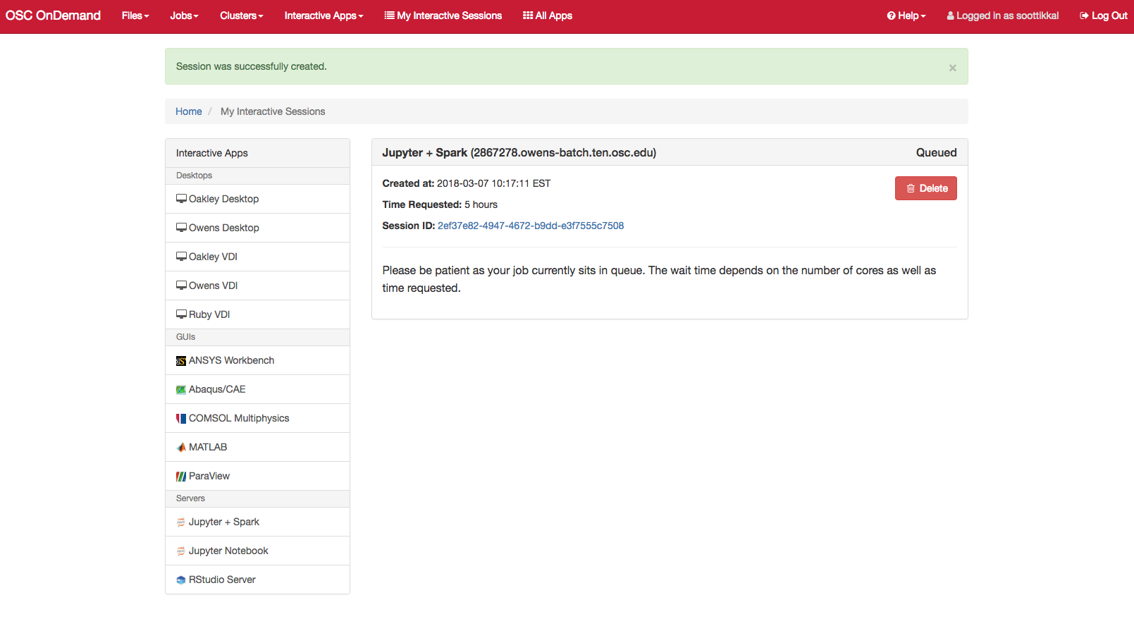

Slide 20
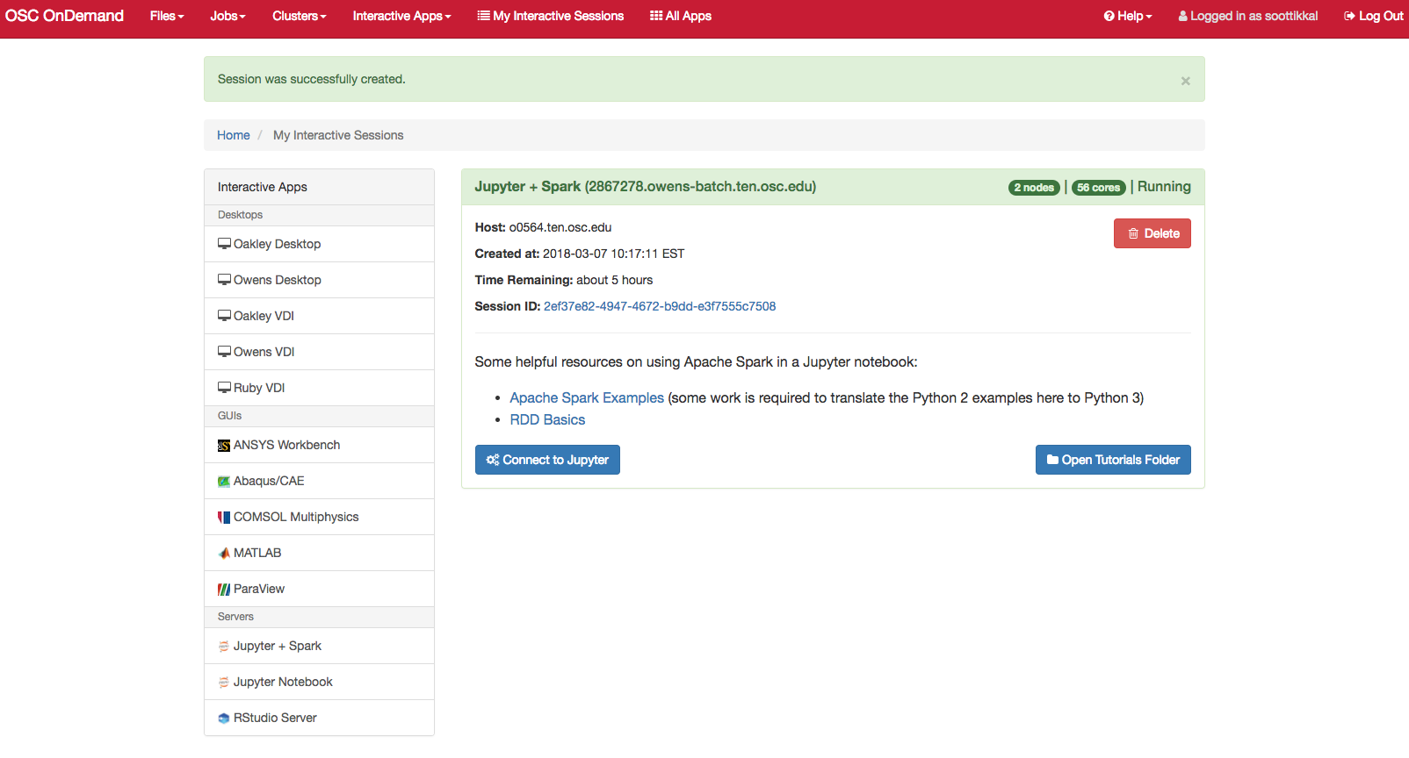

Slide 21
You will see a file called pyspark_tutorials.ipynb. Please check on the file and click on duplicate to make a copy of the file.
You will see a new file pyspark_tutorials-Copy1.ipynb is created. Double-click on the pyspark_tutorials-Copy1.ipynb file will launch Jupyter interface for Spark to proceed with the tutorials.

Slide 22
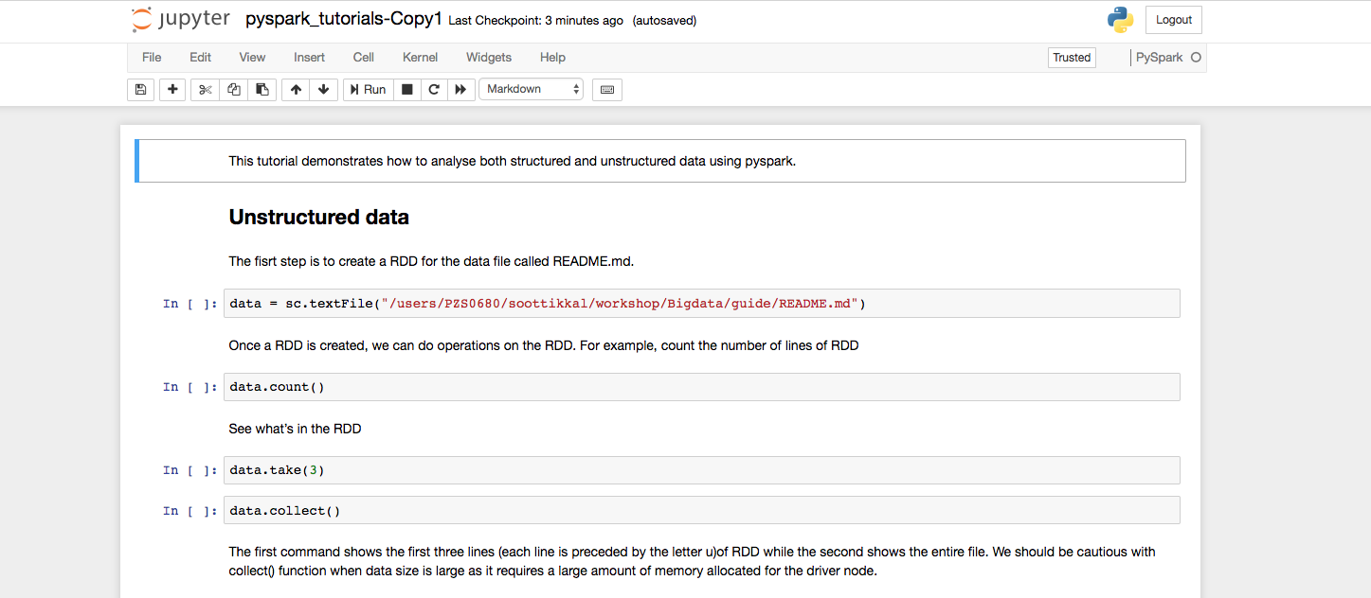

Slide 23
Exercise-3 ​ Launch Jupyter + Spark App

Slide 24
R and Rstudio
R is a language and environment for statistical computing and graphics. R provides a wide variety of statistical and graphical techniques and is highly extensible.
Availability:
OSC installs and maintains latest versions of R with necessary packages.
User can pick any version of R by loading appropriate module. The R module depend on either gnu or intel compiler.
#R/3.5.2 is compiled using our default intel compiler
module load R/3.5.2
#R/3.6.3 is compiled using gnu
module load R/3.6.3-gnu9.1
#To see all available versions
module avail R

Slide 25
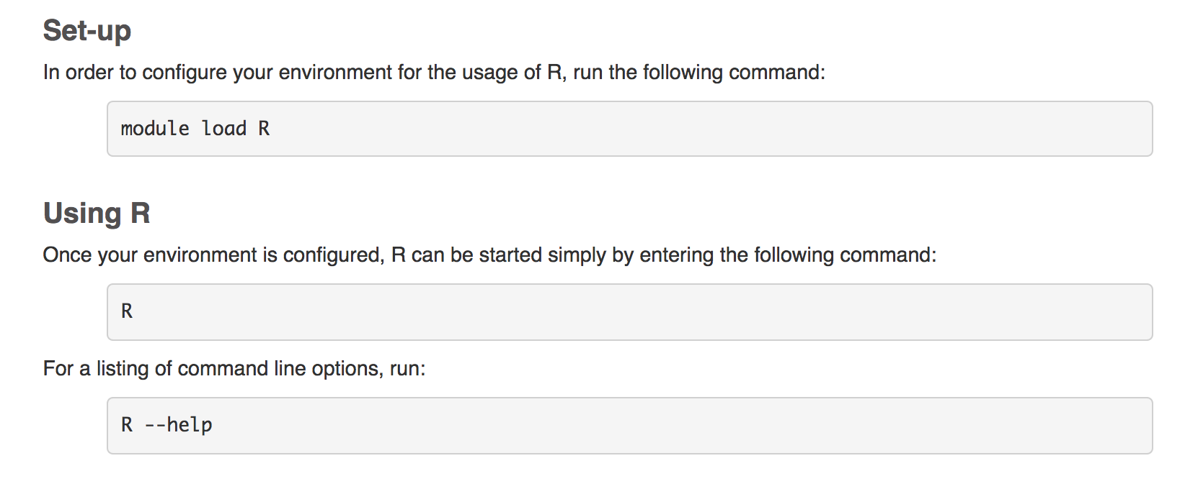
Running R interactively: Terminal access

Slide 26
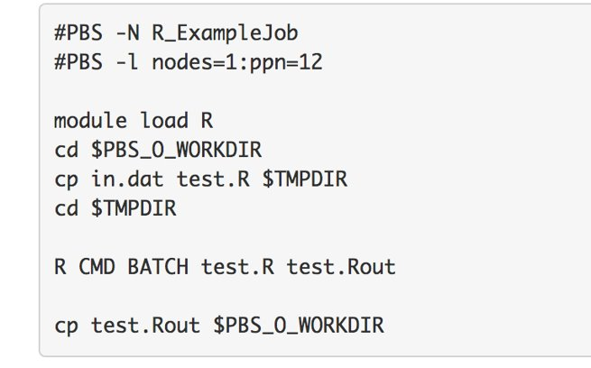
Batch Usage

Slide 27
Rstudio on Ondemand

Slide 28
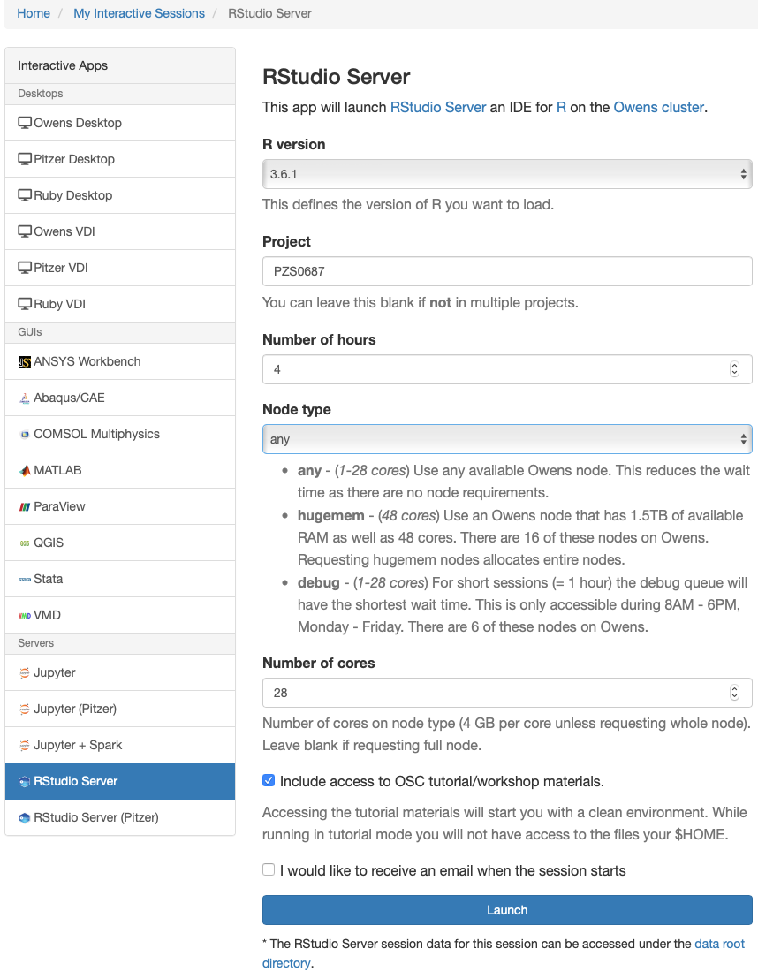

Slide 29
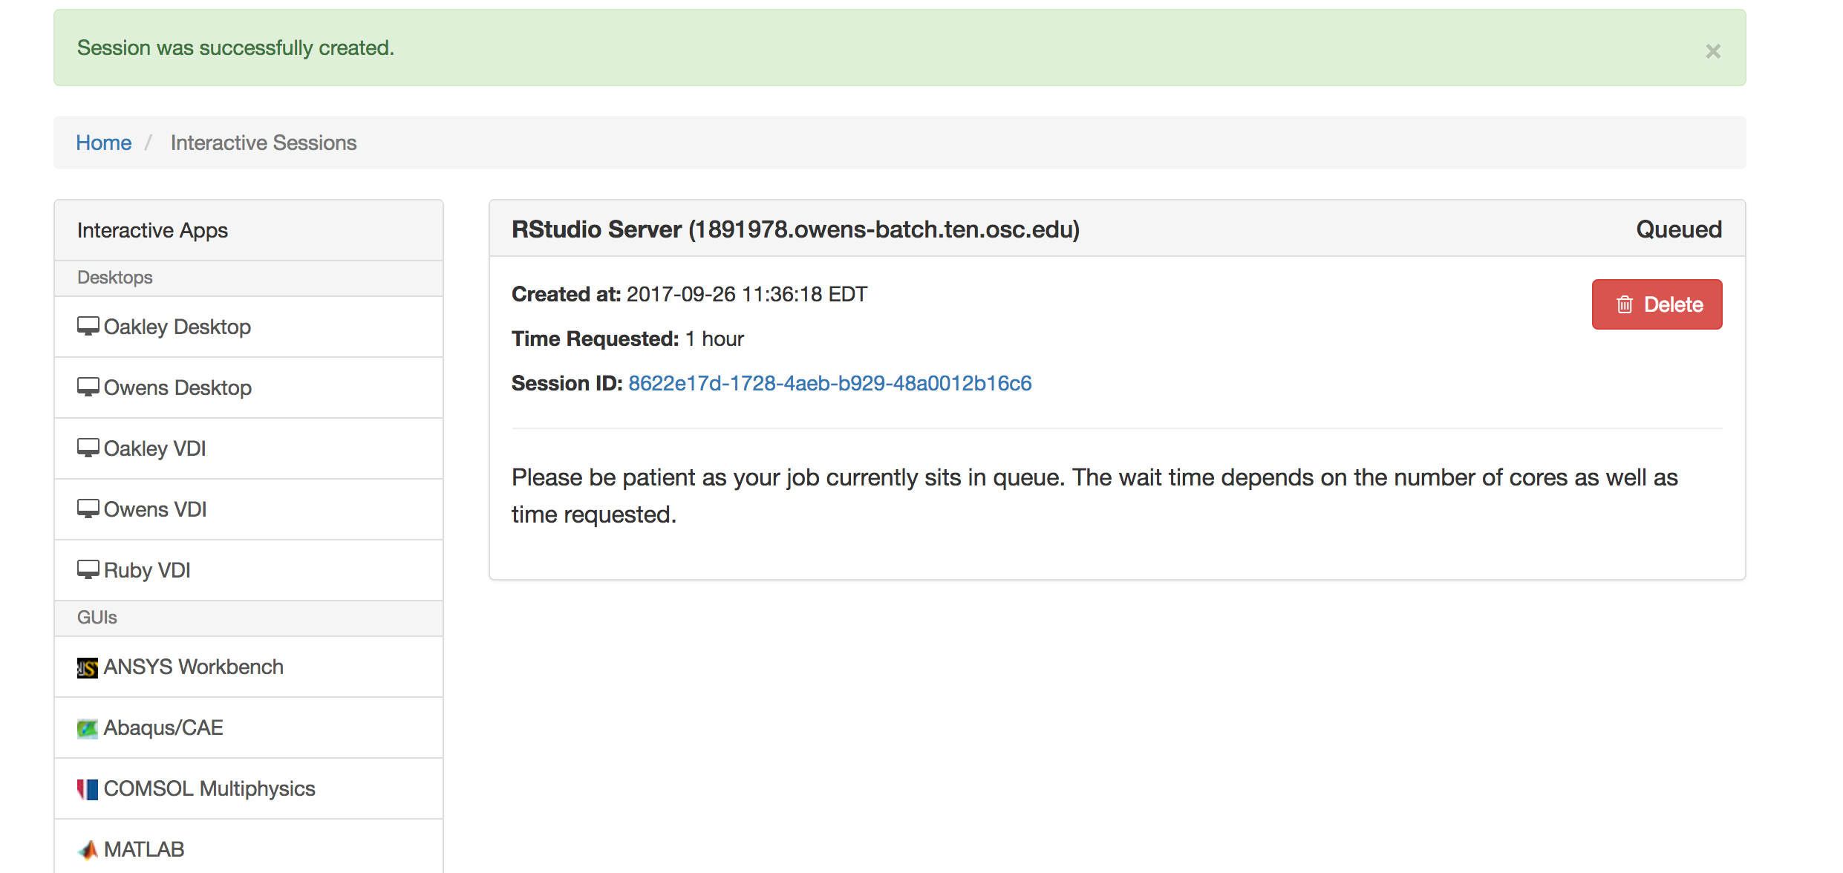
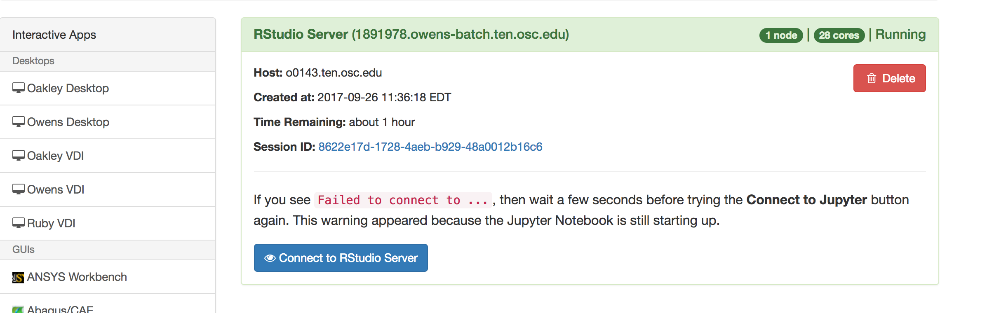

Slide 30
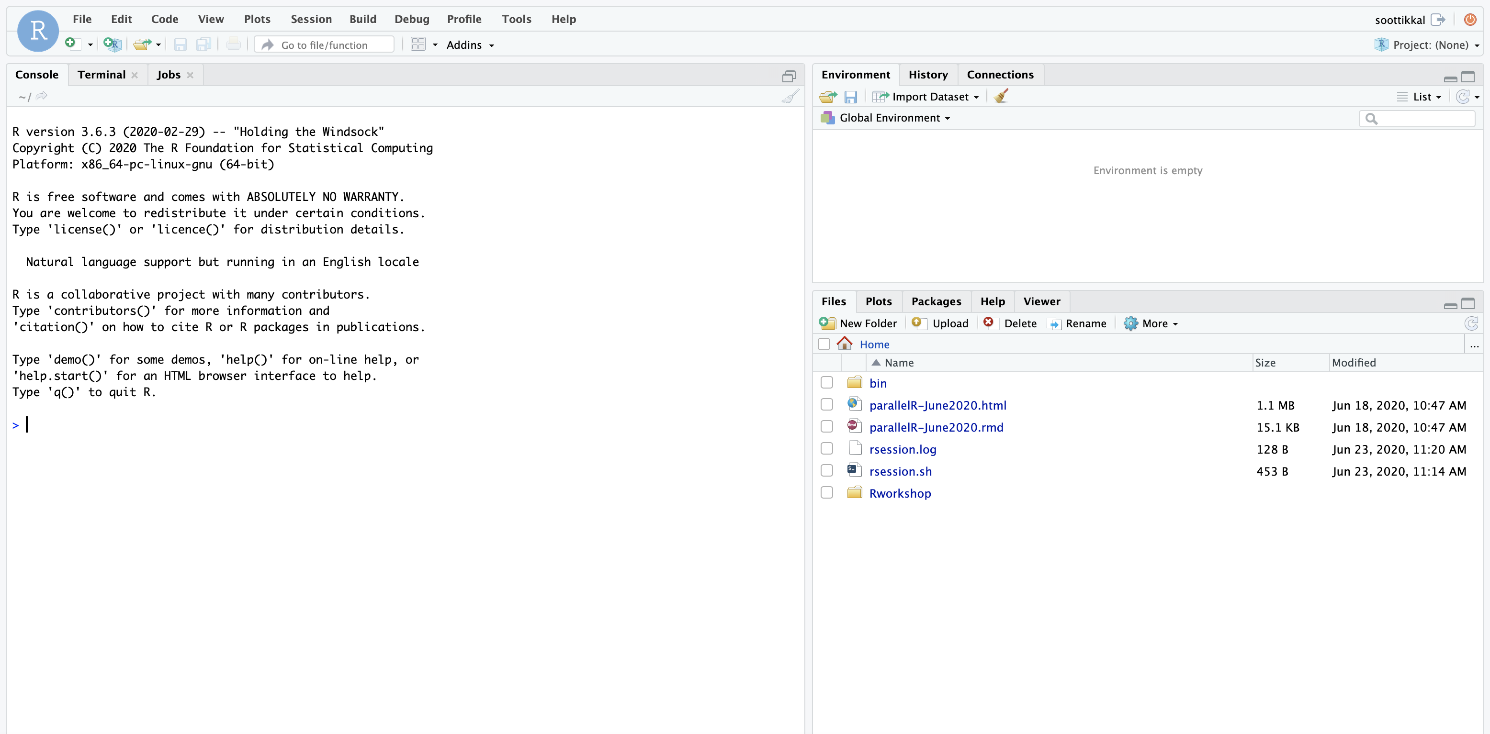

Slide 31
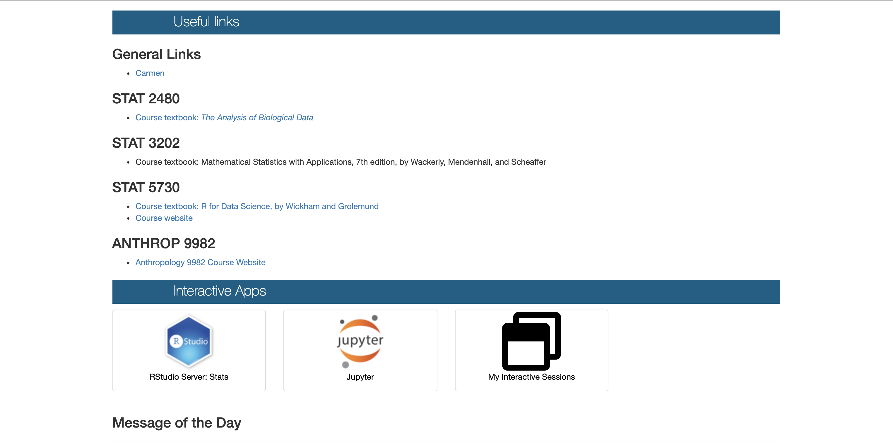
class.osc.edu
OSC provides an isolated and custom R environment for each classroom project that requires Rstudio. The interface can be accessed at class.osc.edu
https://www.osc.edu/content/using_rstudio_for_classroom

Slide 32
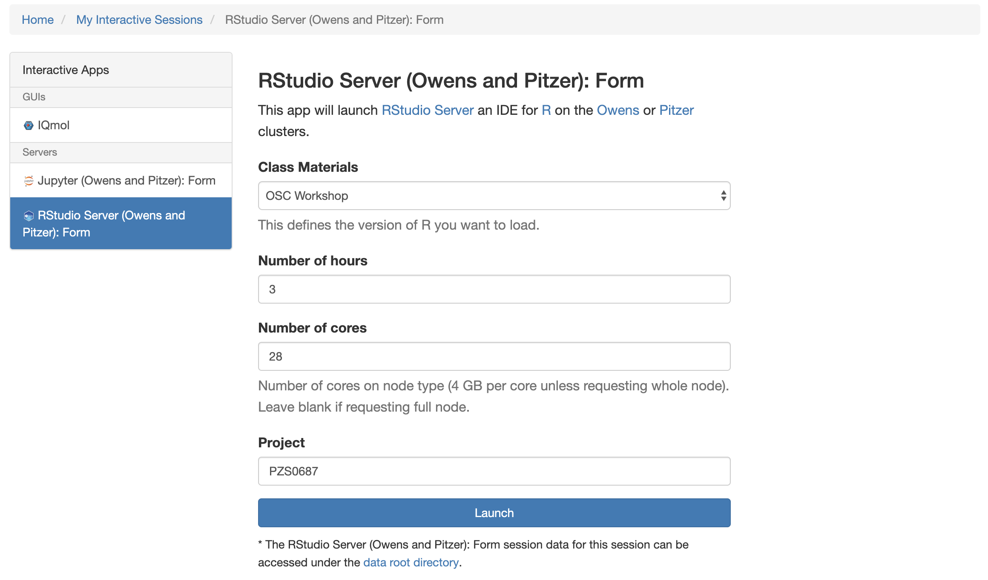

Slide 33
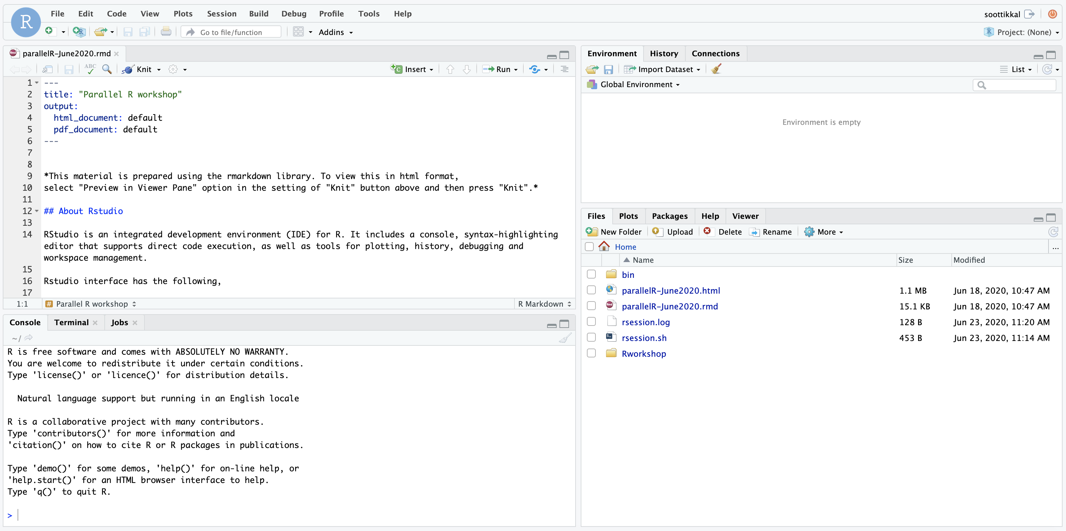

Slide 34
class.osc.edu
OSC provides an isolated and custom R environment for each classroom project that requires Rstudio. The interface can be accessed at class.osc.edu
https://www.osc.edu/content/using_rstudio_for_classroom

Slide 35
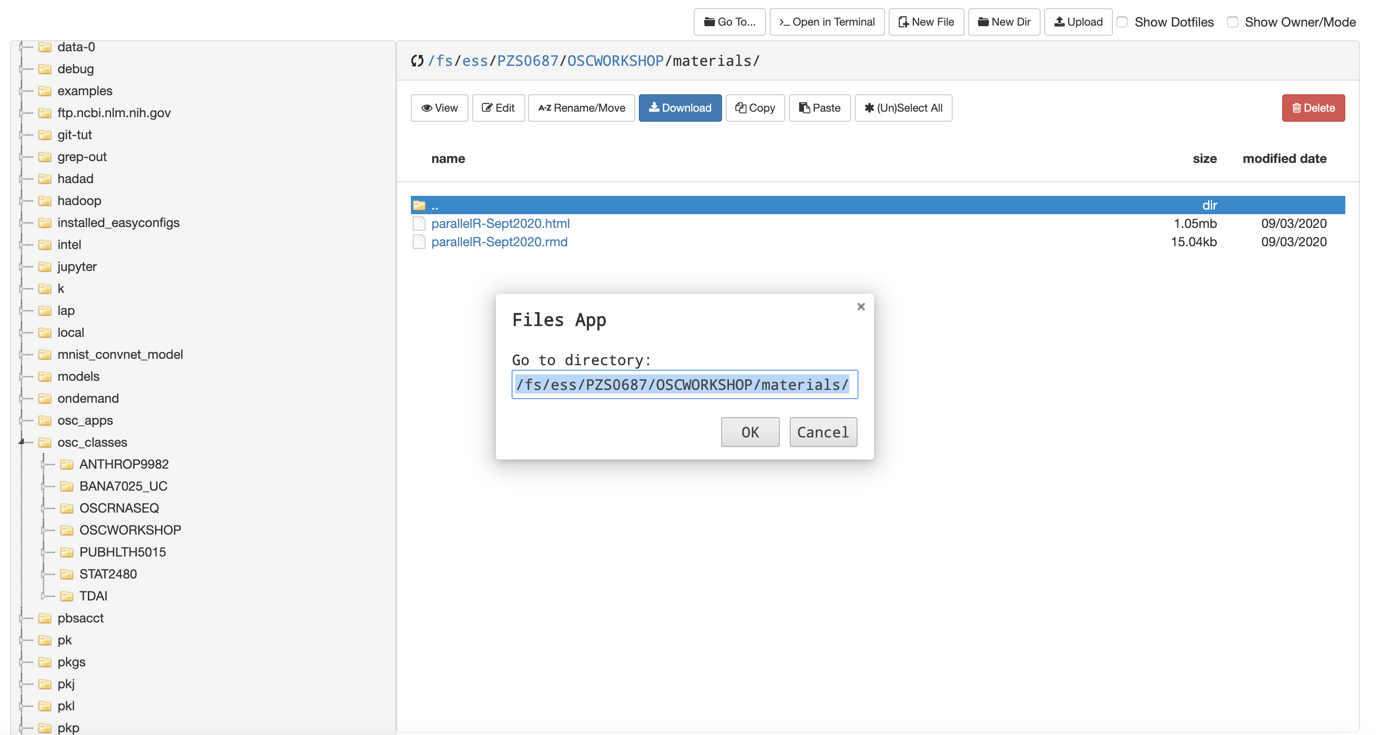
Getting workshop materials
On class.osc.edu, click on Files-> Home Directory

Slide 36
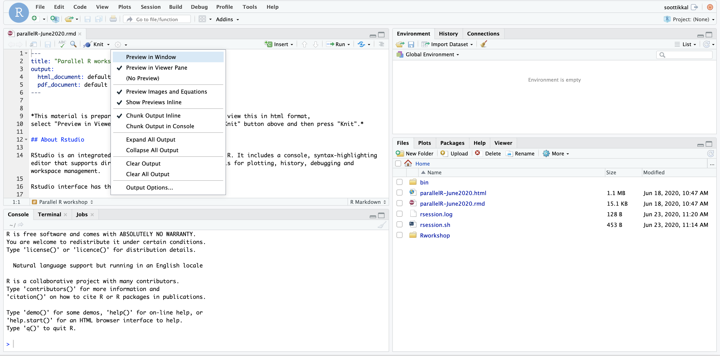

Slide 37
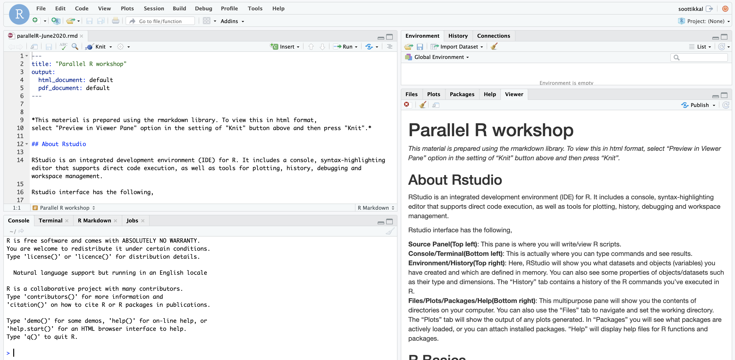

Slide 38
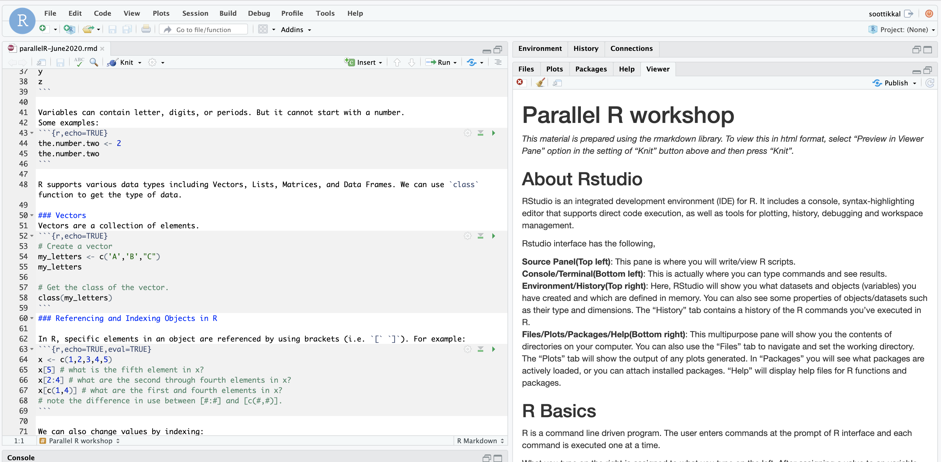
Run

Slide 39
Exercise-4 Launching Rstudio App at class.osc.edu

Slide 40
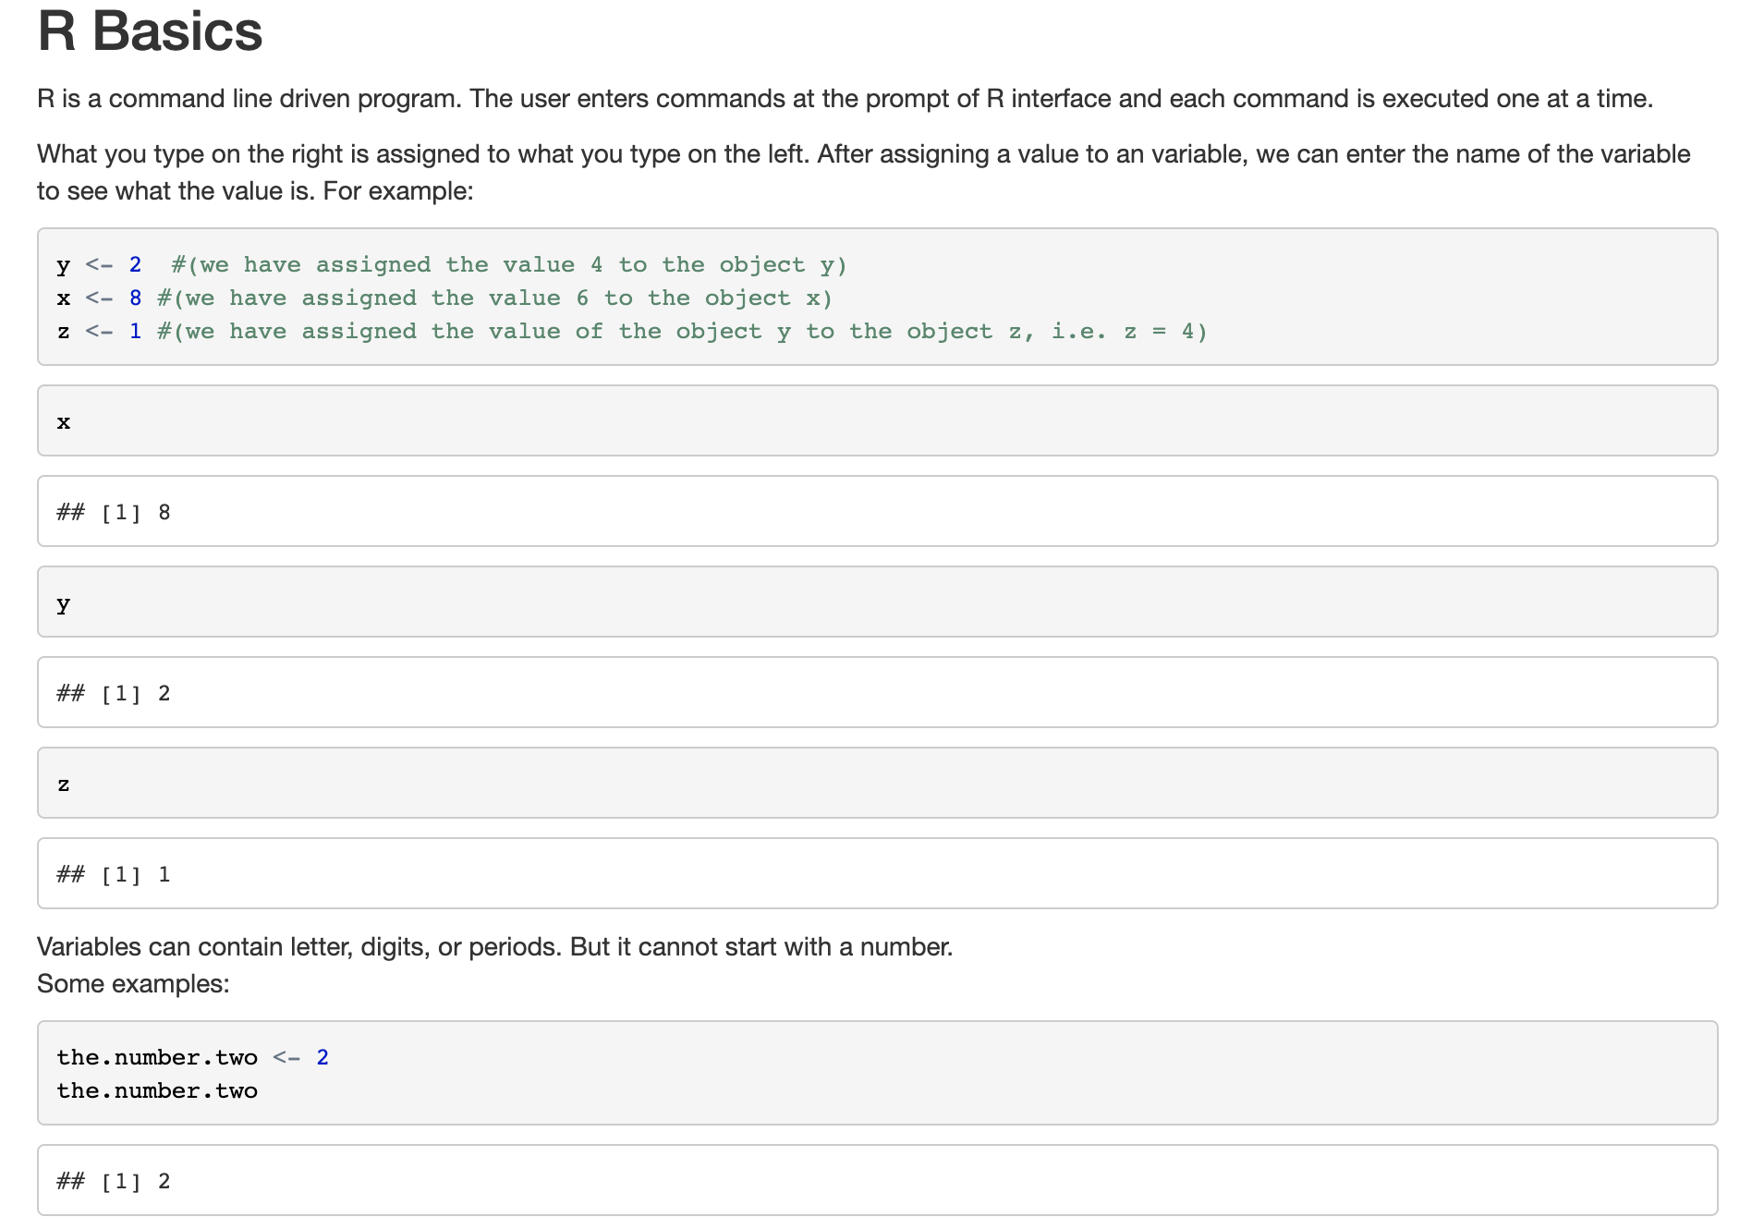

Slide 41
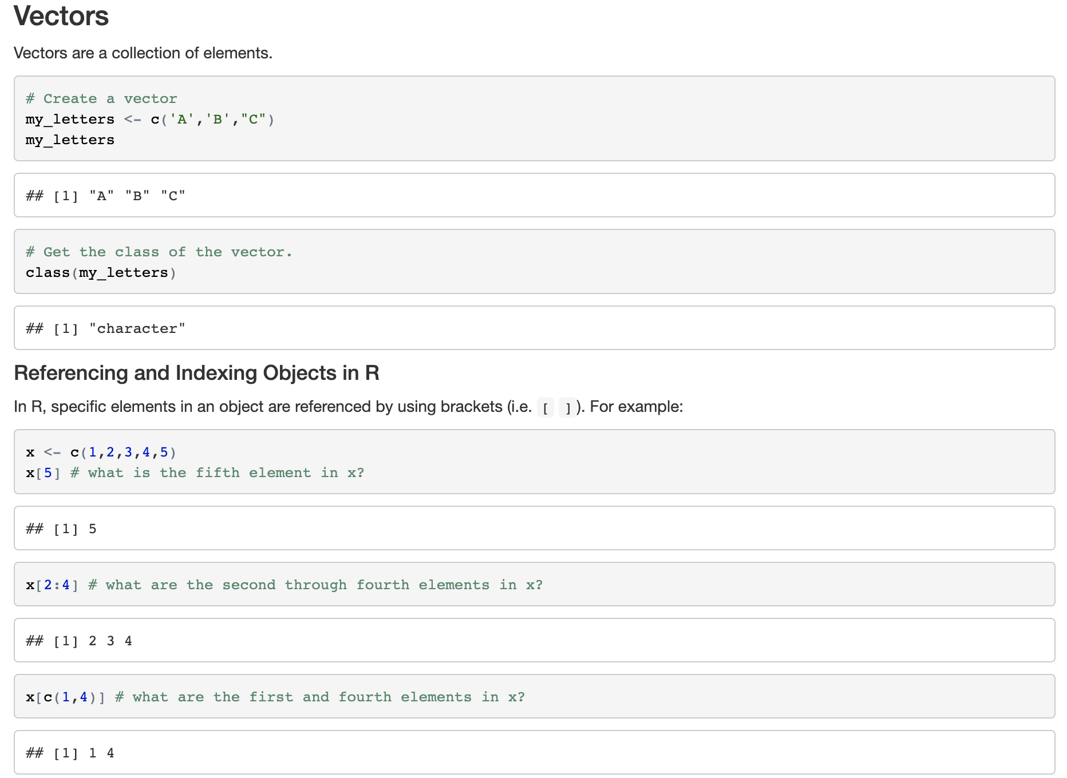
R supports various data types including Vectors, Lists, Matrices, and Data Frames.

Slide 42
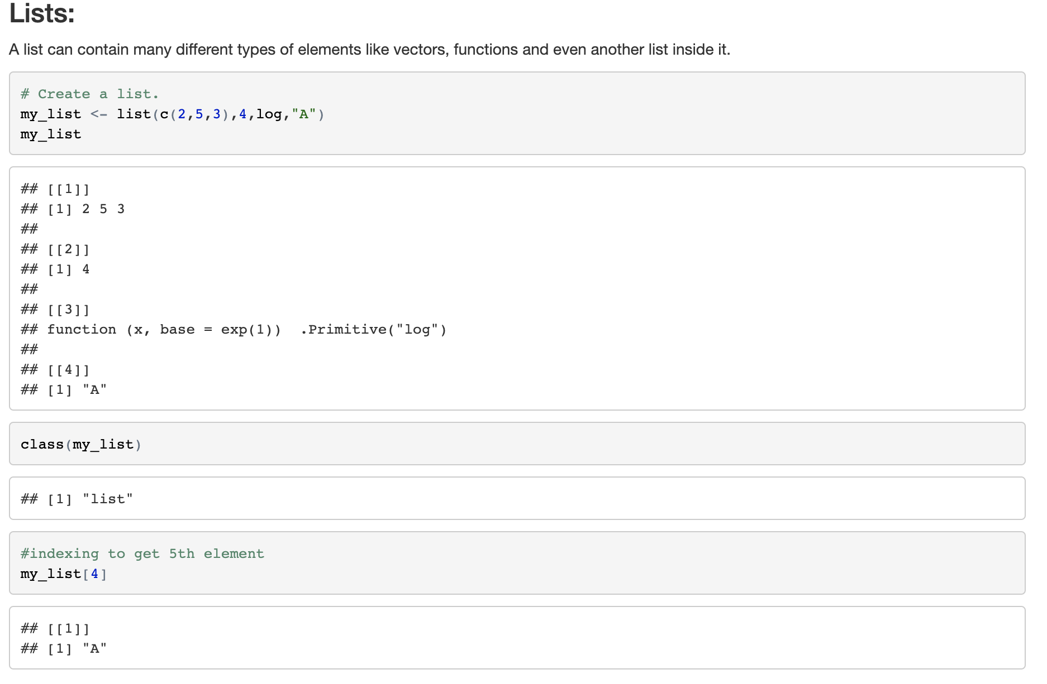

Slide 43
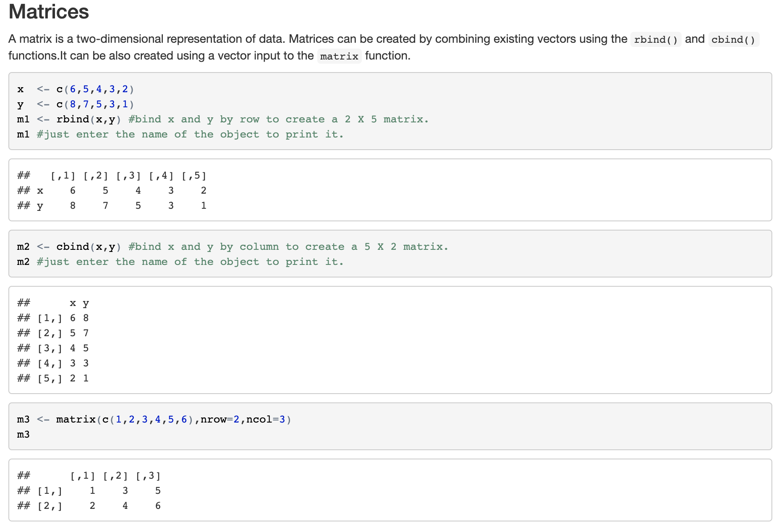

Slide 44
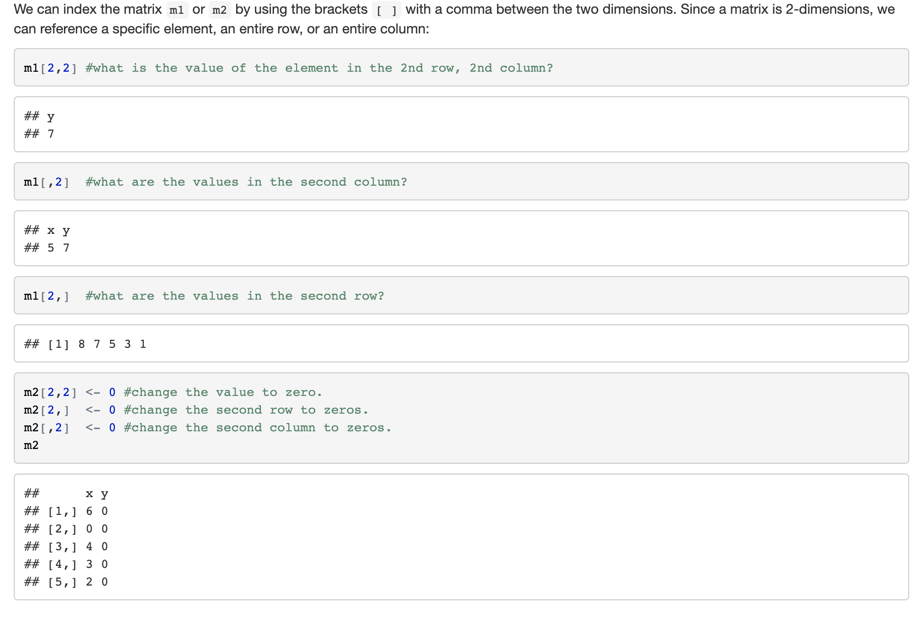

Slide 45
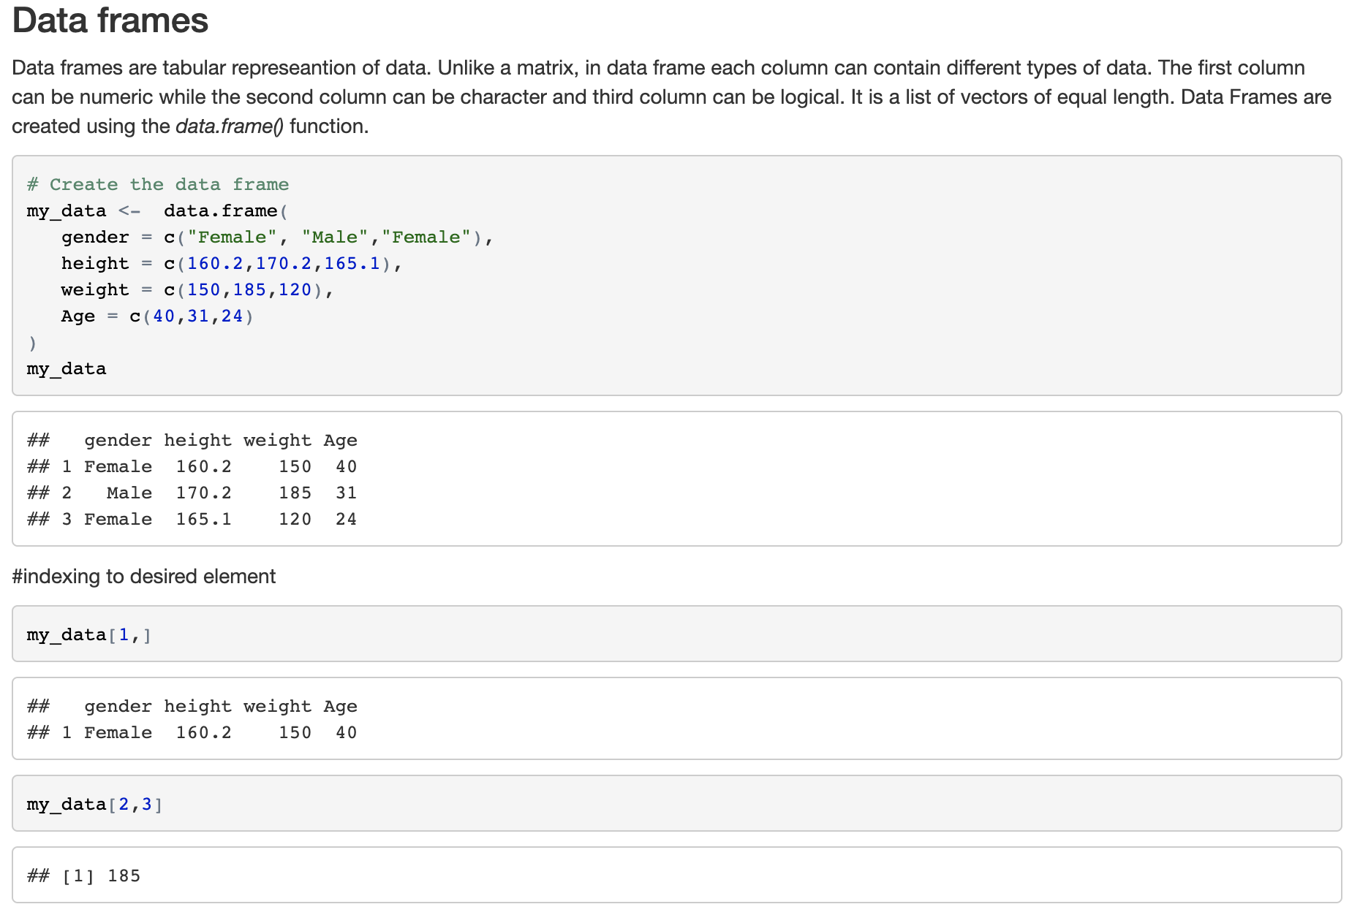

Slide 46
Exercise-5 R Basics-1

Slide 47
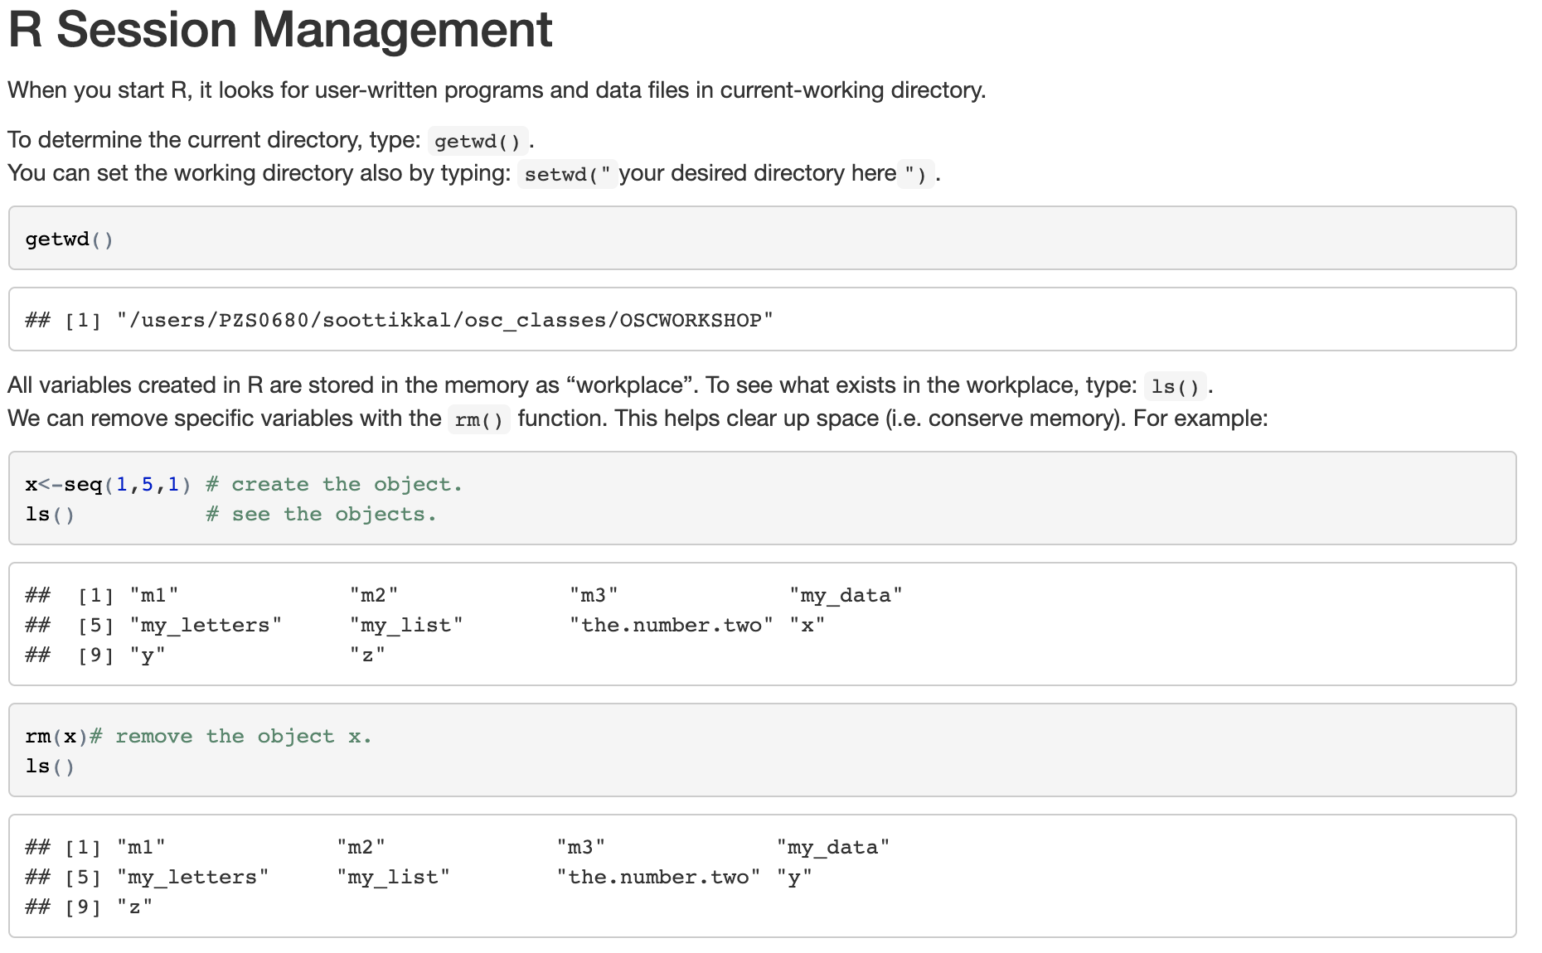

Slide 48
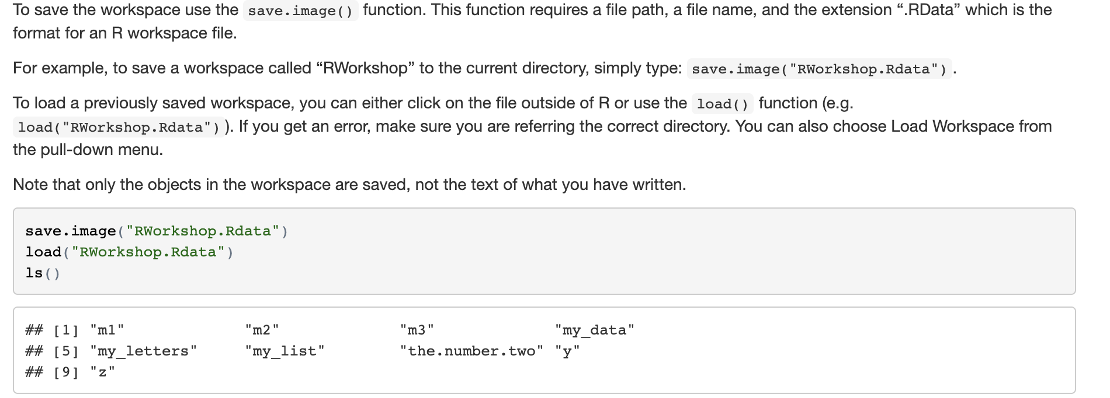

Slide 50
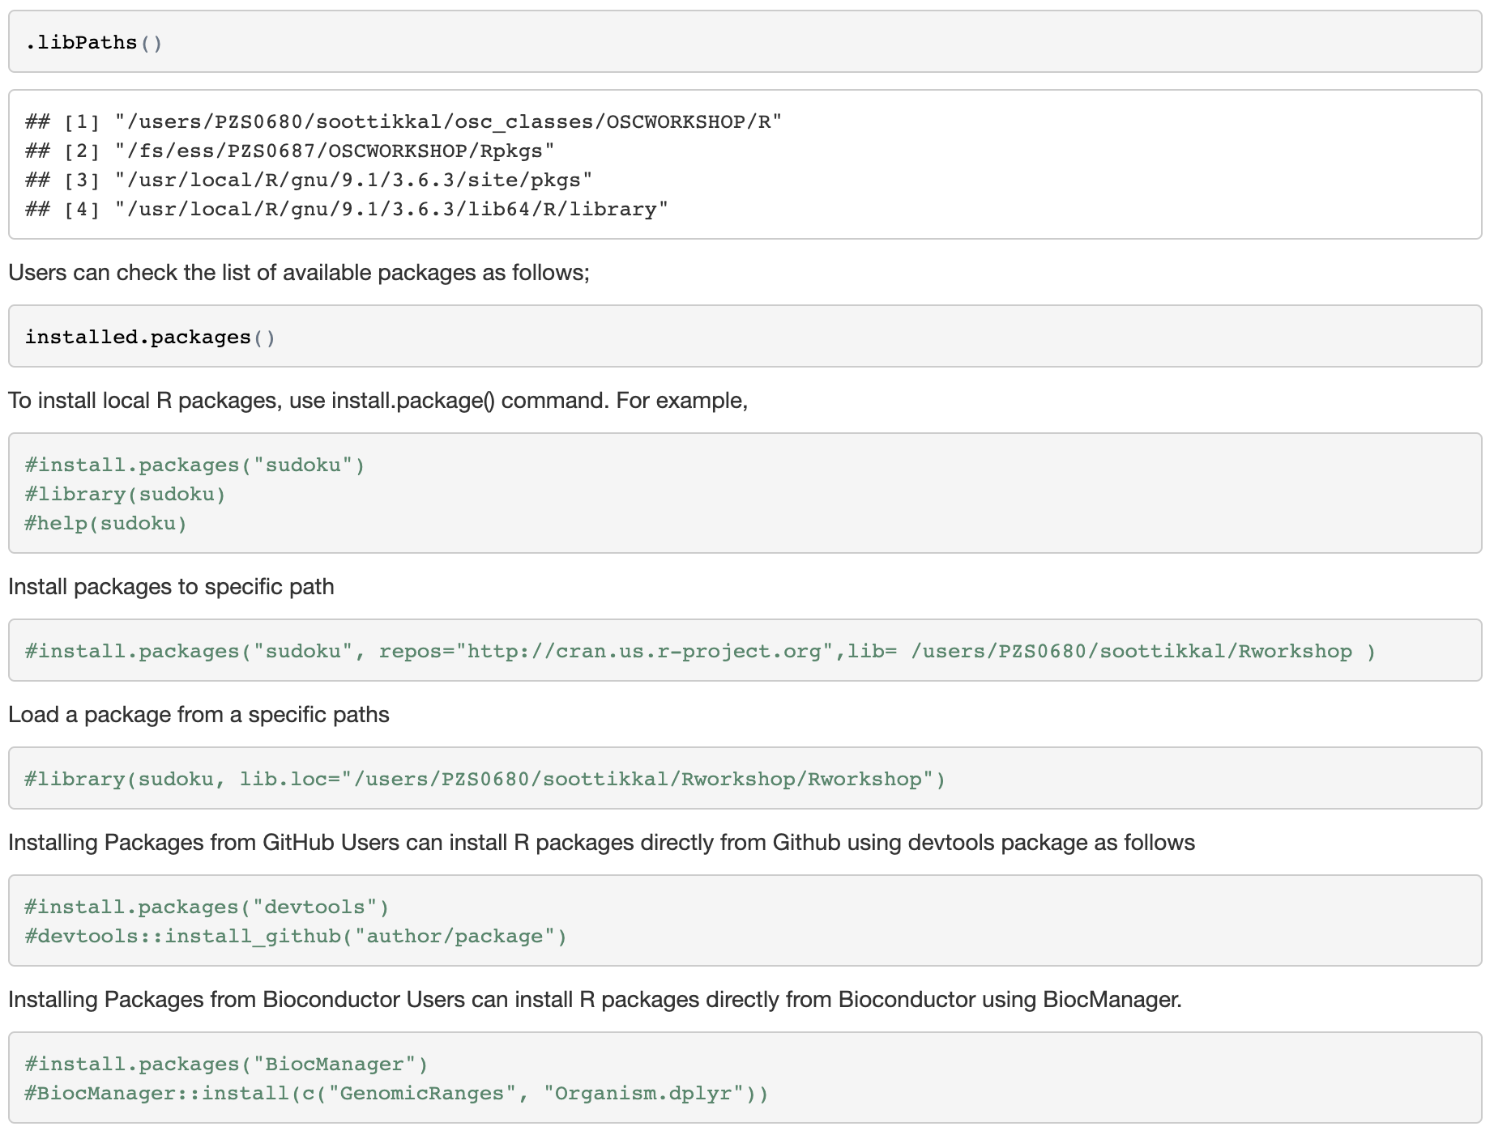

Slide 51
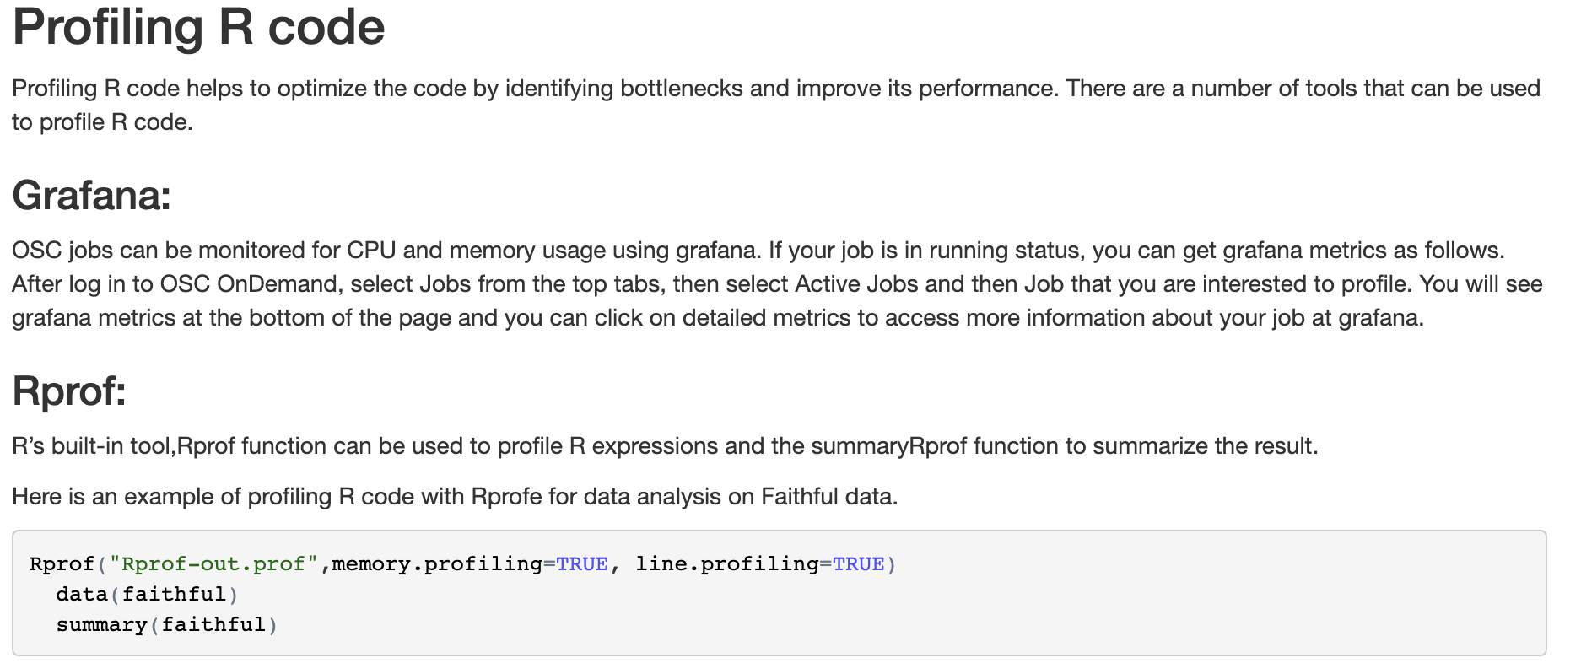

Slide 52
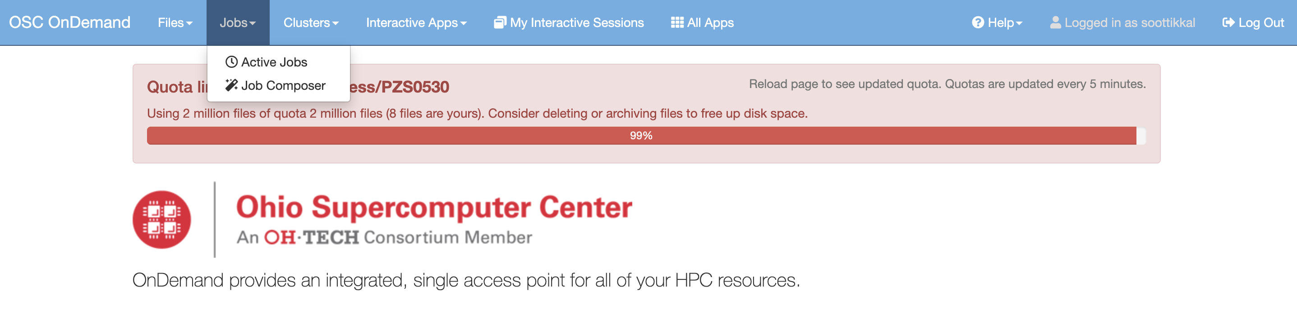
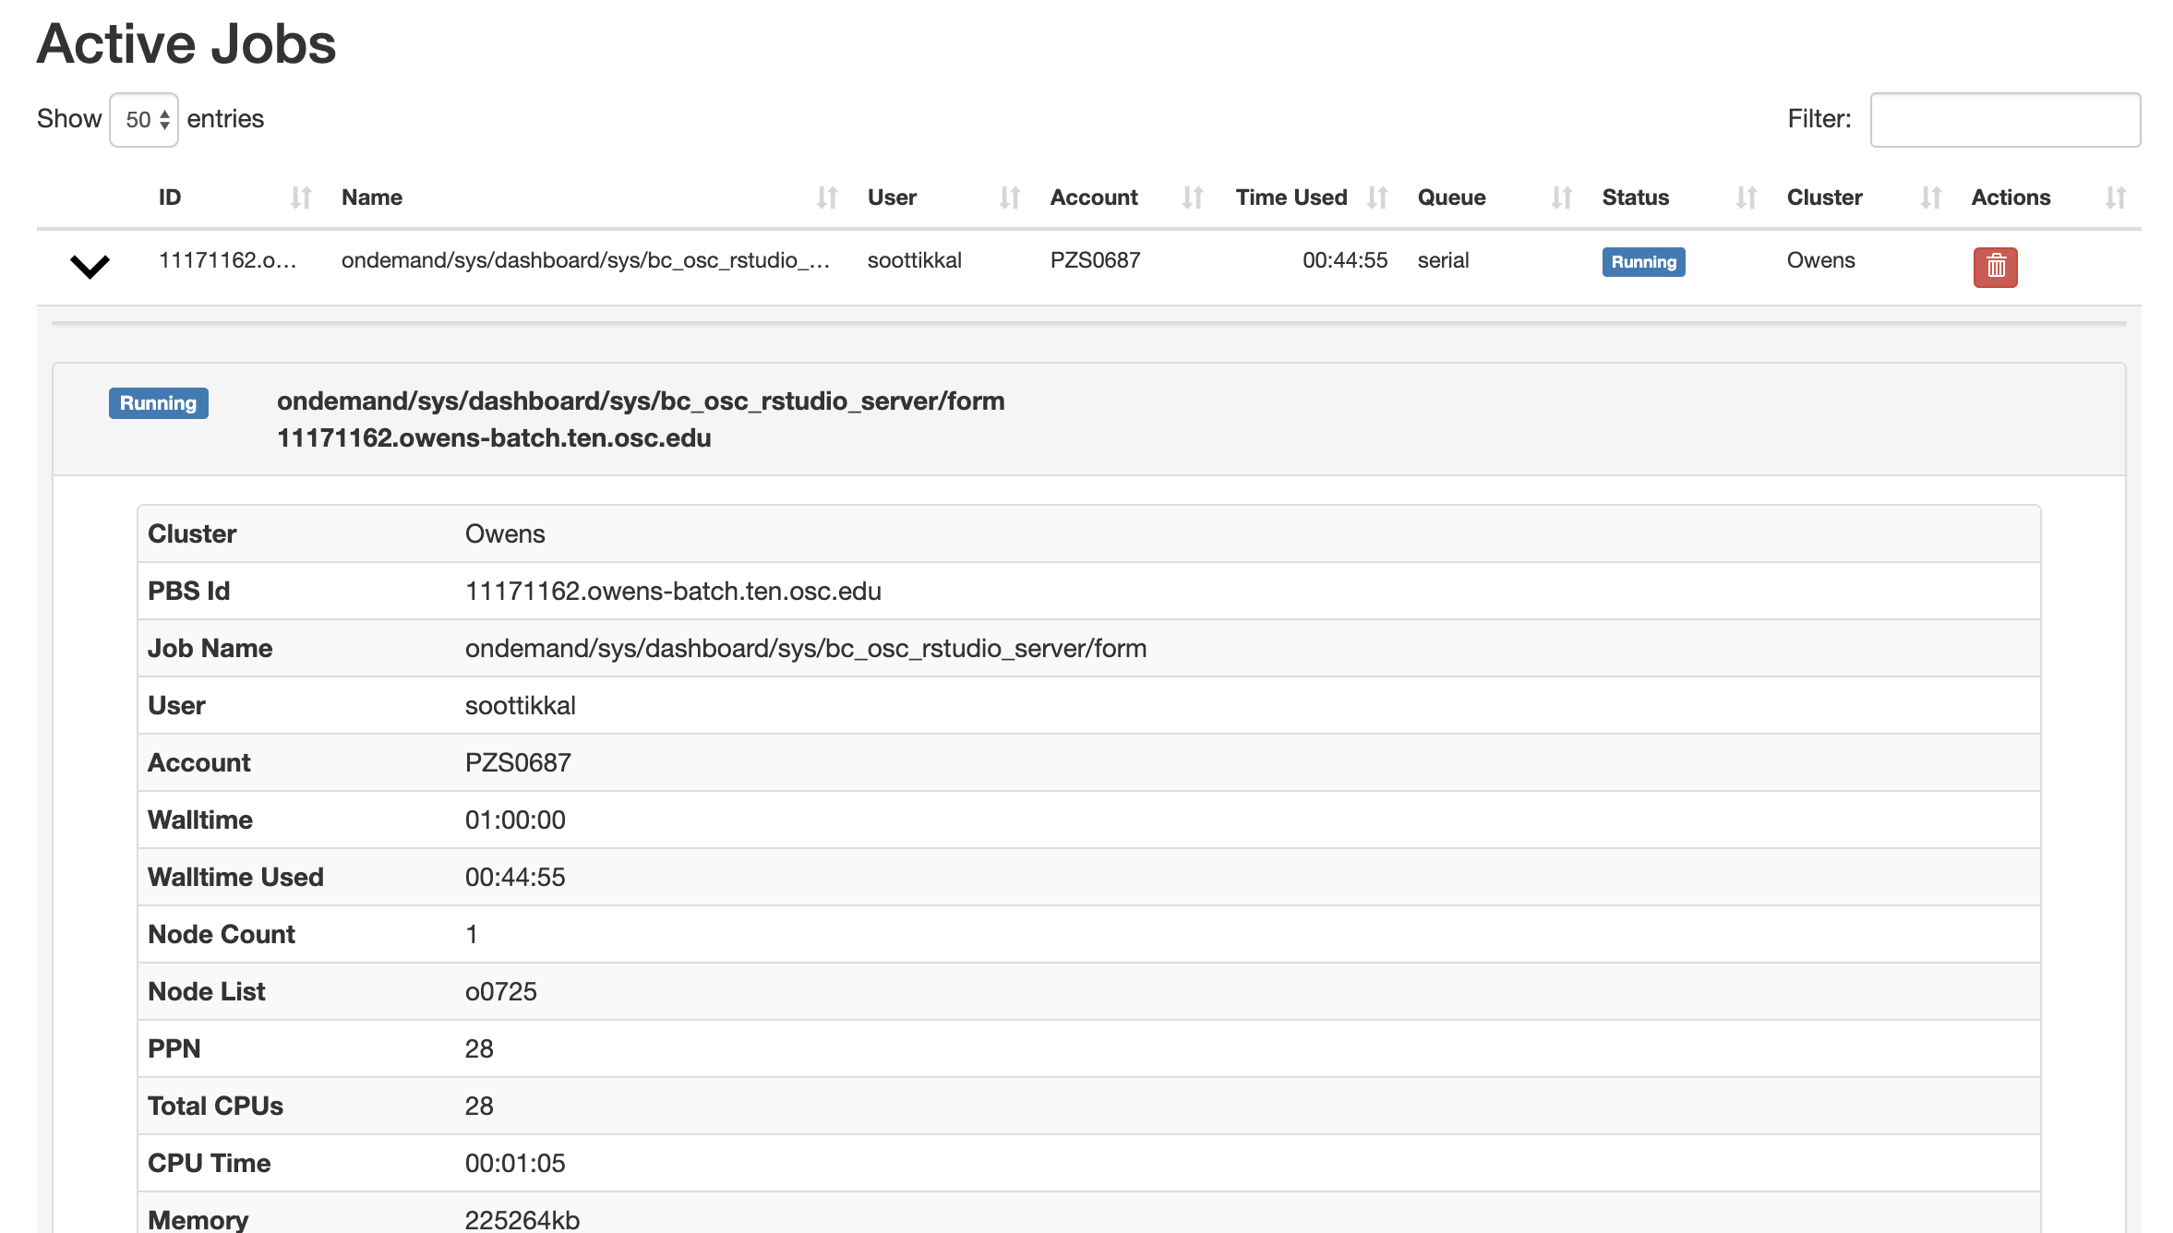

Slide 53
Exercise-6 R Basics-II

Slide 54
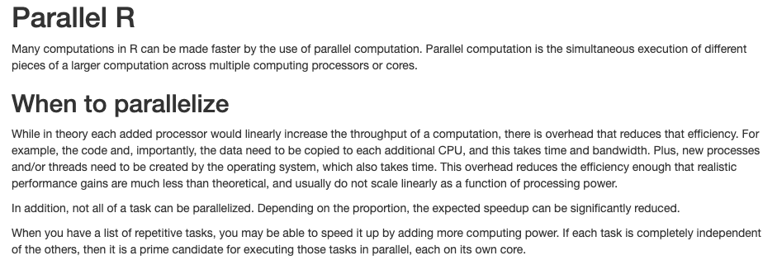

Slide 55
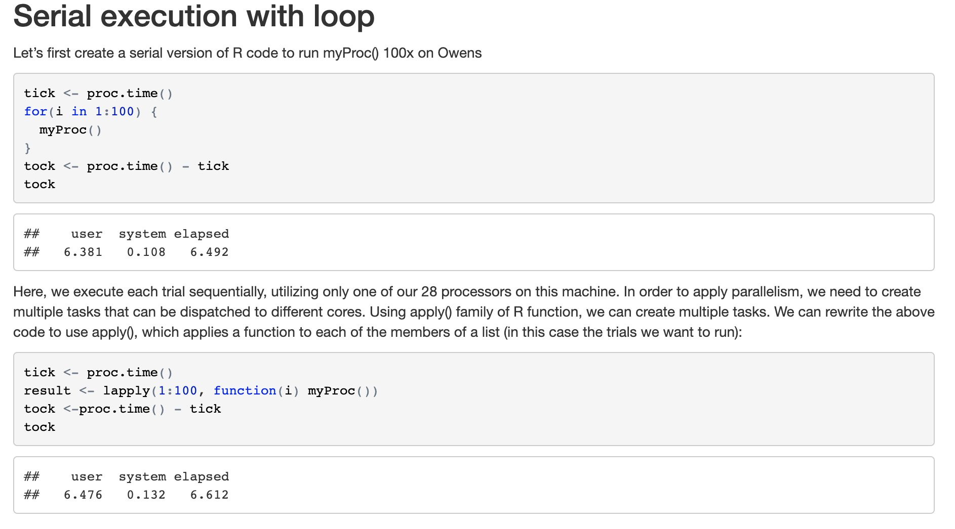

Slide 57
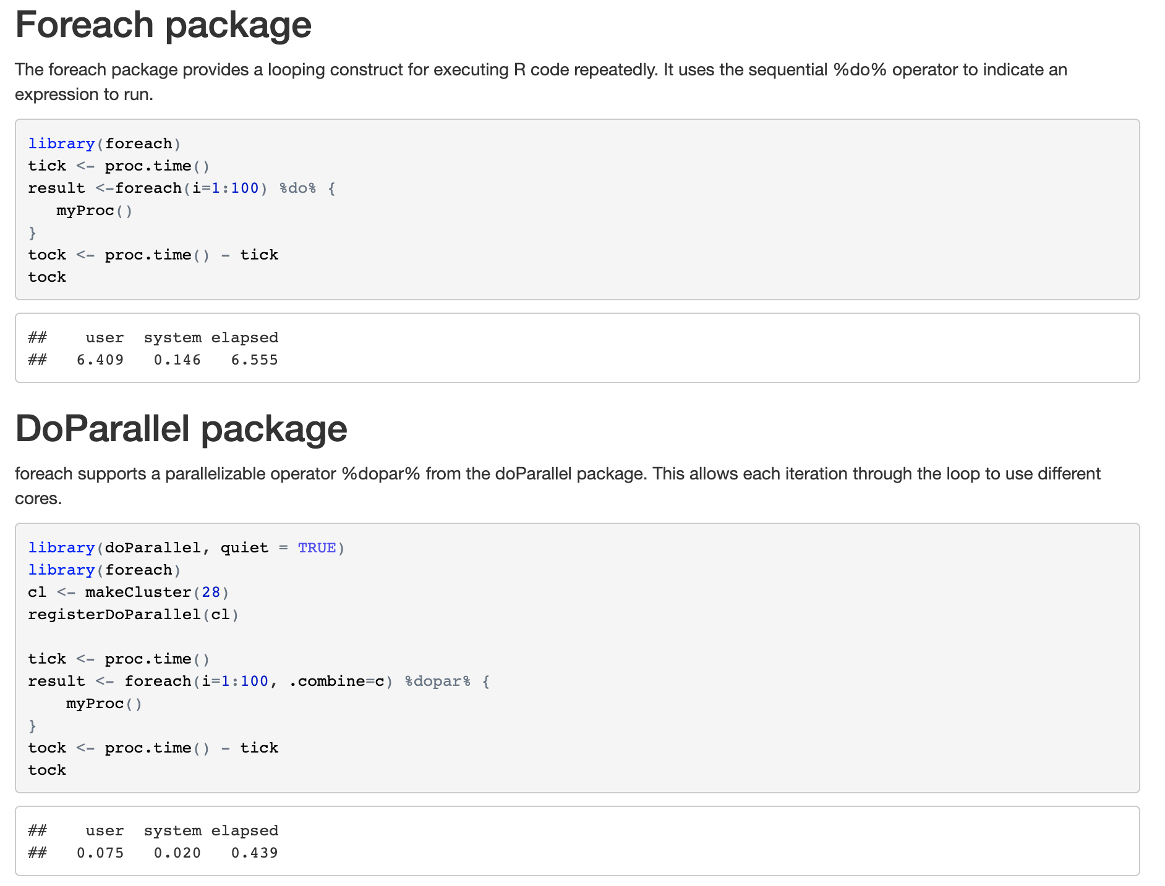

Slide 58
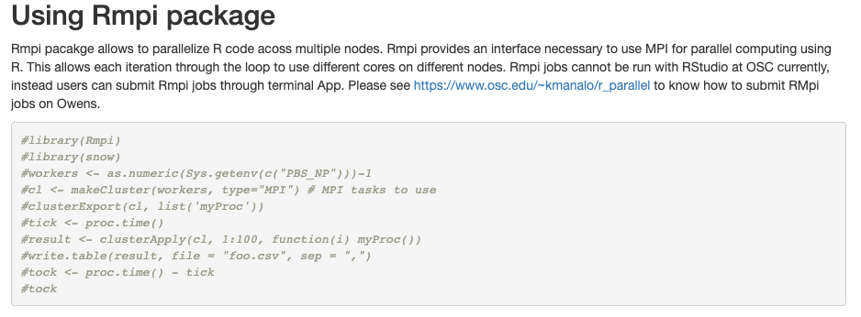
qsub job.pbs
#!/bin/bash
#PBS -l walltime=10:00
#PBS -l nodes=4:ppn=28
cd $PBS_O_WORKDIR
ml R/3.6.3-gnu9.1
ml openmpi/1.10.7
# parallel R: submit job with one MPI master
mpirun -np 1 R --slave < parallel_testing.R

Slide 59
Exercise-7 Parallel R examples

Slide 60
Summary
In this lesson, we reviewed the way in which traditional for loops in R can be rewritten as functions that are applied to a list serially using lapply, and then how the parallel package mclapply function can be substituted in order to utilize multiple cores on the cluster to speed up computations. We also reviewed the use of the foreach package with the %dopar operator to accomplish a similar parallelization using multiple cores. We also reviewed example on parallelizing R code across nodes.
References:
https://www.osc.edu/resources/available_software/software_list/r
https://www.jacobtnyoung.com/r-workshop.html
https://www.osc.edu/~kmanalo/r_parallel
https://nceas.github.io/oss-lessons/parallel-computing-in-r/parallel-computing-in-r.html
THANK YOU!

