Slide 1
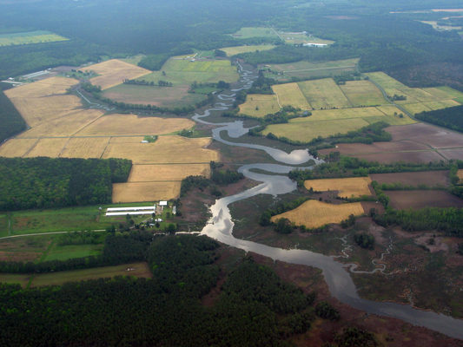
The Upper Paint Creek Watershed
Group 1:
Annie
Allison
Prapti

Slide 2
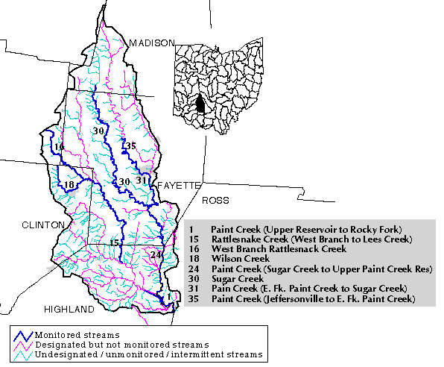
General Information
Counties:
Madison, Fayette, Ross, Highland, Clinton
Location:
Located in the Southwest quadrant of Ohio
Drains into the Ohio River

Slide 3
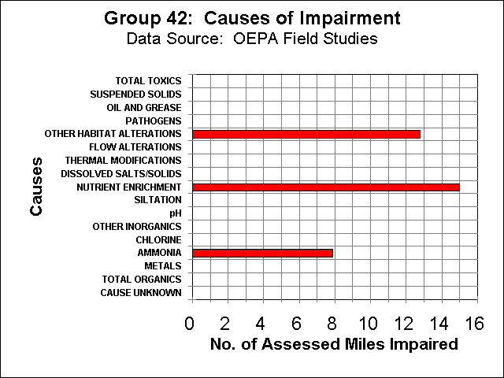
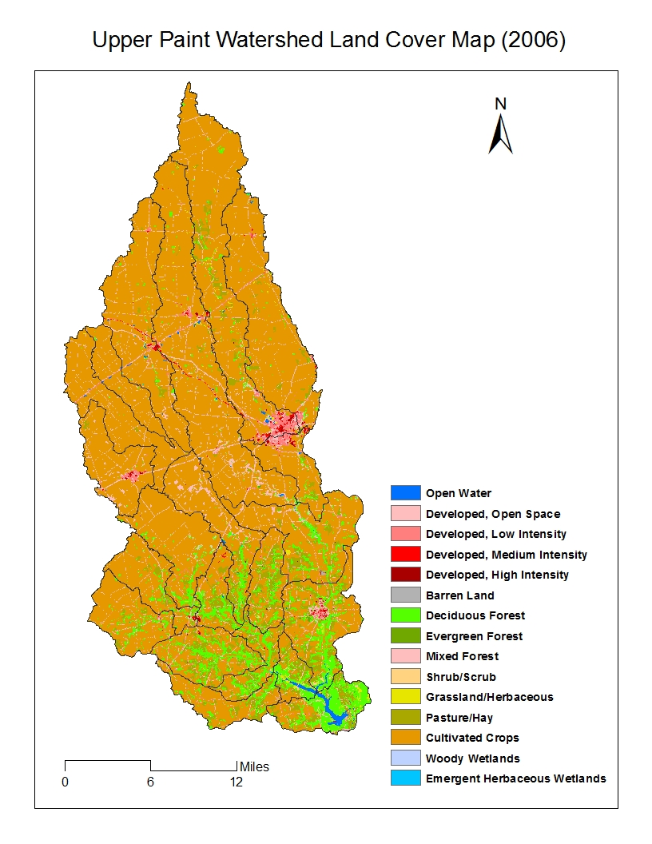
More General Information
Land Use:
Sources of Impairment:
Land is used for agricultural reasons with some forest areas

Slide 4
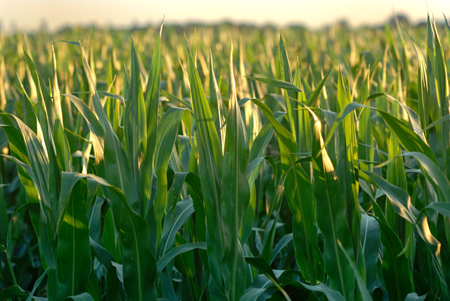
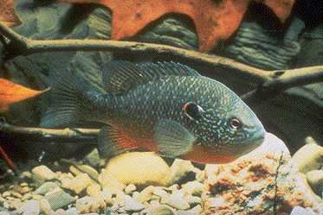
Hypothesis
As the amount of agricultural areas increase in the riparian zone, the fish diversity decreases.

Slide 6
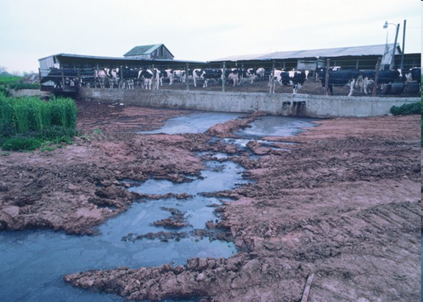
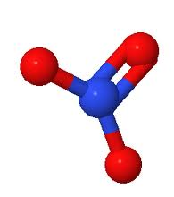
Hypothesis
When the percent of agricultural land in the riparian zone increases then the nitrate level should increase.
Nitrate Ion

Slide 7
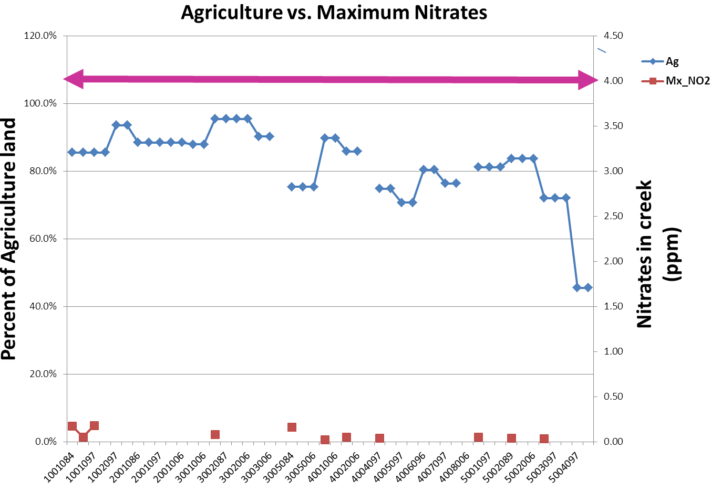
My Graph on Nitrates and Agriculture

Slide 8
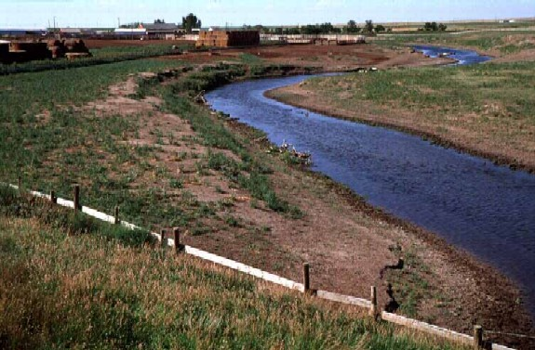
Hypothesis
If the substrate quality is poor, the fish diversity will also be poor.

Slide 10
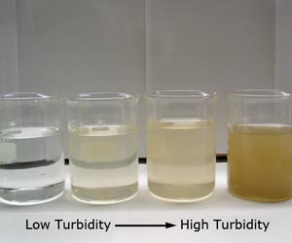
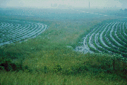
Conclusion
Current Conservation
What can we do to help?
Conservation Tilling: When at least 30% of the soil is covered with residue
No-till farming: When the most of the soil is covered all the time. The soil is also firmly compacted, which decreases runoff.
Strip farming is when the farmers put vegetation in between the land
Improve the quality of the riparian zone by planting more vegetation
EPA requests 30ft of high quality riparian zone
Use the prescribed amount of fertilizer

Slide 11
Thank You!
We want to say thank you to the chaperones, the teachers, the OSC staff, and OSU for doing this camp and helping out! It was really fun and we learned a lot about Environmental Science.

