Slide 1
The Rocky River
Presented by:
Julia: Marietta Area
Liz: Bowling Green
Sophia: Athens
How healthy is the Rocky River Watershed?

Slide 2
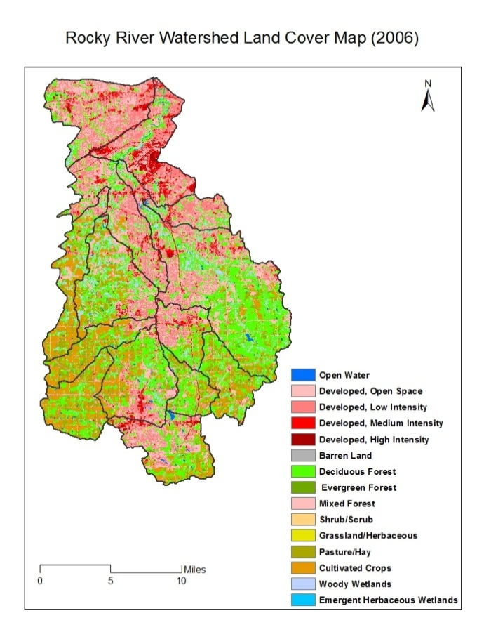
Background Information
Runs through Cuyahoga, Lorain, Medina, & Summit Counties
Located in Northeastern quadrant, near Cleveland
Seven Major Tributaries:
Plum, Blodgett, Baldwin,
Abram, Baker, Mallet, & Healey
Drains into Lake Erie

Slide 3
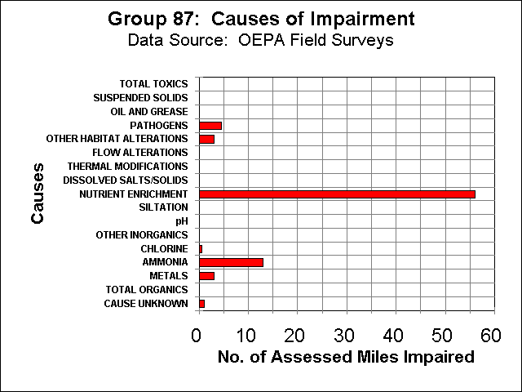

Slide 4
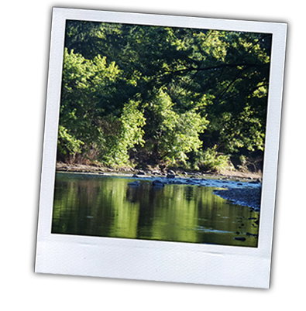
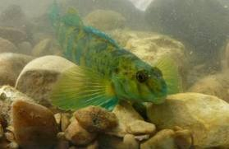
Sophia’s Hypothesis
When the QHEI (habitat quality) escalates, the IBI (fish diversity) will escalate with it.
This darter is from Big Darby Creek, where we went this week.

Slide 5
QHEI vs. IBI
Key
QHEI Score
IBI Score
Location

Slide 6
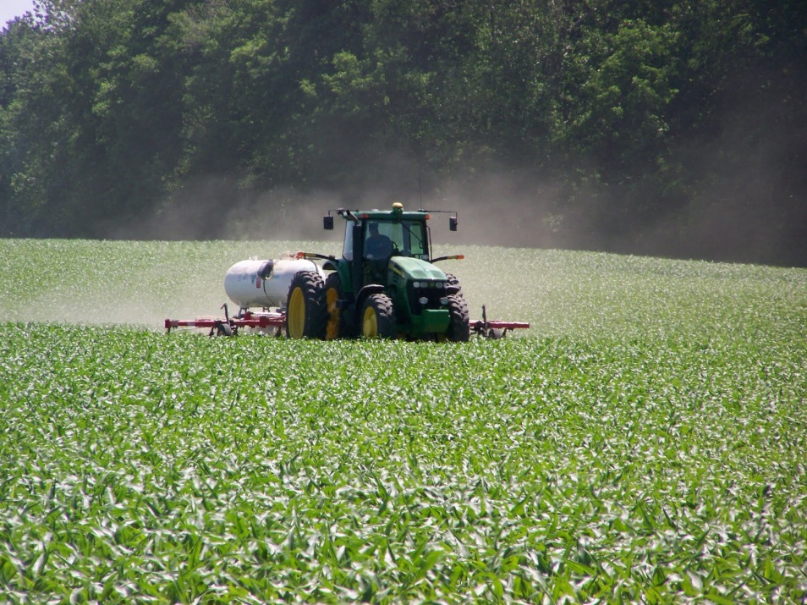
Liz’s Hypothesis
As ammonia levels increase in the Rocky River Watershed, the IBI, which is fish diversity, will decrease.

Slide 7
Ammonia vs. IBI Levels
IBI Score
Location

Slide 8
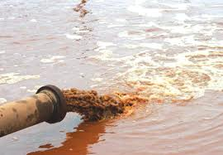
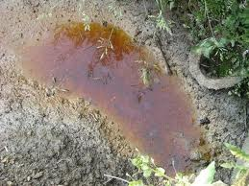
Julia’s Hypothesis
My hypothesis was that as the COD – organic chemicals and metals – increased, the IBI – fish diversity – decreased.

Slide 9
COD vs. IBI
COD (ppm)
IBI Score
Location

Slide 10
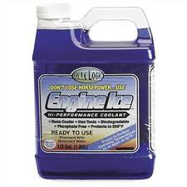
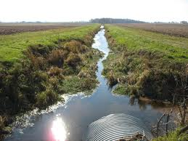
How can YOU help?
Be cautious of what you use when you deice! Some salts will run into the river as ammonia. Ethylene Glycol and Propylene Glycol are eco-friendly choices.
When you paint around your house or wash your car, be careful not to dump it into the storm drains.
Restore the riparian zones so they can keep the pollutants under control.
These practices will keep the environment balanced with the economy.
How healthy is the Rocky River Watershed?

Slide 11
Thank You!
Thank you to all the people who helped make our project possible:
Steve Gordon
Paula Williams
Tori Cook
All other YWSI teachers and chaperones

