Slide 1
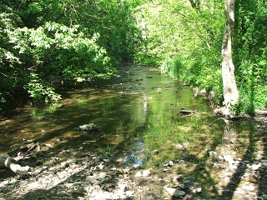
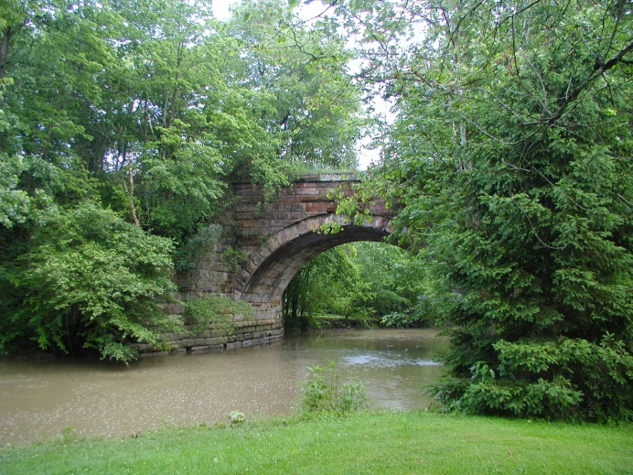
Scioto Bokes Watershed
By: Akanksha, Annalese, and Madison

Slide 2
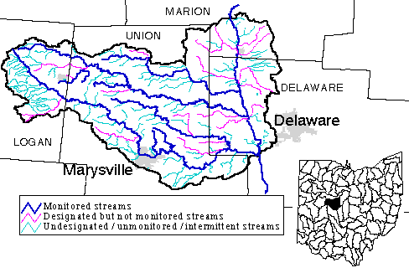
Location
Counties: Union, Marion, Logan, and Delaware
Located in central Ohio.
Surrounded by an agricultural environment.
Largest City: Marysville
Main Water Sources: Scioto River, Bokes Creek, and Mill Creek
Used as drinking water for Marysville and Columbus.
Notes:
The location of the Scioto Bokes watershed is in Union, Marion, Logan, and Delaware counties which are all located in central Ohio. It is surrounded by agricultural fields. The largest city near the Scioto Bokes watershed is Marysville. The main water sources are the Scioto River, Bokes Creek, and Mill Creek

Slide 3
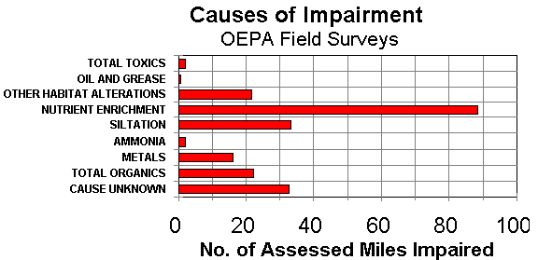
Impairment
Nutrient enrichment from nitrates and phosphates
Others are siltation and habitat alterations such as channelization of the river.
Notes:
These are some impairments in the Scioto Bokes Watershed. The highest, from the looks of the graph, is the nutrient enrichment. These enrichments could com from runoff from farms. The pesticides and the fertilizers from the runoff can be carried in to the river. The second highest is the siltation. This caused when sediments on land come into the river from runoff. This could be harmful for the fish and macroinvertebrates that live there. The third highest is the habitat alteration. This is mainly caused by channelization.

Slide 4
Hypothesis
As QHEI (the quality of the habitat) increases, the IBI (diversity and health of fish) should increase.
Clear water, riparian zone, cover, cool temperature, substrate, and meanders.
Fish with good habitats have many of their needs met.
When ammonia and nutrients are high, the fish population will decrease.

Slide 5
The Effect of QHEI on IBI
QHEI
IBI
4
1
2
3
Place and Time
Notes:
Point out some trends in the graph
All points=ammonia high levels (mostly 1 & 4 spikes)
Points 2 &3 also have high total nitrogen

Slide 6
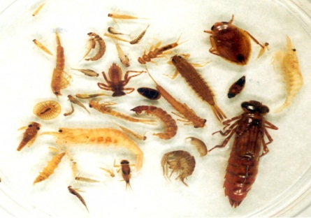
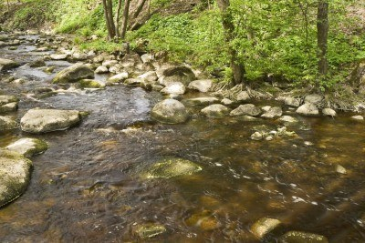
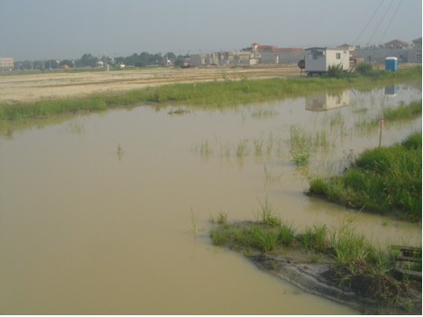
Hypothesis
When the substrate quality increases, the ICI (diversity and health of macroinvertebrates) also increases.
Usually when the substrate is rocky, there is a larger ICI. If the substrate is full of sediment, the ICI is lower.
Notes:
This is my hypothesis about the Scioto Bokes watershed. The hypothesis is that when the substrate quality increases, the ICI (diversity and health of macroinvertebrates) also increases. When the substrate quality decreases, the ICI also decreases. If the substrate is rocky, there is a larger ICI. If the substrate is full of sediment, the ICI is lower.

Slide 7
ICI and Substrate Scatter Plot
Notes:
This is a scatter plot showing the relationship between macroinvertebrate community and substrate in our watershed. The r2=0.7464 means that 75% of the times that the ICI increased, the substrate was a part of why it increased. In general when the substrate quality was low, the macroinvertebrate community is low. When the substrate quality is high, the macroinvertebrate community is high.

Slide 8
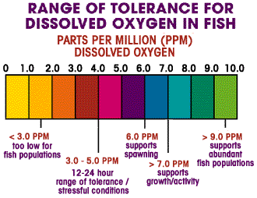
Hypothesis
When dissolved oxygen (DO) is high, so is the health and diversity of the fish (IBI).
DO is important to the IBI because it allows them to respire. Without this the fish would be smothered to death.
Notes:
DO can be effected by COD and BOD. These are the measures of oxygen being used by bacteria that decomposes the waste in the river.

Slide 9
IBI and DO Line Graph
DO
IBI
Place and Time
Notes:
This graph shows the relationship between the fish population and Dissolved oxygen in the watershed. When the dissolved oxygen levels are high the fish population is healthier. For example, my hypothesis is supported in these areas. But not all the points shown follow this pattern. Points five and fourteen show areas where DO is high yet the IBI is somewhat low. This has happened because high biochemical oxygen demand (BOD) or chemical oxygen demand (COD) are found here. This means that bacteria is using up the dissolved oxygen in these areas.

Slide 10
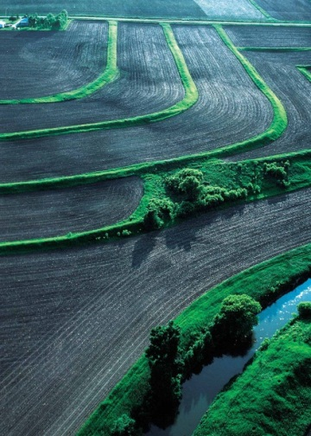
Why is this Important??
Drinking water for Columbus and Marysville
Agricultural industry sometimes clears too close to streams
Runoff leads to sedimentation
Nitrates and ammonia lead to nutrient enrichment, which leads to increased algae growth and less dissolved oxygen
Runoff from industrial areas can increase the chemical oxygen demand
Farmers can use conservation practices
This is an agricultural field. This farmer is being conservative and using strips of grass in between crops to stop run off
Turbid Stream
Notes:
This study of water quality is important because the Scioto River, Bokes Creek, and Mill Creek are used for daily life! Mill Creek supplies drinking water to two main cities, Columbus and Marysville. The area around our stream was mainly used for agriculture. When land is cleared for farming, sometimes they clear too close to the stream, removing the riparian zone and tree cover. When the water runs off the fields, it takes extra dirt with it, causing excess sedimentation in the stream. Farmers use fertilizers that contain nitrates and ammonia to help their crops grow. When the run off carries excess fertilizer to the stream, it leads to nutrient enrichment. This causes the growth of algae to increase and use up a lot of dissolved oxygen that the fish need. Runoff from industrial areas can increase the chemicals in the water causing an increased chemical oxygen demand, which also uses up the dissolved oxygen. To stop or prevent these things from happening, farmers can use conservation practices. Some conservation practices are using mulch cover, less tillage, planting cover crops, not over-applying fertilizers, replanting or keeping a good riparian zone around the stream.

Slide 11
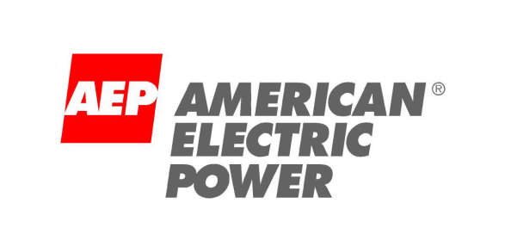
Special Thanks! to…
Patricia Carey
Dr. Steve Gordon
Paula Williams
Teachers and Chaperones!
Elizabeth Stong
Katie Hendrickson

