Slide 1
The Great Miami Loramie Watershed
Neelu, Jasmine, and Cassie

Slide 2
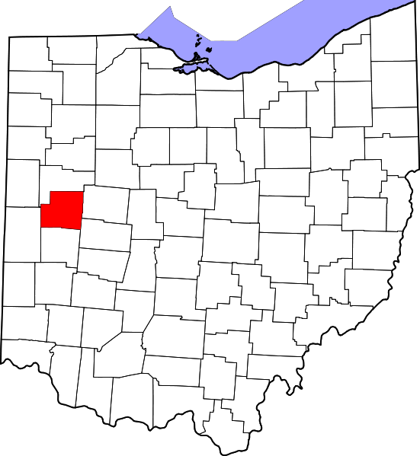
Information
Loramie Creek is part of the Great Miami Watershed
Primarily located in Shelby County
North of Dayton in Southwest Ohio
Drains into the Ohio River
Length = 40 mi
Farming is Ohio’s #1 industry & agricultural land borders most of our stream
Sources of Impairment: Habitat Alterations, Flow Alterations, Nutrient Enrichment, Metals, Siltation, and Ammonia

Slide 3
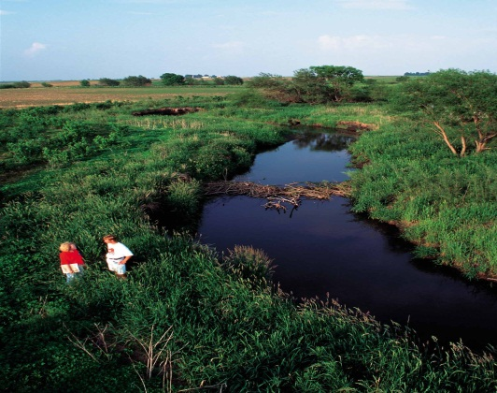
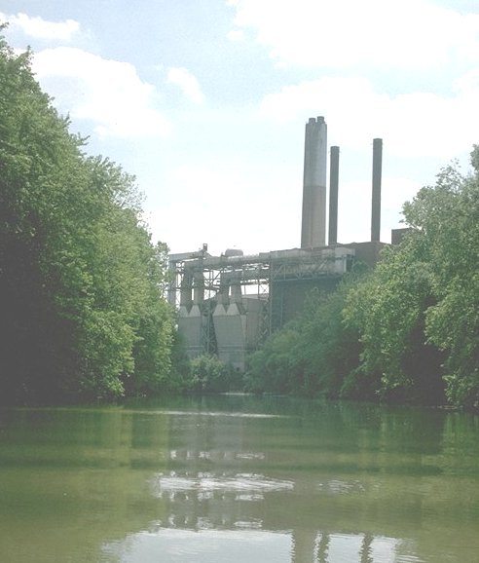
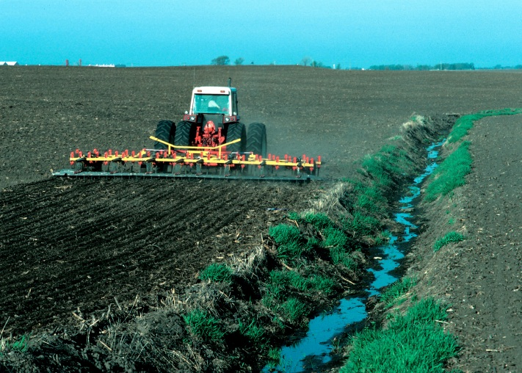
As the COD increases, the IBI decreases
COD (Chemical Oxygen Demand): Measure of chemical pollution in the water
IBI: fish diversity
Urban growth increases COD levels
Growth in the agricultural and urban areas increases runoff of harmful chemicals from the watershed
COD levels are significantly high in our watershed
High levels of COD can be harmful to the fish, causing the IBI to drop

Slide 4
Increased levels of COD result in decreased IBI
Green arrows represent two areas that would deny my hypothesis
This could be due to other physical indicators, such as substrate, which will be introduced later
IBI Scale
COD Scale
HUCDATE
Notes:
Neelu

Slide 5
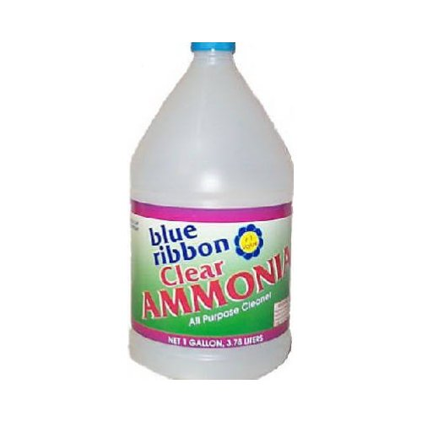
Background Information
Ammonia:
A specific chemical measure in stream quality
Tested for in watersheds
Used in farming fertilizer, also used in household cleaners
Many agricultural areas use fertilizer
Agricultural areas make up 87% of land around our watershed

Slide 6
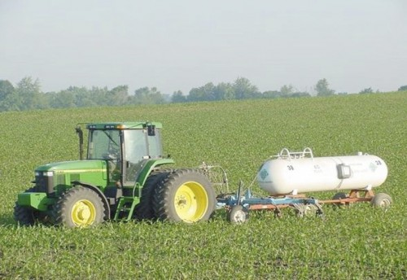
Background Information cont.
More about Ammonia:
Ammonia gets into the watershed via runoff from farm fields
Very toxic to fish
My Hypothesis: As Ammonia levels increase, IBI levels decrease.

Slide 7
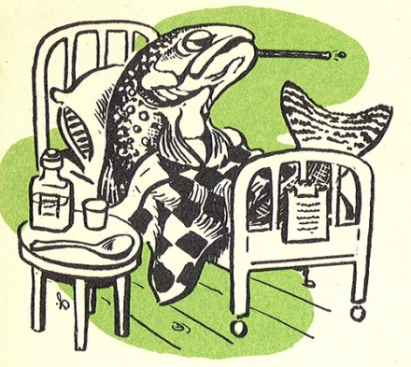
Comparing IBI & Ammonia (NH3)
Support:
NH3 levels >1 ppm are toxic to fish
A few spots with decreased IBI and decreased Ammonia
Ammonia Scale
IBI Scale
HUCDATE
Could be because of other factors in our stream that are both
chemical & physical

Slide 8
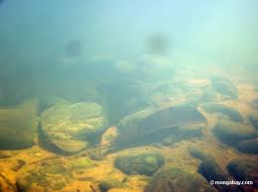
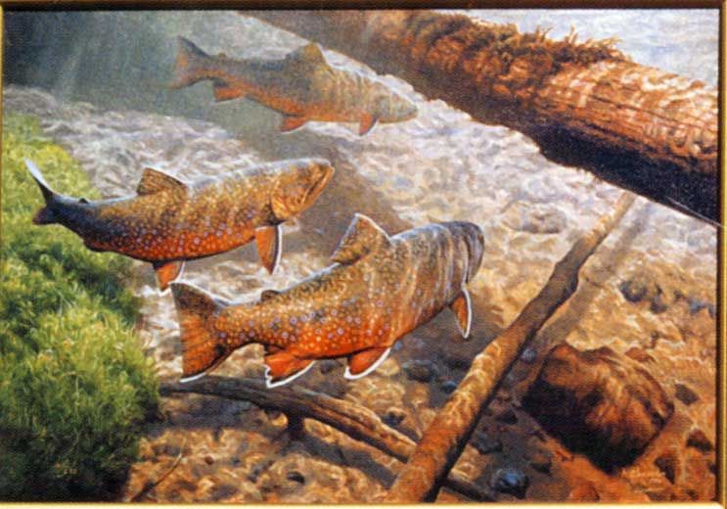
Substrate vs. IBI vs. ICI
3 Indicators are used to measure streams health
*Biological
*Chemical
*Physical
Substrate physical indicator
Notes:
Cassie

Slide 9
Why is the Substrate Important? The substrate acts as a breeding ground for the fish and macroinvertebrates that live in the stream
Moderate substrate score of 13.8 on a scale of 0-20
Good Substrate Scores result in Increased ICI & IBI
Substrate is a habitat for macroinvertebrates
Serves as breeding ground for fish.
Macroinvertebrates at bottom of food chain; acts as food for fish
Because our substrate is of good quality, fish can grow and develop in our stream. The macroinvertebrates live in the substrate and are eaten by fish.
Notes:
Cassie

Slide 10
The higher quality the substrate is, the higher IBI and ICI are.
HUCDATE
Notes:
Cassie

Slide 11
Thank You!!!
YWSI would like to thank the following sponsors:
Special Thanks to Steve, Paula, & Kristi
Notes:
All

