Slide 1
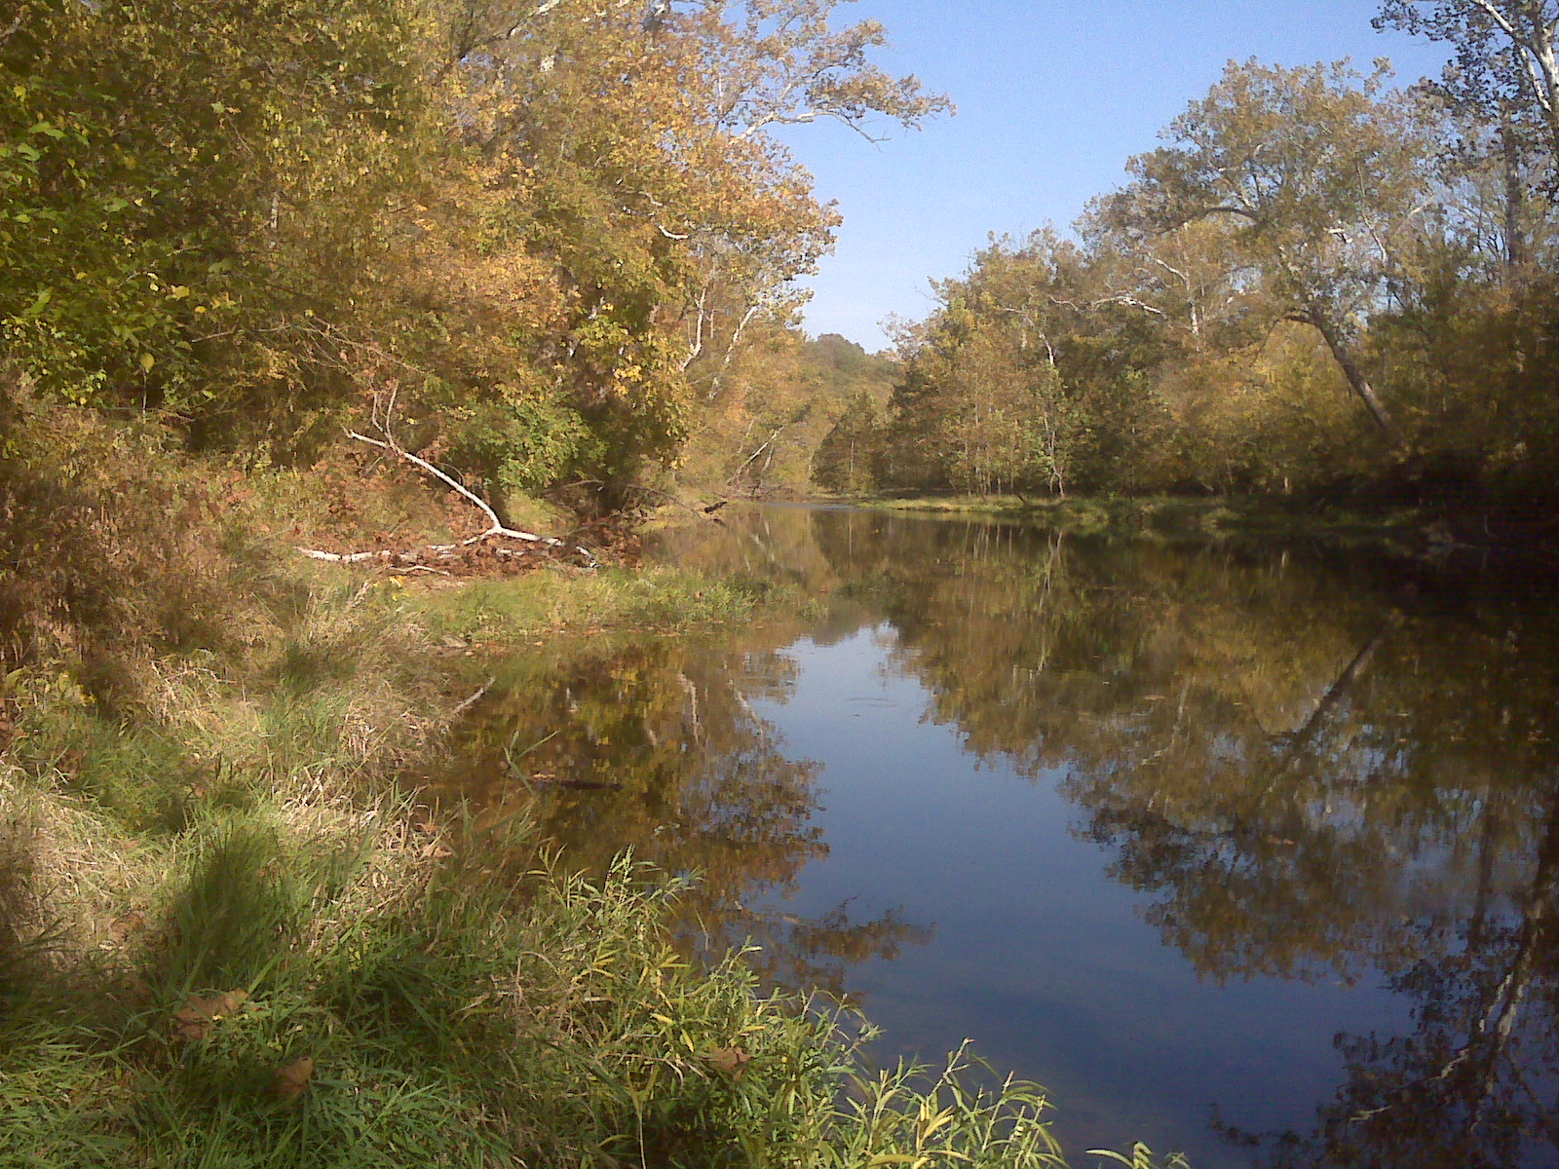
What Are the Problems of the East Fork Little Miami Watershed?
By: Maya & Shreyah

Slide 2
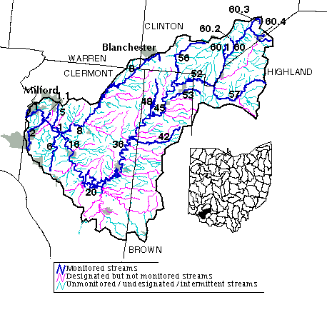
About Our Watershed
Runs through Warren, Clermont, Clinton, Highland, and Brown counties
Southwest quadrant of Ohio
Close to Cincinnati and Dayton
Tributary of the Ohio River
Size of the watershed is 320,000 acres
Dodson Creek and Beaver Creek are a few of the major streams

Slide 3
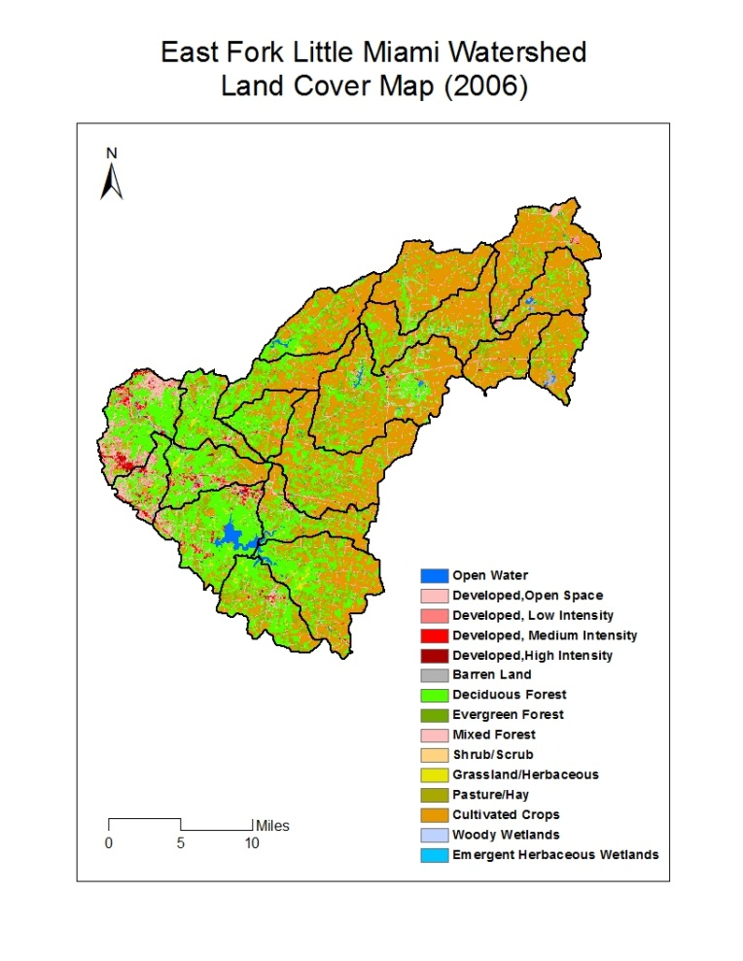
Land Use
40% of the land is used for crops and agriculture
30% is used for forestry
About 17% is developed or urban land*
11% of the land is used for pasture
*www.epa.ohio.gov

Slide 4
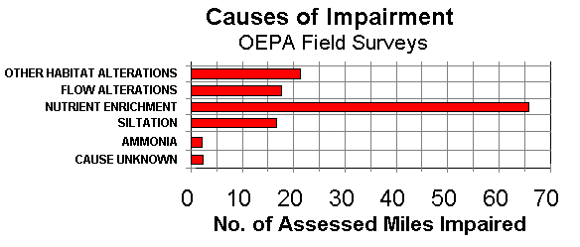
Causes of Impairment
Nutrients may come from agricultural fields close to the riparian zone
Flow alterations can affect habitats in a negative way
Runoff carries silt which can get in between rocks at the bottom of the river

Slide 5
Hypothesis One
As agriculture in the East Fork Little Miami watershed increases, the IBI will decrease.
Agriculture vs. IBI
IBI Levels
Percent of Agriculture Use
PERCENT OF AGRICULTURE
AV IBI
HUCDATES

Slide 6
Hypothesis Two
As the quality of the substrate in the watershed increases, the IBI also increases.
IBI levels
Substrate levels
AVSUBSTRATE
AVIBI
HUCDATES

Slide 7
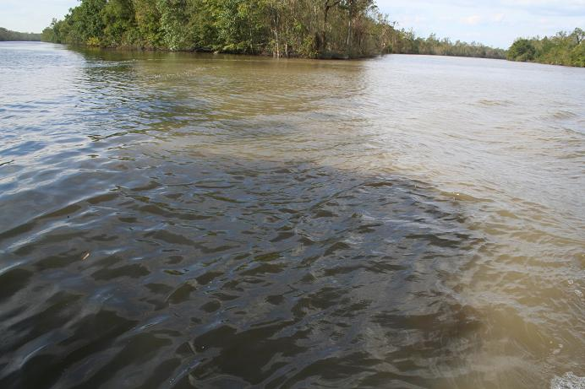
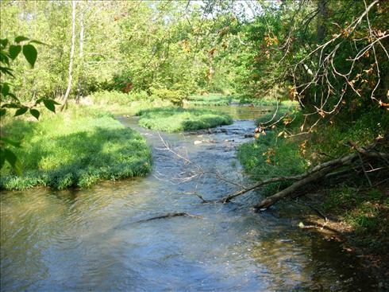
Conclusion
In conclusion, the East Fork Little Miami Watershed is healthy, because only 40% of the land is agriculture and 30% is forest. However, this area is increasing in development.
If the land is developed improperly, the quality of the substrate could be affected by increased sediment.

Slide 8
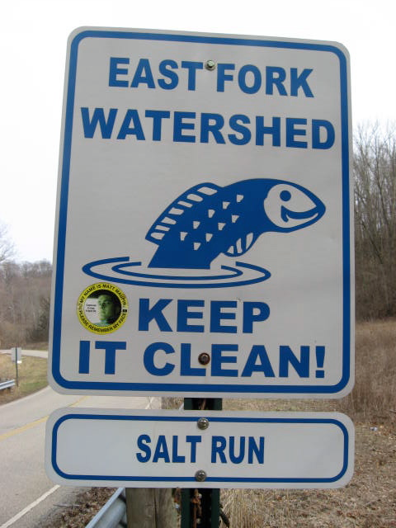
What You Can Do to Help
Don’t dump waste in storm drains
Buy organic produce to reduce the use of pesticides
Participate in river clean-ups
Volunteer in programs that help preserve water quality

Slide 9
Thank You!
Thanks to all of the chaperones, parents, teachers and sponsors! We had such a fun and educational week here at The Ohio State University. Thank you YWSI!

