Slide 1
Running Apache Spark on HPC clusters
Shameema Oottikkal
Data Application Engineer
Ohio SuperComputer Center
email:soottikkal@osc.edu
11/10/2016
TDA-Data Analytics Month

Slide 2
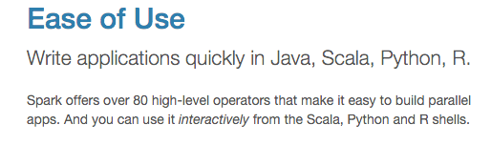
Apache Spark
Apache Spark is an open source cluster computing framework originally developed in the AMPLab at University of California, Berkeley but was later donated to the Apache Software Foundation where it remains today. In contrast to Hadoop's disk-based analytics paradigm, Spark has multi-stage in-memory analytics.

Slide 3
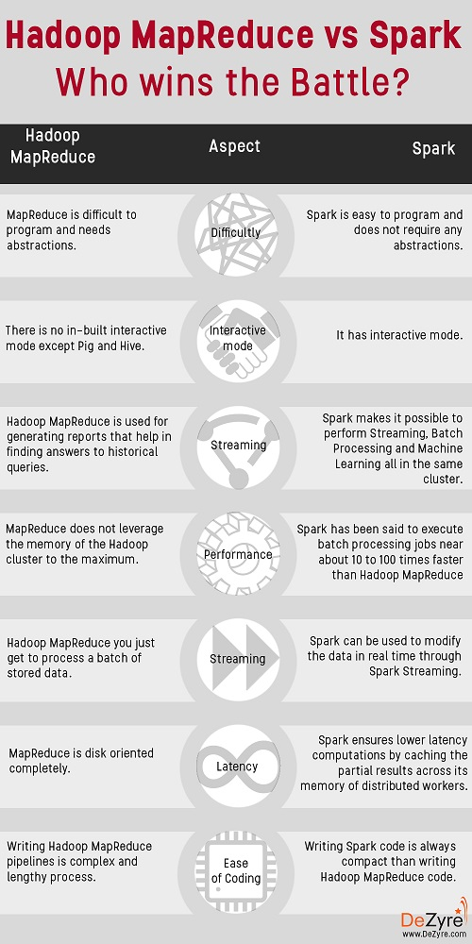

Slide 4
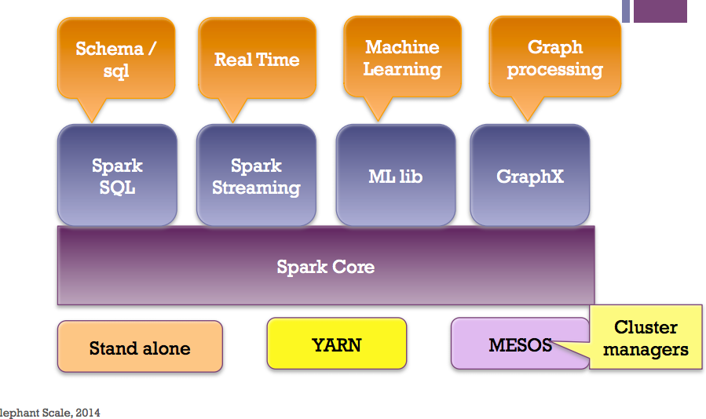
Spark ecosystem

Slide 5
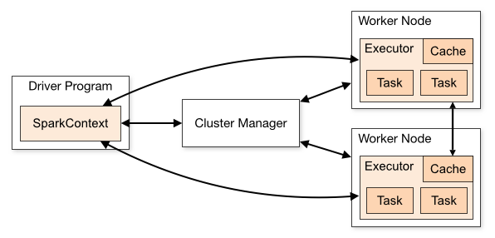
Spark workflow
Spark applications run as independent sets of processes on a cluster, coordinated by the SparkContext object in your main program (called the driver program).
Require cluster managers which allocate resources across applications.
Once connected, Spark acquires executors on nodes in the cluster, which are processes that run computations and store data for your application.
Next, it sends your application code (defined by JAR or Python files passed to SparkContext) to the executors. Finally, SparkContext sends tasks to the executors to run.

Slide 6
RDD- Resilient Distributed Datasets
RDD (Resilient Distributed Dataset) is main logical data unit in Spark. An RDD is distributed collection of objects. Distributed means, each RDD is divided into multiple partitions. Each of these partitions can reside in memory or stored on disk of different machines in a cluster. RDDs are immutable (Read Only) data structure. You can’t change original RDD, but you can always transform it into different RDD with all changes you want.
In Spark all work is expressed as creating new RDDs, transforming existing RDDs, or calling operations on RDDs to compute a result
RDD- Transformations and Actions
Transformations are executed on demand. That means they are computed lazily. Eg: filter, join, sort
Actions return final results of RDD computations. Actions triggers execution using lineage graph to load the data into original RDD, carry out all intermediate transformations and return final results to Driver program or write it out to file system. Eg: collect(), count(), take()

Slide 7
Interactive Analysis with the Spark Shell
./bin/pyspark # Opens SparkContext
1. Create an RDD
>>> textFile = sc.textFile("README.md")
2. Transformation of RDD
>>>linesWithSpark = textFile.filter(lambda line: "Spark" in line)
3. Action on RDD
>>> linesWithSpark.count() # Number of items in this RDD
126
4. Combining Transformation and Actions
>>> textFile.filter(lambda line: "Spark" in line).count() # How many lines contain "Spark"?
15
Word count Example
>>>wordCounts = textFile.flatMap(lambda line: line.split()).map(lambda word: (word,1)).reduceByKey(lambda a, b: a+b)
>>> wordCounts.collect()
[(u'and', 9), (u'A', 1), (u'webpage', 1), (u'README', 1), (u'Note', 1), (u'"local"', 1), (u'variable', 1), ...]

Slide 8
RDD Basics
import urllib
f = urllib.urlretrieve ("http://kdd.ics.uci.edu/databases/kddcup99/kddcup.data_10_percent.gz", "kddcup.data_10_percent.gz")
data_file="./kddcup.data_10_percent.gz"
raw_data=sc.textFile(data_file)
normal_raw_data=raw_data.filter(lambda x: 'normal.' in x)
normal_count=normal_raw_data.count()
print ("There are %f 'normal' interactions" % (normal_count))
#predefined map functions
def parse_interaction(line):
elems = line.split(",")
tag = elems[41]
return (tag, elems)
key_csv_data=raw_data.map(parse_interaction)

Slide 9
Running Spark using PBS script
1. Create an App in python: Stati.py
from pyspark import SparkContext
import urllib
f = urllib.urlretrieve ("http://kdd.ics.uci.edu/databases/kddcup99/kddcup.data.gz","kddcup.data.gz")
data_file = "./kddcup.data.gz"
sc = SparkContext(appName="Stati")
raw_data = sc.textFile(data_file)
import numpy as np
def parse_interaction(line):
line_split = line.split(",")
symbolic_indexes = [1,2,3,41]
clean_line_split=[item for i, item in enumerate(line_split) if i not in symbolic_indexes]
return np.array([float(x) for x in clean_line_split])
vector_data=raw_data.map(parse_interaction)
from pyspark.mllib.stat import Statistics
from math import sqrt
summary = Statistics.colStats(vector_data)
print ("Duration Statistics:")
print (" Mean %f" % (round(summary.mean()[0],3)))
print ("St. deviation : %f"%(round(sqrt(summary.variance()[0]),3)))
print (" Max value: %f"%(round(summary.max()[0],3)))
print (" Min value: %f"%(round(summary.min()[0],3)))

Slide 10
2. Create a PBS script: Stati.pbs
#PBS -N spark-statistics
#PBS -l nodes=18:ppn=28
#PBS -l walltime=00:10:00
module load spark/2.0.0
cd $TMPDIR
pbs-spark-submit stati.py > stati.log
3. Run Spark job
qsub stati.pbs
4. Output: stati.log
sync from spark://n0381.ten.osc.edu:7077
starting org.apache.spark.deploy.master.Master, logging to /nfs/15/soottikkal/spark/kdd/spark-soottikkal-org.apache.spark.deploy.master.Master-1-n0381.ten.osc.edu.out
failed to launch org.apache.spark.deploy.master.Master:
full log in /nfs/15/soottikkal/spark/kdd/spark-soottikkal-org.apache.spark.deploy.master.Master-1-n0381.ten.osc.edu.out
Duration Statistics:
Mean 48.342000
St. deviation : 723.330000
Max value: 58329.000000
Min value: 0.000000
Total value count: 4898431.000000
Number of non-zero values: 118939.000000
SPARK_MASTER=spark://n0381.ten.osc.edu:7077

Slide 11
SparkSQL
1. Create App in python: sql.py
from pyspark import SparkContext
import urllib
f = urllib.urlretrieve ("http://kdd.ics.uci.edu/databases/kddcup99/kddcup.data.gz","kddcup.data.gz")
data_file = "./kddcup.data.gz"
raw_data = sc.textFile(data_file).cache()
#getting a data frame
from pyspark.sql import SQLContext
sqlContext = SQLContext(sc)
from pyspark.sql import Row
csv_data=raw_data.map(lambda l: l.split(","))
row_data=csv_data.map(lambda p: Row(
duration=int(p[0]),
protocal_type=p[1],
service=p[2],
flag=p[3],
src_bytes=int(p[4]),
dst_bytes=int(p[5])
)
)
interactions_df = sqlContext.createDataFrame(row_data)
interactions_df.registerTempTable("interactions")
# Select tcp network interactions with more than 1 second duration and no transfer from destination
tcp_interactions = sqlContext.sql("""
SELECT duration, dst_bytes FROM interactions WHERE protocal_type = 'tcp' AND duration > 1.000 AND dst_bytes = 0
""")
tcp_interactions.show()
tcp_interactions_out = tcp_interactions.map(lambda p: "Duration: %f, Dest. bytes: %f"%(p.duration, p.dst_bytes))
for ti_out in tcp_interactions_out.collect():
print ti_out
interactions_df.printSchema()
interactions_df.select("protocal_type", "duration", "dst_bytes").groupBy("protocal_type").count().show()
interactions_df.select("protocal_type", "duration", "dst_bytes").filter(interactions_df.duration>1000).filter(interactions_df.dst_bytes==0).groupBy("protocal_type").count().show()

Slide 12
Output: sql.log

Slide 13
CASE STUDY
Data mining of historical jobs records of OSC’s clusters
Aim: To understand client utilizations of OSC recourses.
Data: Historical records of every Job that ran on any OSC clusters that includes information's such as number of nodes, software, CPU time and timestamp.
DATA on MYSQL DB
Import to Spark
Save as parquet file
Data till 2016
Reload to Spark
Analysis
Newer
Data
Import to Spark
Append to parquet file

Slide 14
Pyspark code
#importing data
df=sqlContext.read.parquet("/fs/scratch/pbsacct/Jobs.parquet")
#Which types of queue is mostly used
df_mysql.select("jobid",queue").groupBy("queue").count().show()
#Which software is used most?
from pyspark.sql.functions import
df_mysql.select("jobid","sw_app").groupBy
("sw_app").count().sort(col("count").desc()) .show()’
#who uses gaussian software most?
df_mysql.registerTempTable("mysql”)
sqlContext.sql(" SELECT username FROM
mysql WHERE sw_app='gaussian’ " ).show()

Slide 15
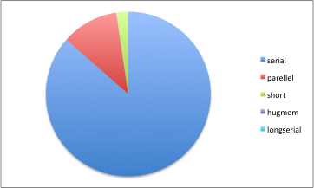
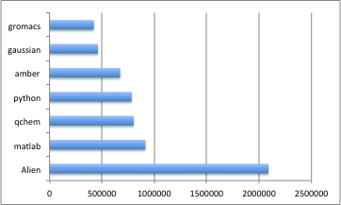
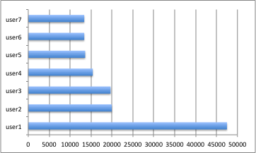
Results
Statistics | MYSQL | SPARK
Job vs CPU | 1 hour | 5 sec
CPU vs Account | 1.25 hour | 5 sec
Walltime vs user | 1.40 hour | 5 sec

Slide 16
References
1. Spark Programming Guide
https://spark.apache.org/docs/2.0.0/programming-guide.html
-Programming with Scala, Java and Python
2. Data Exploration with Spark
http://www.cs.berkeley.edu/~rxin/ampcamp-ecnu/data-exploration-using-spark.html
3. Interactive Data Analytics in SparkR
http://ampcamp.berkeley.edu/5/exercises/sparkr.html
https://www.osc.edu/documentation/software_list/spark_documentation

